Slide 1
Health, Safety and Wellbeing Update
October 2023

Slide 2
Contents
Sharing Something Goods
Learn Alert
Critical Risk Stats
Safety topic of the month
PPE Reminder
Wellbeing
WorkSafe updates

Slide 3
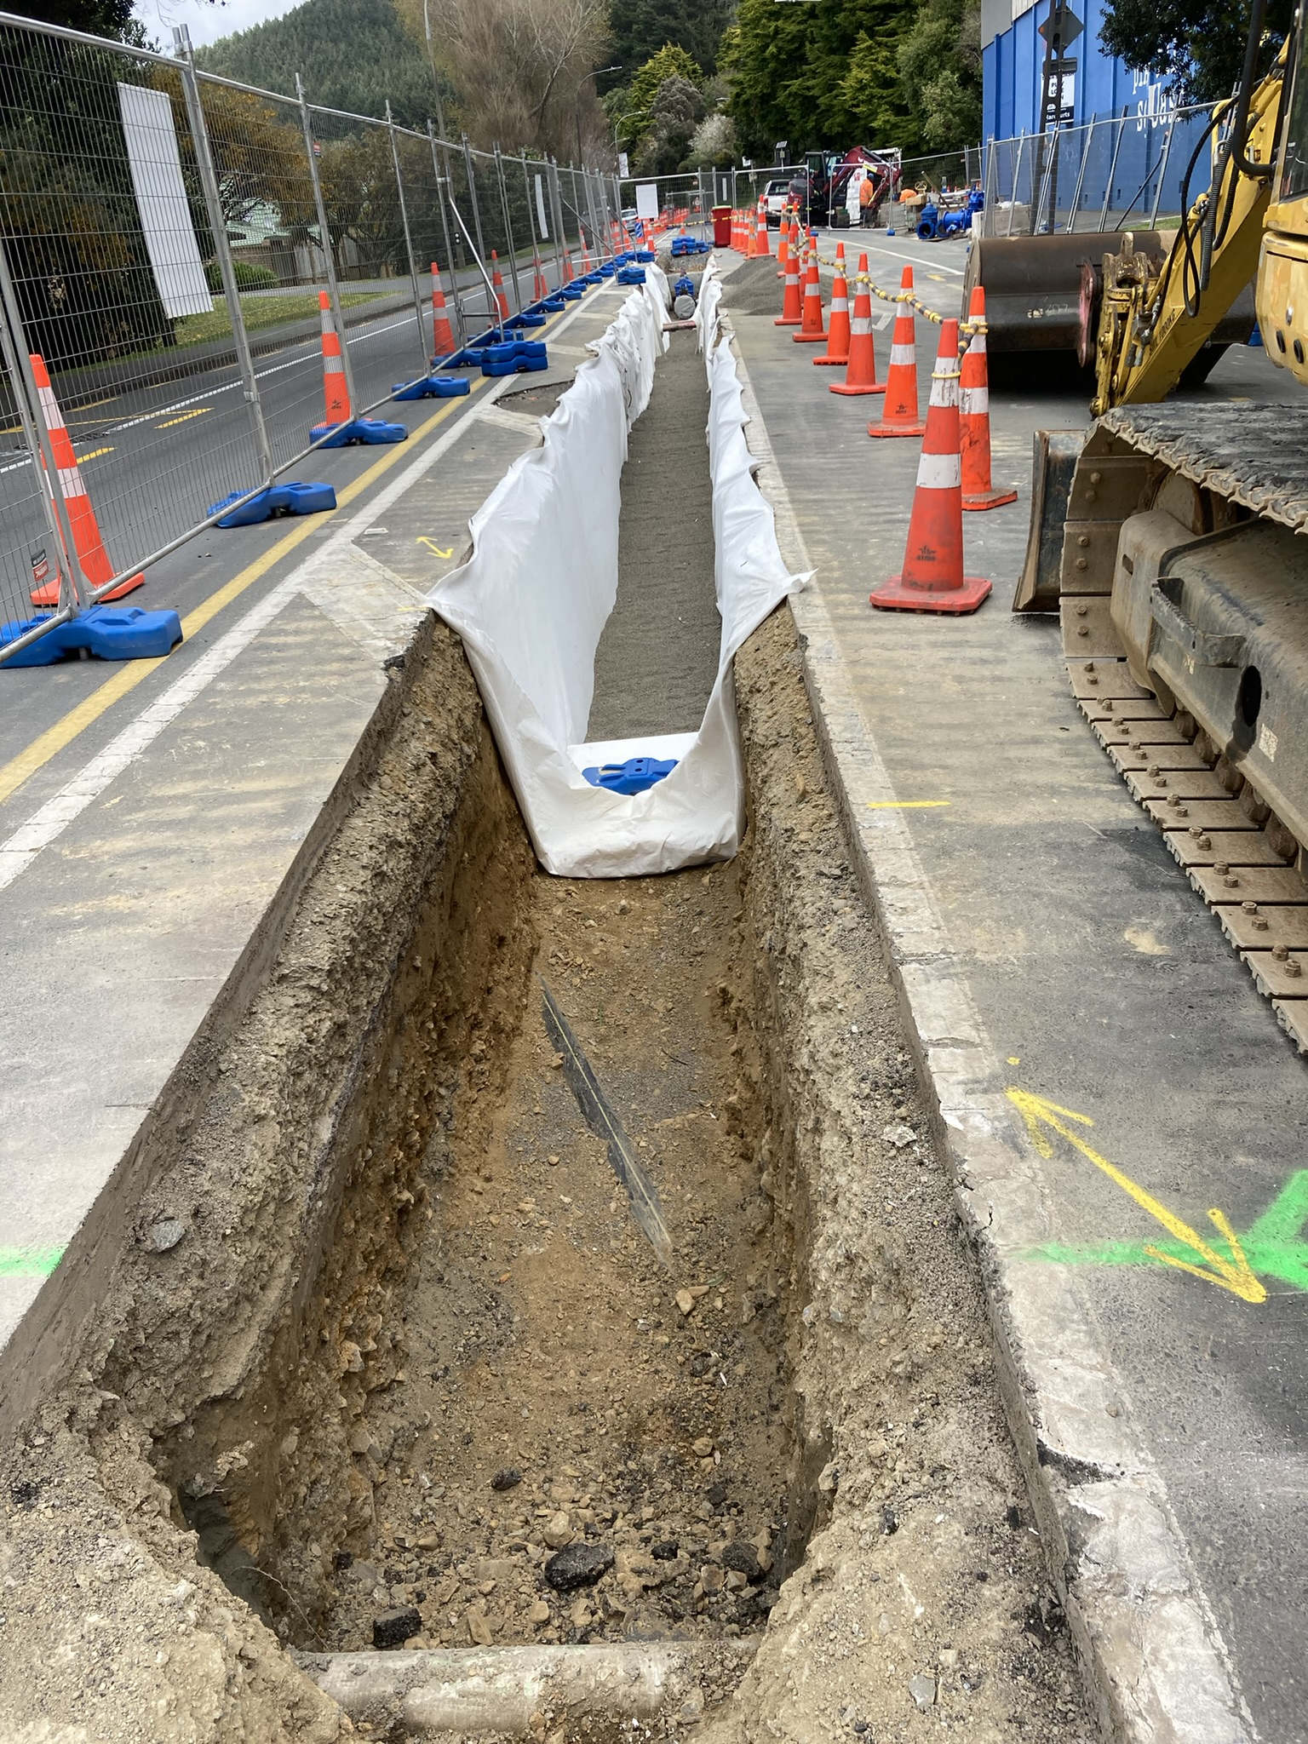
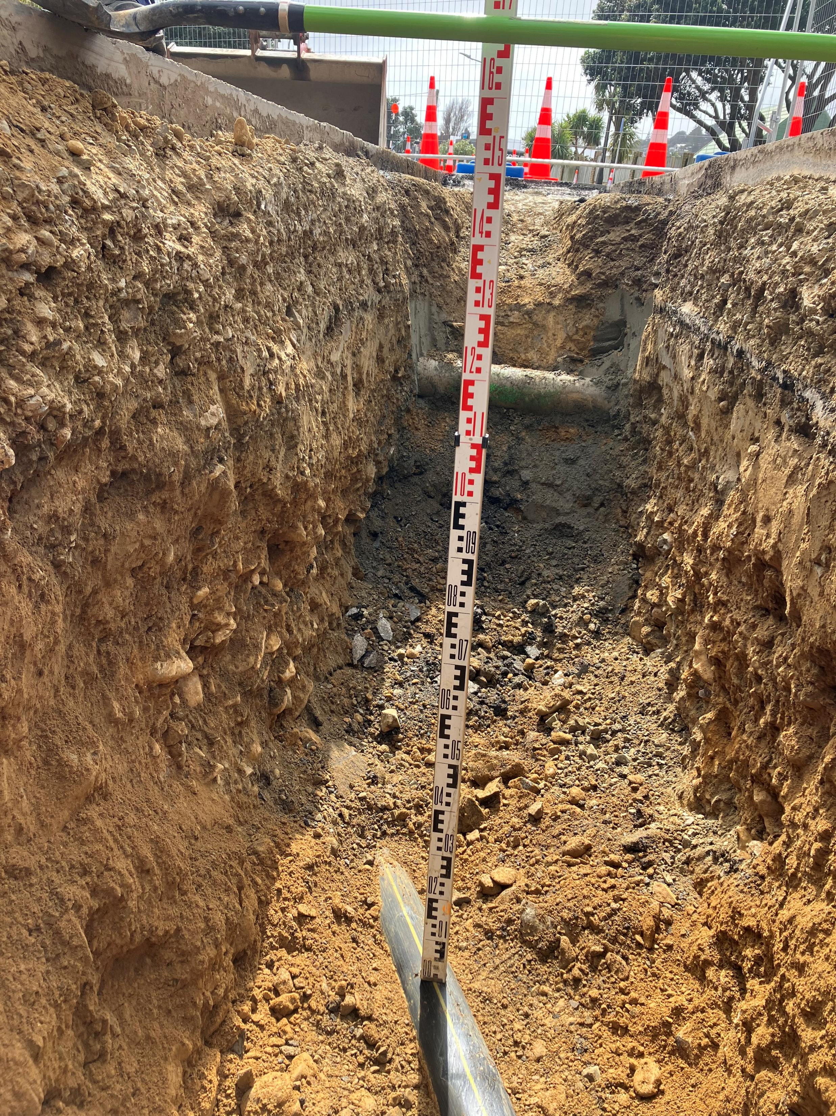
Something Good
While excavating for the water main, the site team have uncovered a high pressure gas main in a location that was 65m from where it was shown on the dial before you dig plans and the design drawings.
Thanks to the correct digging practices and the site team taking care when excavating, the pipe was not damaged or scrapped.

Slide 4
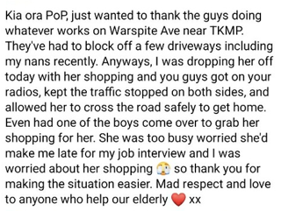
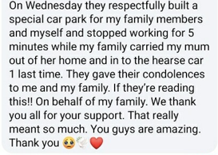
Something Good
A recent report from the team at G P Friel who received some amazing comments on a Facebook page recently
On another site following the high winds the team noticed that there was a low hanging cable going across the street they are working on. Whilst the low hanging cable wasn't a hazard to the general public, one of their trucks could have clipped it while travelling under it. It was reported it to WE and repaired it within the hour.
One of the crews had a new starter who had recently finished high school and had limited exposure to a working construction site. The supervisor and team took extra caution to ensure the new worker was comfortable but learnt the importance of working safely.
On another GP Friel site, some positive feedback was received from residents and council following efforts to reduce noise on a site recently, with the noise reduction deemed half as loud.
If you have any cool stories to share, please send them to safe@wellingtonwater.co.nz

Slide 5
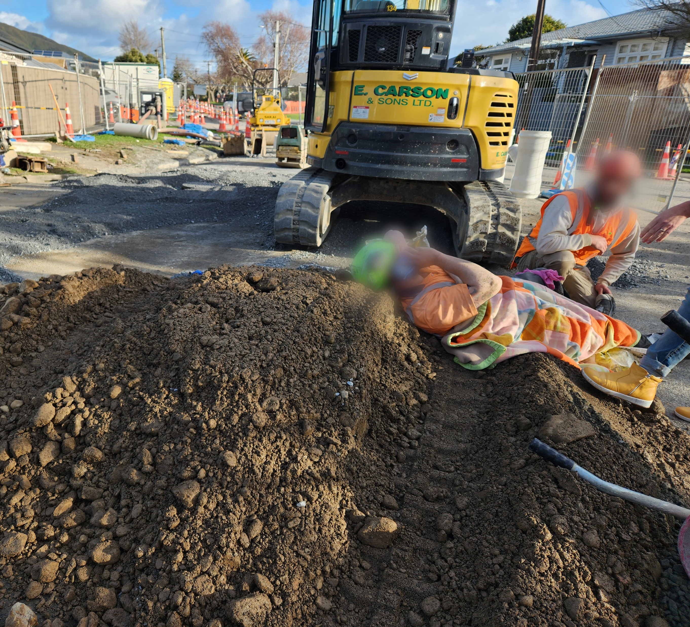
Learning Alert
Excavators (Moving Plant) – Controlling the Risk
WHAT HAPPENED
On 21 July 2023, a worker from E Carson & Sons Ltd (ECS) at WWL’s Avalon Wastewater Renewal project site was struck and seriously injured by a reversing excavator, while pushing a wheelbarrow in the work site.
The excavator struck the drainlayer, knocking him face-first onto the ground and the right track ran over both his lower legs, causing serious fractures in both legs. The injured worker was taken to hospital where he had surgery and is now in recovery for about the 6 months.
WHAT WE LEARNED
Wellington Water is to look at the installation of reversing cameras on all mobile plant, large or small.
The need to review site conditions before starting work to ensure there is sufficient space for mobile equipment and workers to move without the need to share the same travel paths.
Ensure work site entry points is safe from mobile plant and traffic.
The need of good communication and awareness when working around/with mobile plant, double checking the surroundings and not making assumptions.
The emphasis on using spotters when reversing mobile plants.
Regular retraining of all workers and reiteration of H&S risks at daily toolbox meeting to reduce desensitization to regular work activities.
Use of Health and Safety Association of New Zealand approved investigator for ICAM investigations.

Slide 6
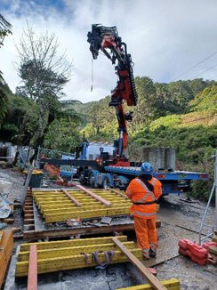
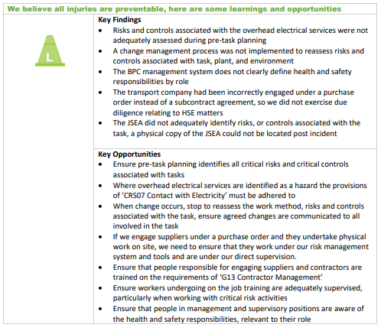
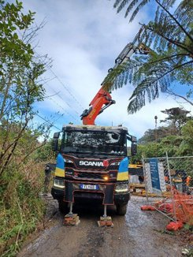
Learn Alert

Slide 7
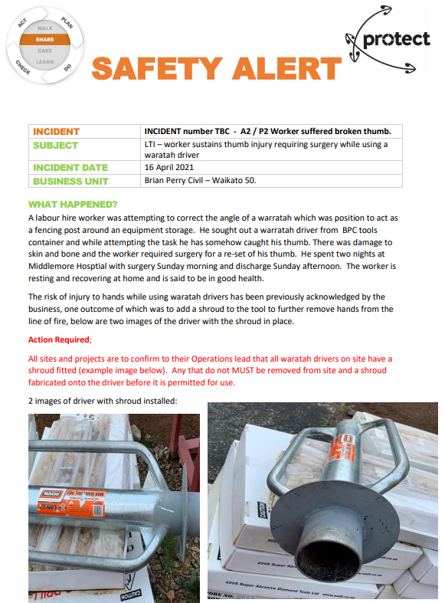
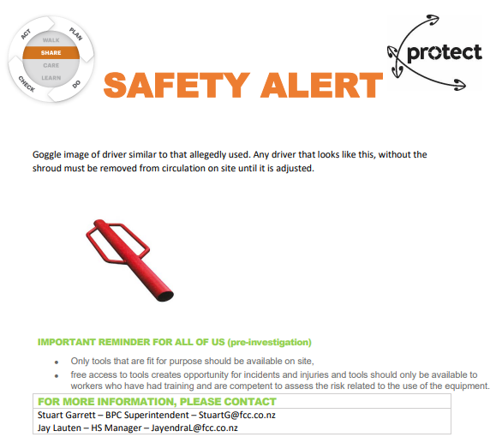
Safety Alert
We should always use waratah drivers with shrouds fitted

Slide 8
Critical Risk Stats - September
In September there were 49 reported critical risk related incidents, this is a decrease from August (85) and an increase from September 2022 (27)
Traffic/Pedestrian Movement is our highest reported critical risk this month with 15 reports, followed by at Working with/near Services at 9 and Work at Height/Dropped Objects at 9.
If you’re interested in seeing other stats please let us know!

Slide 9
Safety topic of the month
Working at Heights

Slide 10
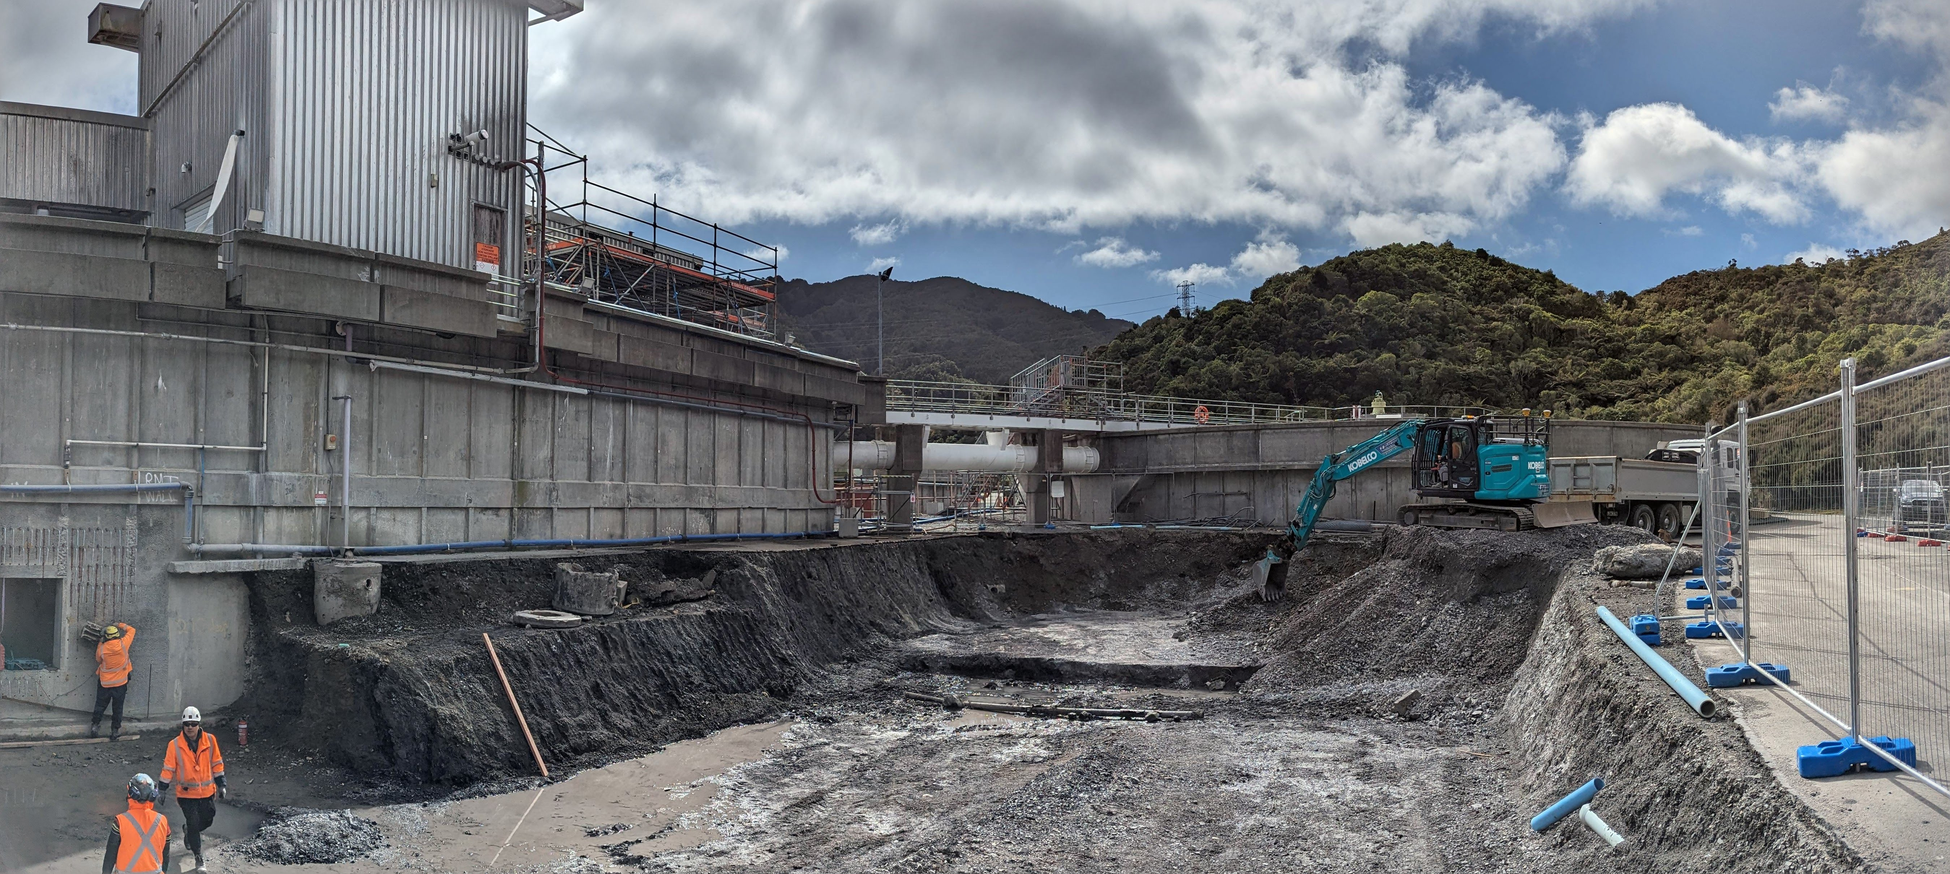
Safety topic of the month – Working at heights
Working from any height, above and below ground level, where you can fall has the potential to cause significant injury or death
There were 79 hazard identification and near miss reports that involved working at height hazards over the last 12 months
Across NZ, there were 2139 fall from height incidents that resulting in more than a week away from work from Jun 2022 to May 2023
Te Marua DAF Upgrade
Preventing falls should be actively managed so that people working at height, are kept safe.

Slide 11
Safety topic of the month – Working at heights
It’s not just someone falling or dropping something that can hurt. Watch out for:
Crushing from contacting structures or other moving parts.
Contacting overhead services.
Slip / trip / falls from height / access steps / ladders / unstable ground
Losing footing in slippery / uneven surfaces.
Change in weather conditions, rain, wind, temperature.
Inadequate planning and risk assessments
Equipment failure, or choosing the wrong equipment
Incorrect use or set-up of equipment/PPE
Even small mistakes can result in serious injuries or fatality

Slide 12
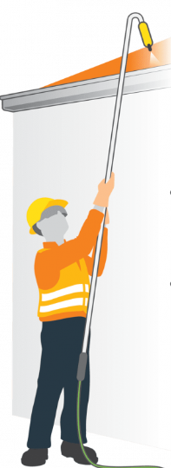
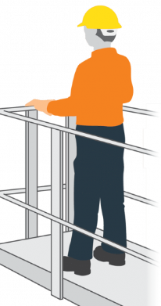
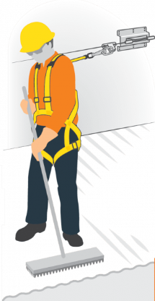
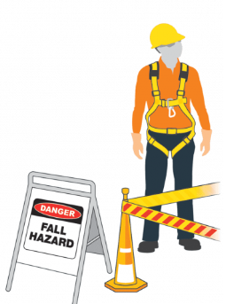
Safety topic of the month – Working at heights
Can the hazard of working at height be eliminated?
Could long-handled tools be used from ground level?
Could structures be built at ground level and lifted into position on completion?
Can the hazard of working at height be isolated?
Could edge protection be used?
Could a guard-railed work platform (eg, scaffold or elevating work platforms) be used?
Could a total restraint system be used to prevent a fall occurring?
Can the distance and impact of the fall be minimised?
Only take this step when elimination and isolation options have been exhausted.
Could a fall arrest system be used?
Could nets or air bags be used to minimise the impact of a fall?

Slide 13
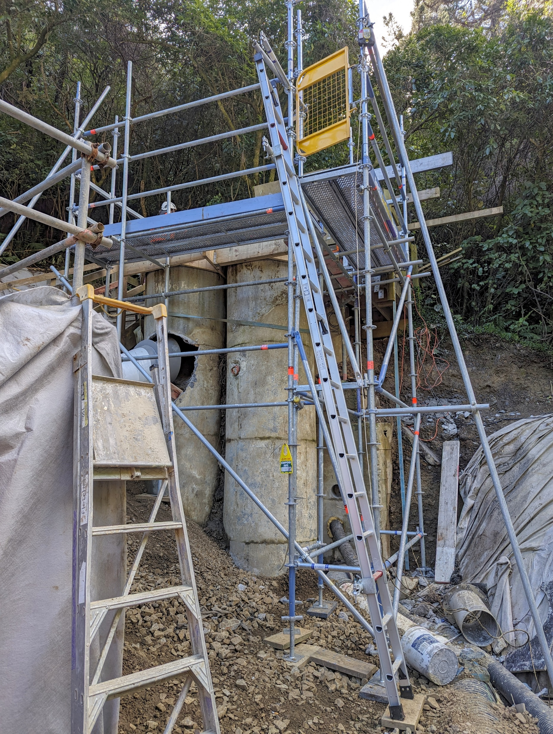
Safety topic of the month – Working at heights
Before you start work at height, check the structure/work platform (eg roof or scaffold) and means of access (eg cherry picker, ladder) are safe and sound.
There are several options to make sure you are safe and stable while working at height:
Use edge protection to prevent falls of people or objects
Use barriers to keep people out of drop zones
Use mechanical access equipment (eg cherry picker, elevated work platform (EWP))
Use total restraint (harness and fixed length lanyard) to prevent a fall
Use fall arrest systems to “catch” you if you fall
Secure your ladder and maintain three points of contact
Check all safety and access equipment before use, ensure it is free from damage and defects
Scaffold
(Edge protection)
Safe egress/ingress
Ladder secured
(Top and bottom)
Platform Ladder
Karori Tunnel Upgrade Project

Slide 15
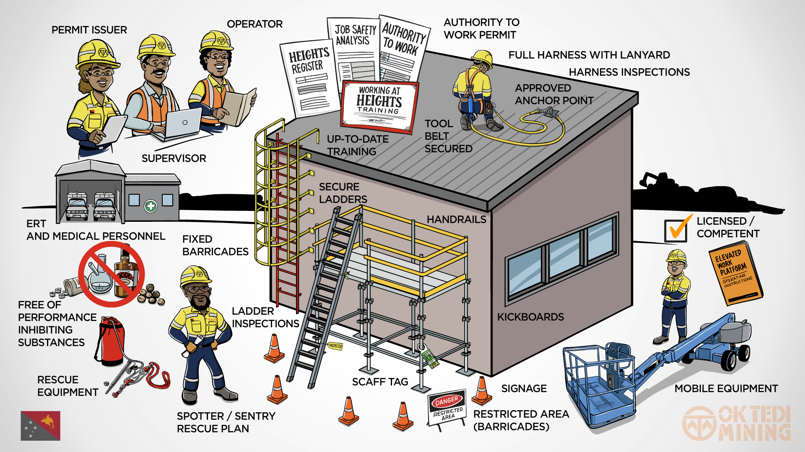
Safety topic of the month – Working at heights
Always have edge or fall protection
Always complete an RCP and permit
Always have exclusion zones and drop zones in place
Always have a rescue plan
Make sure you are trained and competent for the work you are doing
For more information have a chat to the H&S team, or check out WorkSafes best practice guidelines for working at height here

Slide 16
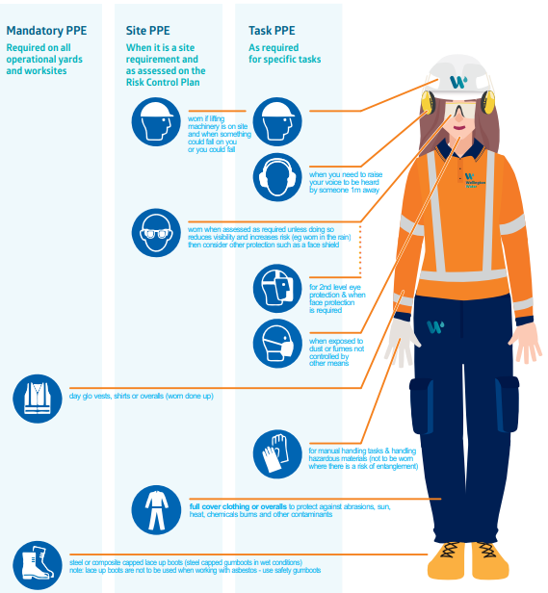
PPE
When you go to a Wellington Water site, you might need PPE. Make sure you check what PPE you need before you go.
Hard Hats must be fitted with a chin strap
Click here to download the Water Ways guide, or contact the H&S team if you need help. This includes task specific PPE (e.g., concrete cutting, working with asbestos)

Slide 17
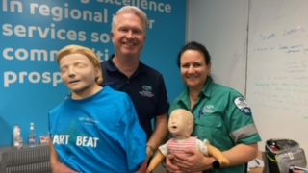
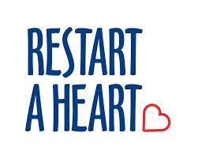
Restart a Heart – CPR & AED Training is back!
Wellington Free Ambulance are coming to our head office again to deliver their Heartbeat Training Sessions.
Join us on the 19th October at 2pm in the Petone office to learn the basics of CPR and using an AED.
Sign up here!
For more about Restart a Heart Day click here.

Slide 18
September Wellbeing Calendar
Calendar coming soon

Slide 19
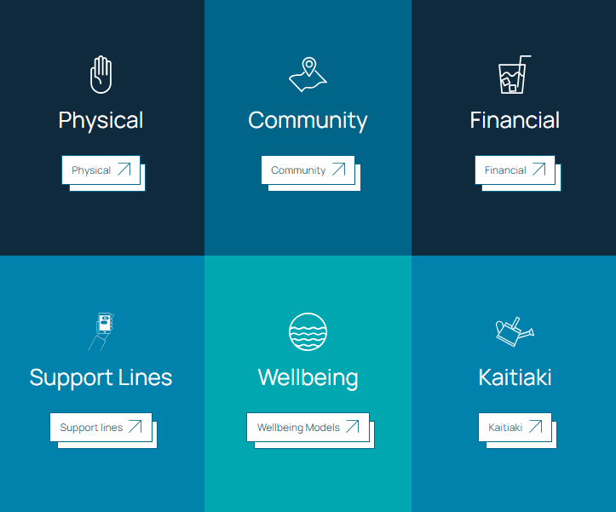
Wellbeing Hub
The Wellbeing Hub is available for all Wellington Water whanau. It has information to support all staff wellbeing.
The Kaitiaki Network is a peer to peer support group trained to have conversations with anyone in the Wellington Water whanau.
CLICK TO VISIT THE
WELLBEING HUB ↗

Slide 20
WorkSafe Updates
A teenage worker needed three fingers partly amputated when his summer holiday job went horribly wrong in a workplace incident
A worker was trying to fix a chain on a conveyor belt when his hands were drawn into the machine, resulting in two fractured fingers on his left hand, and required surgery to partly amputate three fingers on his right hand.
A WorkSafe investigation found poor safeguarding of the machinery and an inadequate risk assessment contributed to the victim’s injuries. There were also no lockouts to safely isolate and de-energise the parts of machinery that could cause harm to workers.

