Slide 1
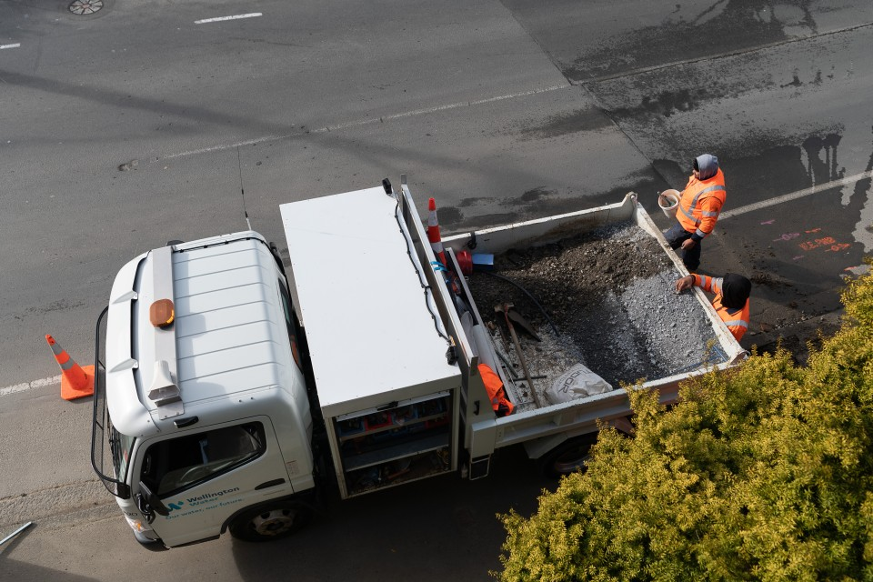


October 2024

Slide 2
Critical Risk Stats
In September there were 21 critical risk related reports, this is an increase from September 2023 (12) and a decrease from August 2024 (33)
Mobile Plant & Equipment is our highest reported critical risk this month with 6 reports, followed by Hazardous Substances at 5 reports

Slide 3
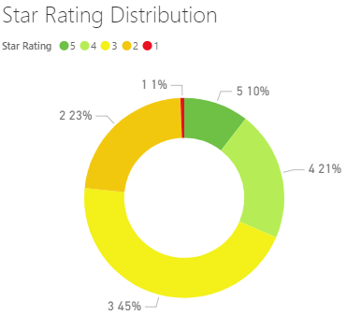


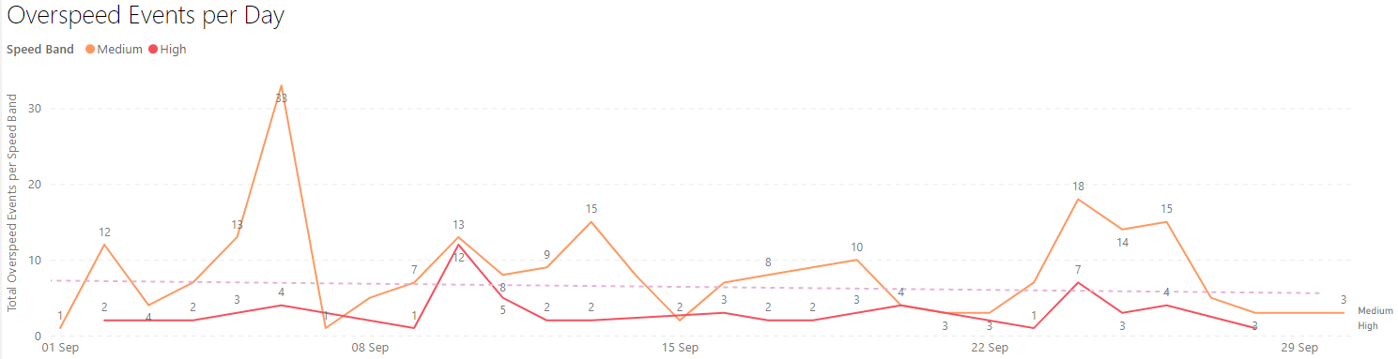
Driving
Here are our latest stats from EROADS for September
We are still seeing a positive downward trend on the overspeed events overall.
Light Vehicles
Medium: + 15km /h
High: + 20 km/h
Heavy Vehicles
Medium: +10 km/h
High: + 15 km/h

Slide 4
Safety topic of the month
Working at Height

Slide 5
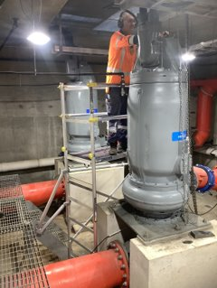
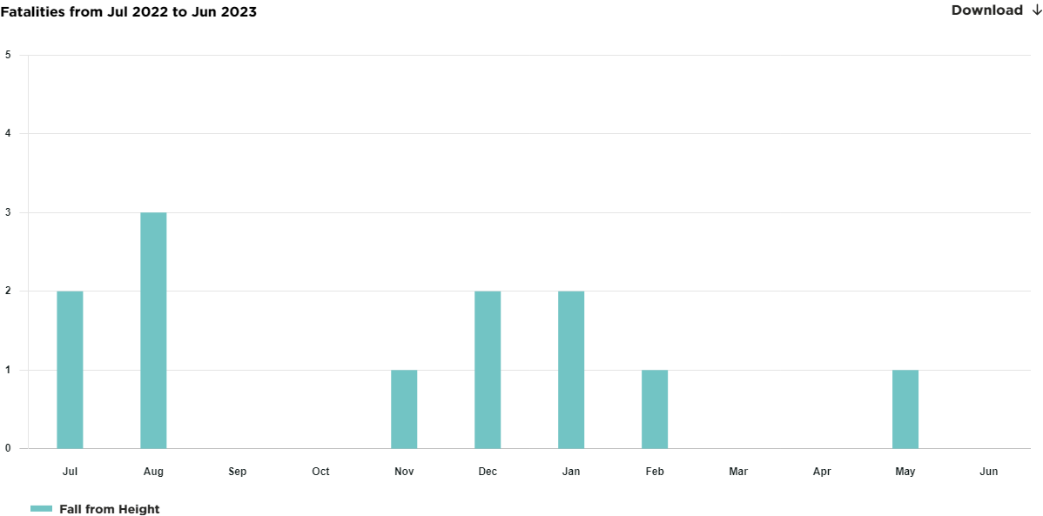
Working at Height
Working from any height, above and below ground level, where you can fall has the potential to cause significant injury or death
We should always try to prevent falls first. If we can't prevent them, we should use safety equipment to protect people from falling
Fatalities caused by “ Fall from Heights” July 22 – June 23
Fatalities WorkSafe New Zealand Fatalities Register

Slide 6
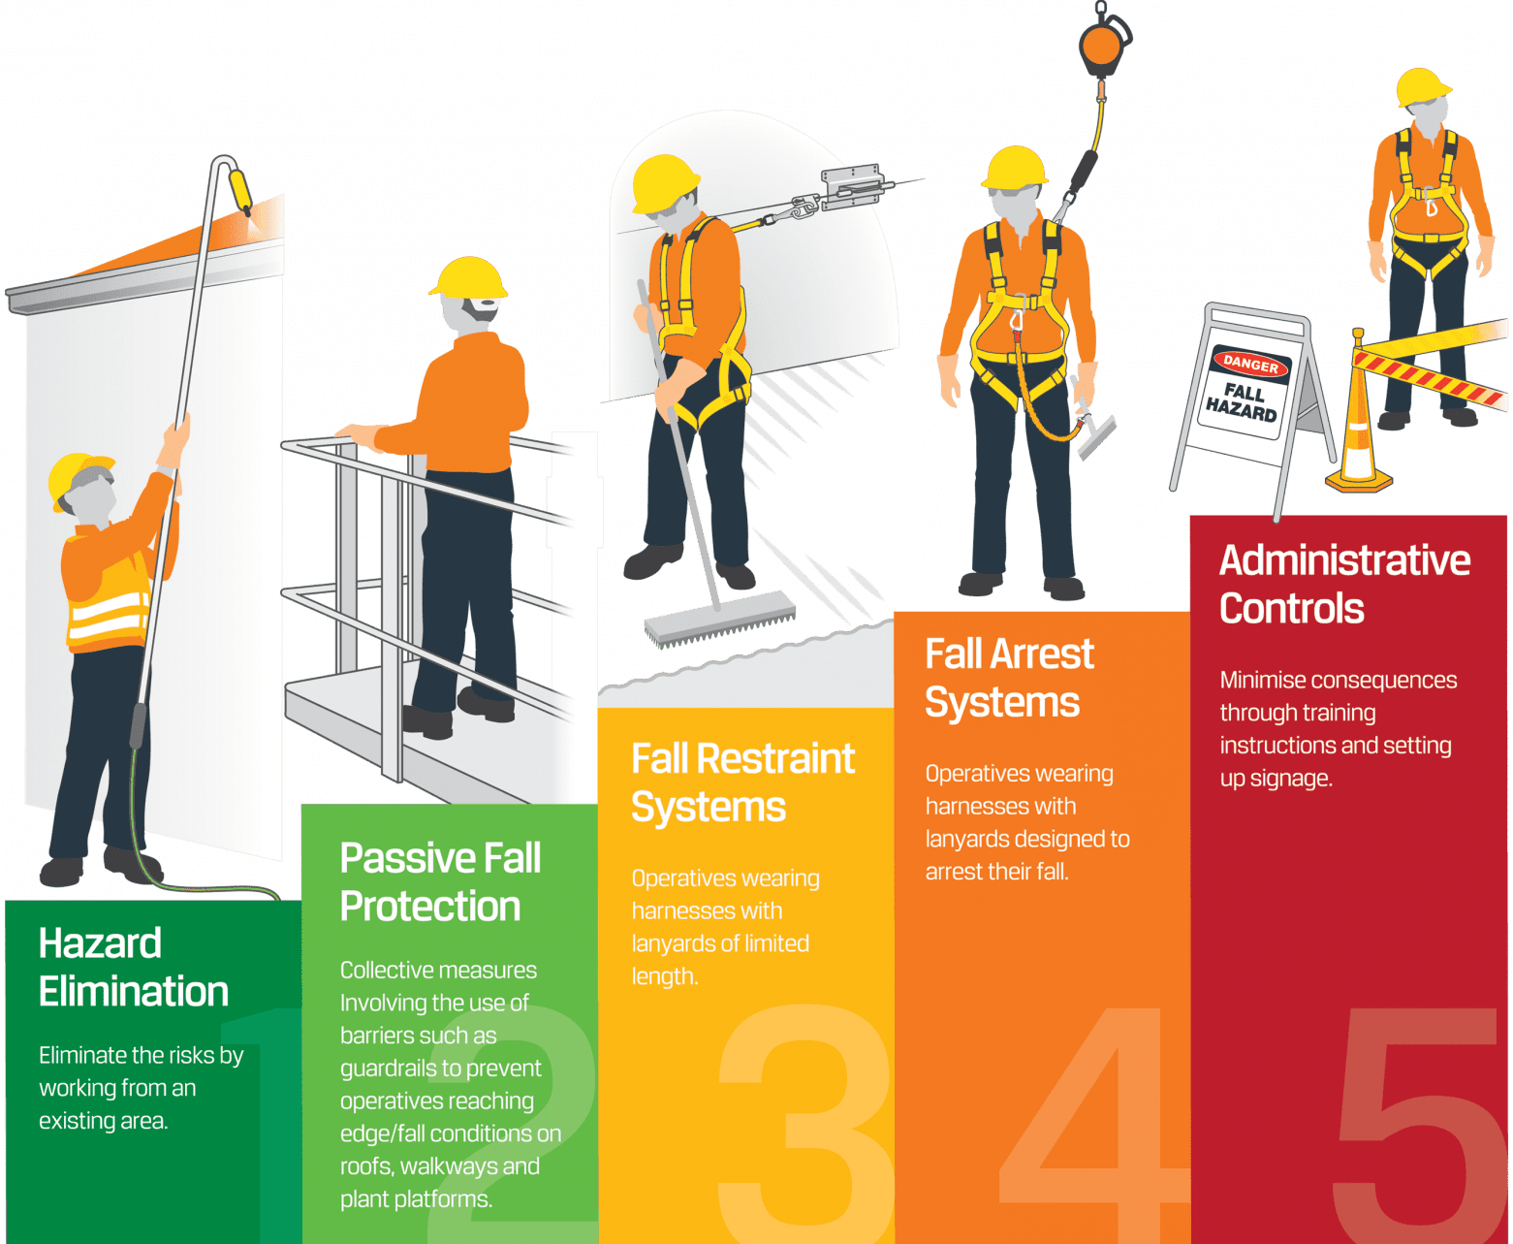

Working at Height – Controlling the Risk
Work at height means working in a place where a person could be injured if they fall from one level to another. This can be above or below ground level.
Avoid working at height whenever you can
If you have to work at height, or work where there is a risk of falling, make sure you put controls in place to keep yourself and other people safe.
Discussion points:
What tasks do you do that involve working where you can fall? What controls do you have in place?

Slide 7
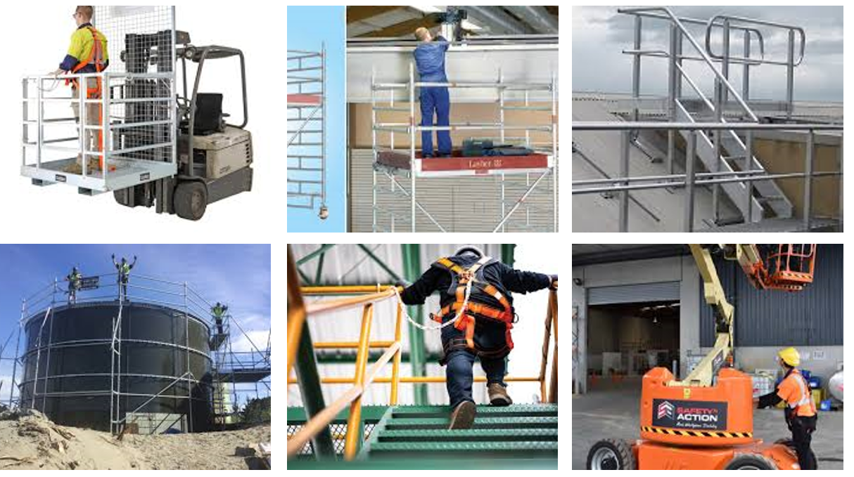
Working at Height – Fall Protection
Fall protection can take a number of forms including:
Edge protection systems
Guardrails
Kickboards
Barriers
Scaffolding/Mobile Scaffolding
Mobile elevating work platforms (MEWPs)
Forklift Safety Cage/Man Cage
Fall arrest systems
Fall restraint systems
Training, inspection and equipment maintenance are critical for these control measures to be effective.

Slide 8
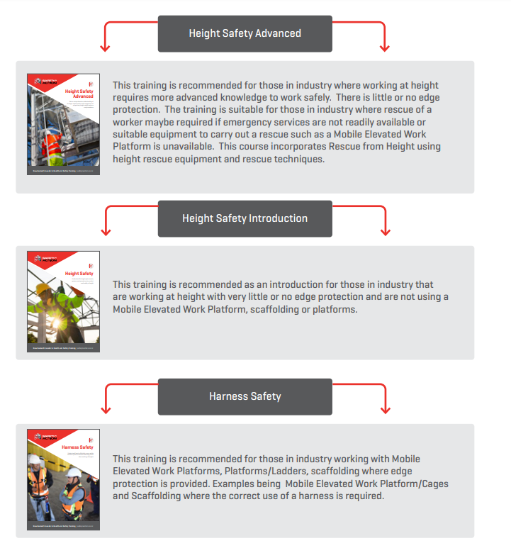
Working at Height - Training
Training & Administrative controls include risk control plans, permits to work, work instructions, risk assessments, excavation checklists, fall prevention procedures, training in the use of EWP’s, harnesses, scaffolding and retrieval equipment, PPE fall arrest and lanyard systems
Doing nothing is not an option
If you need any training speak to your Team Leader or Manager

Slide 9
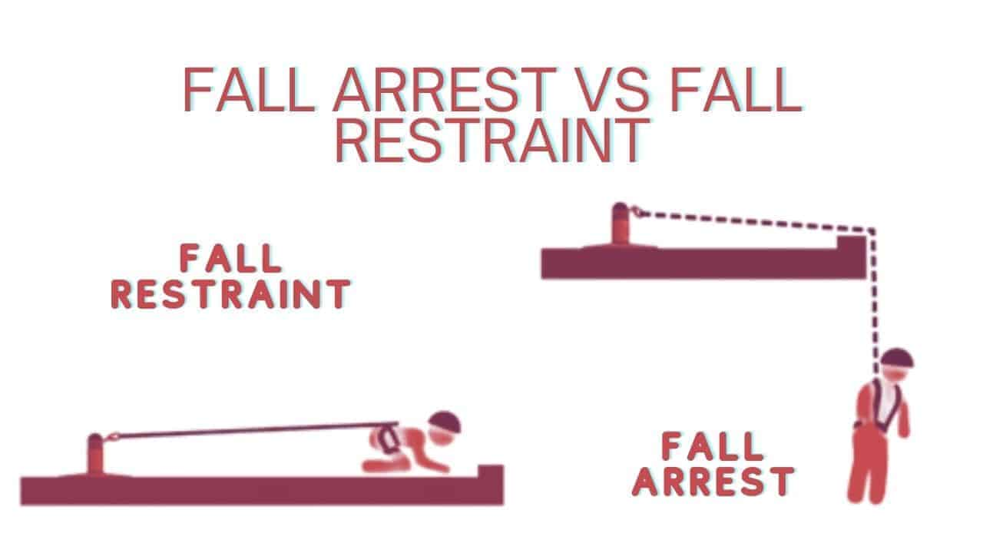
Working at Height – Fall Arrest and Fall Restraint
A fall restraint system is designed to prevent a worker from falling.
A fall arrest system is designed to support and hold a person in the event of a fall.
It typically consists of a harness, lifeline, and anchor point.
Fall arrest systems should only be used if you can’t eliminate the risk of a fall.
These may include a personal safety harness, rope access system, industrial rope system, travel restraint system, or a catch platform.
Discussion points:
Have you got a harness or lanyard? Is it in good condition?
Take a moment to check your training – in need of a refresher?
All equipment must be currently certified and inspected prior to use.
All operators must have the right training for the task.
Equipment that is damaged or fails inspection for any reason must be locked and tagged out and removed from service.

Slide 10
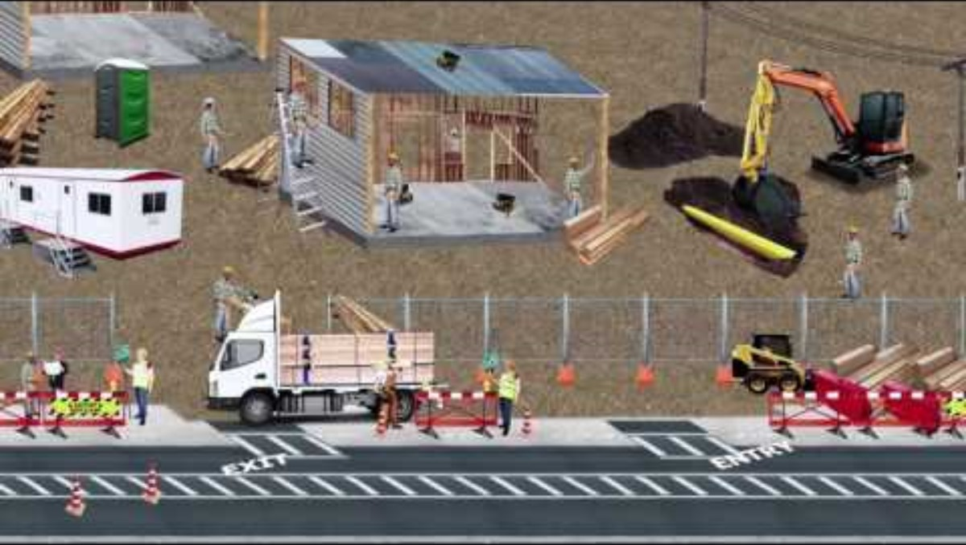
Topic of the month – Working at Height

Slide 11
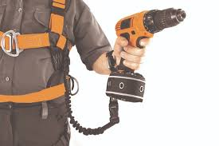
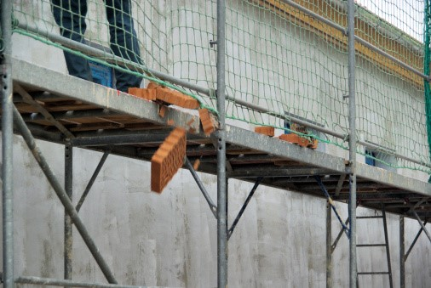
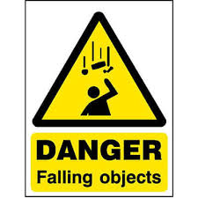
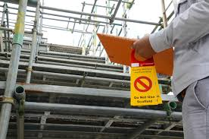
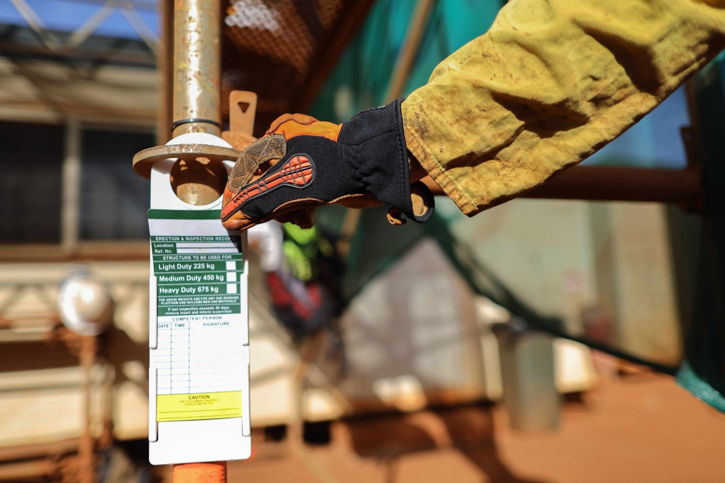


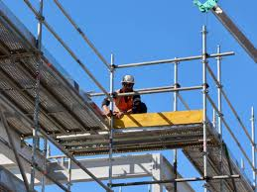


Working at Height – Scaffolding and Tools
Scaffolds less than 5m must be built by an experienced competent person in scaffolding.
Any scaffold greater than 5m must be built by a qualified scaffolder.
All scaffolds must have a “Scaff Tag”- attached after completion and must be inspected. A Scaff Tag is internationally used and recognized.
Controls must be in place to ensure that objects/tools cannot fall and injure someone when working at height.
These controls may include:
Kickboards to prevent falling objects
Exclusion Zones
Lanyards, tool tethers or drop ropes on tools
Store materials/equipment securely to prevent movement
Discussion points:
Did you know an object with a mass of 1kg becomes fatal to a person when dropped around 10 meters.
A can of spaghetti weighs 420grams
Don’t forget:
Any work where there is a risk of falling 5 metres or more must be notified to WorkSafe

Slide 12
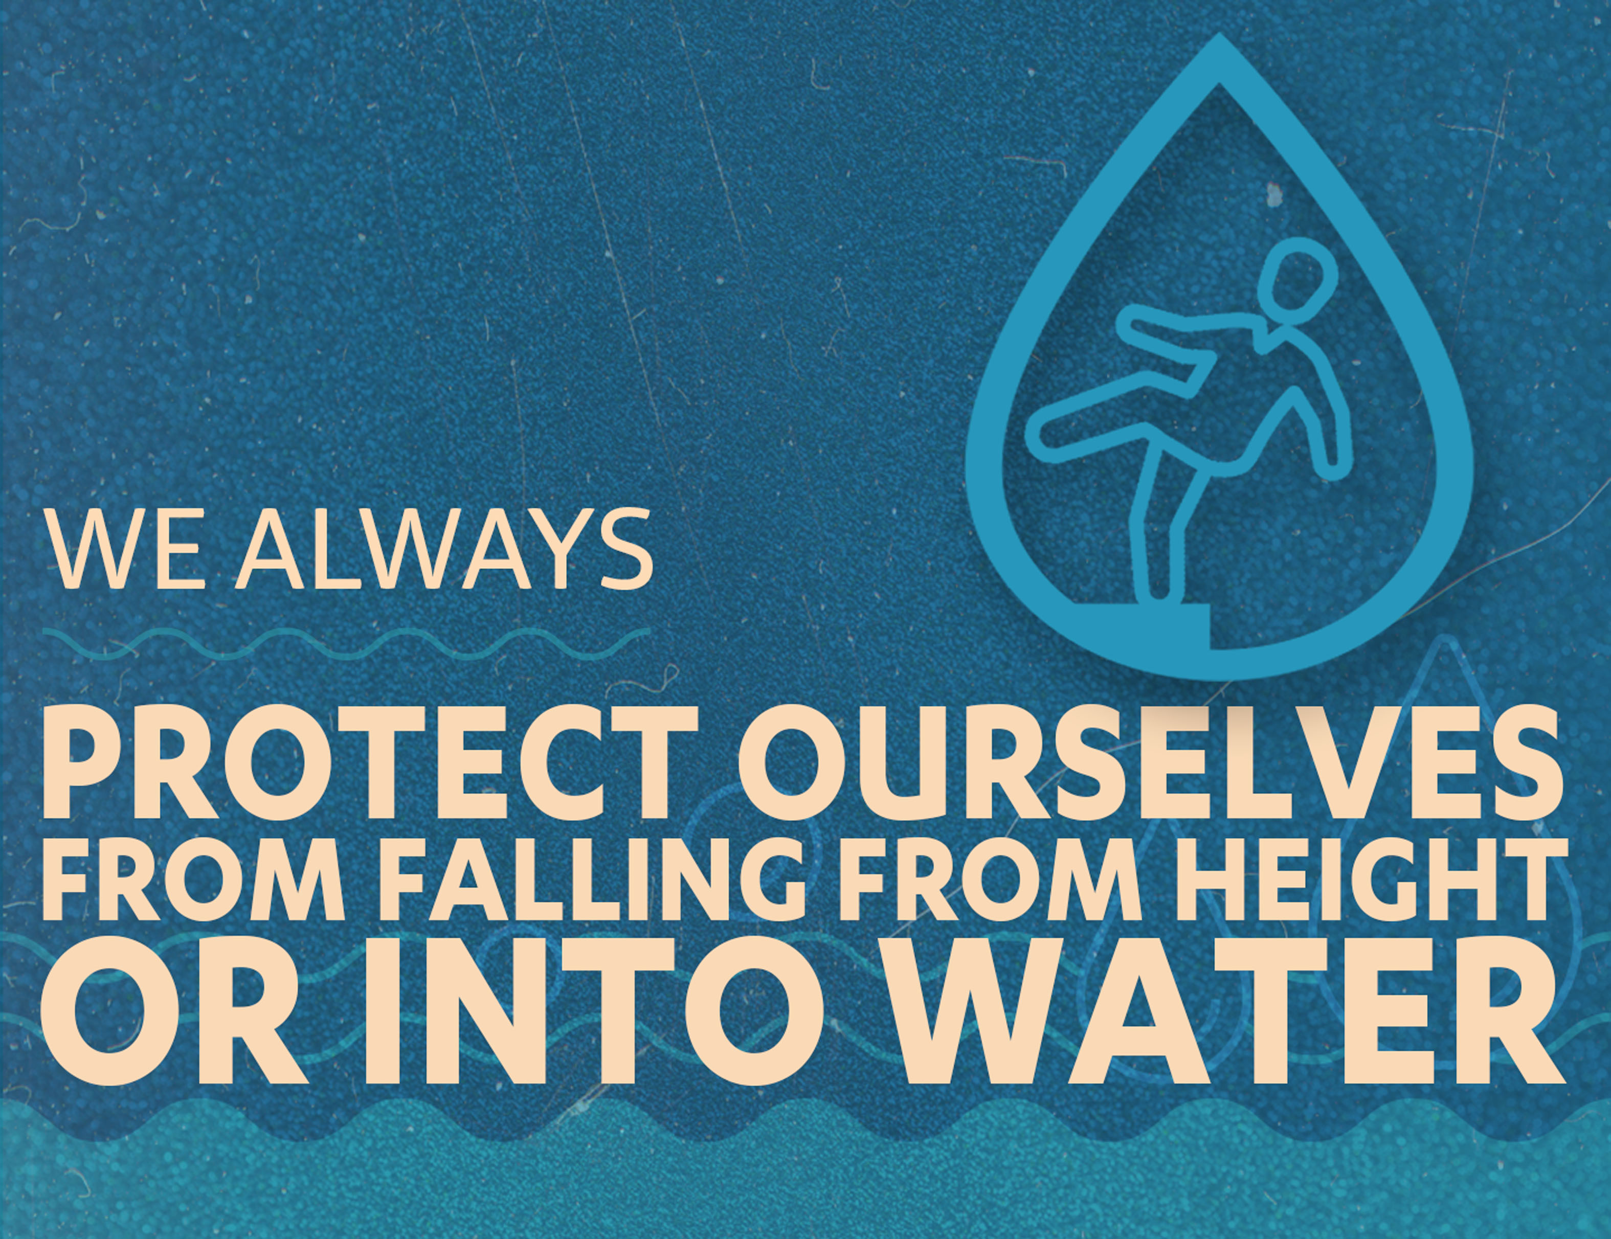
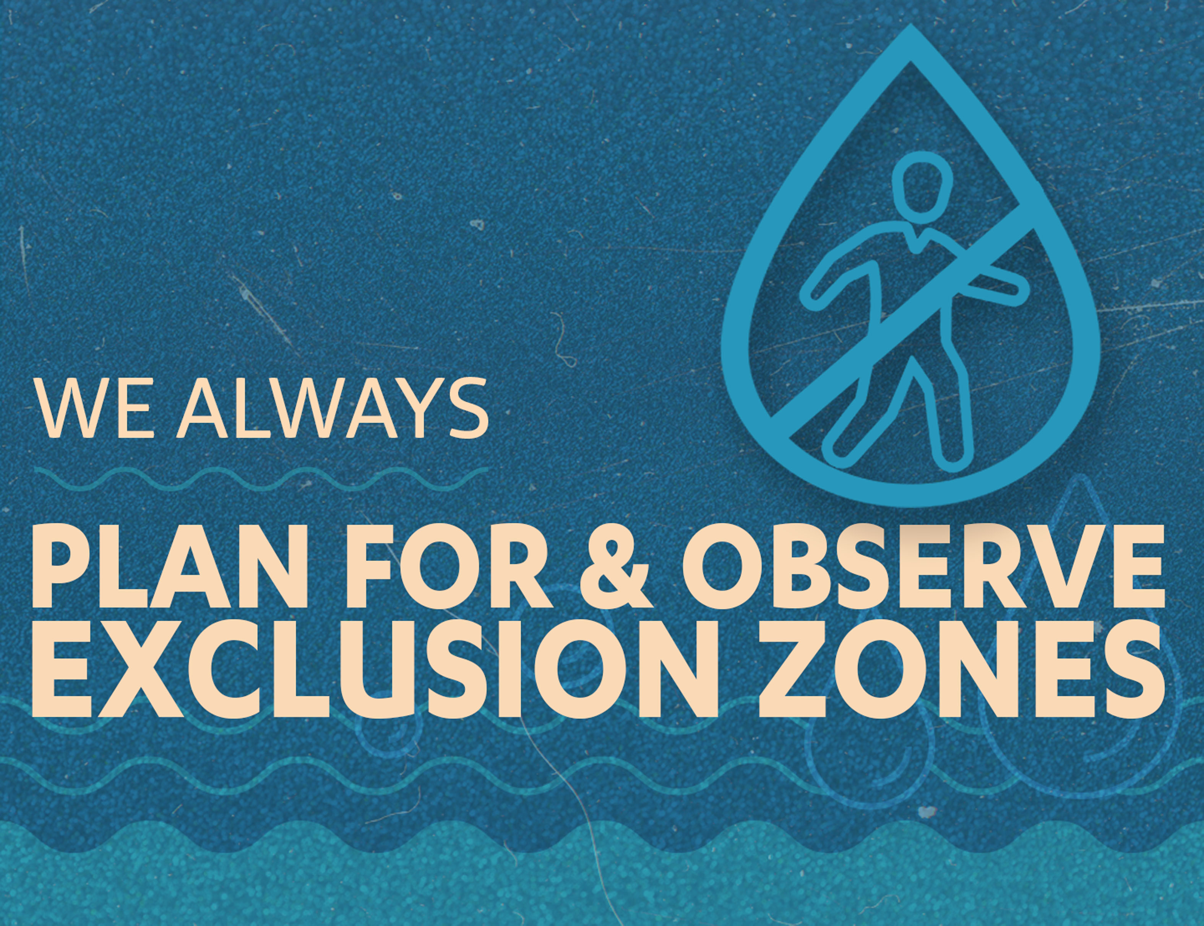
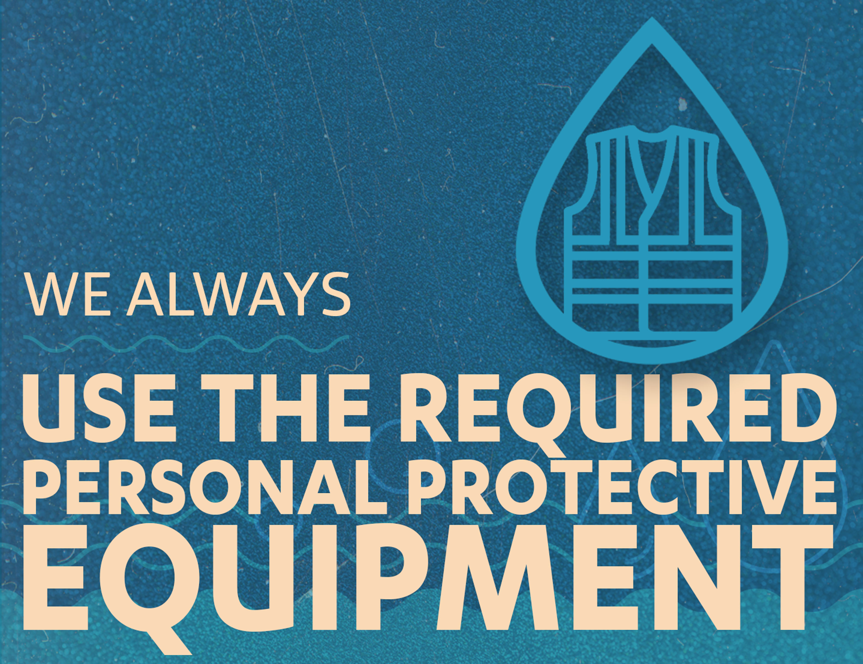
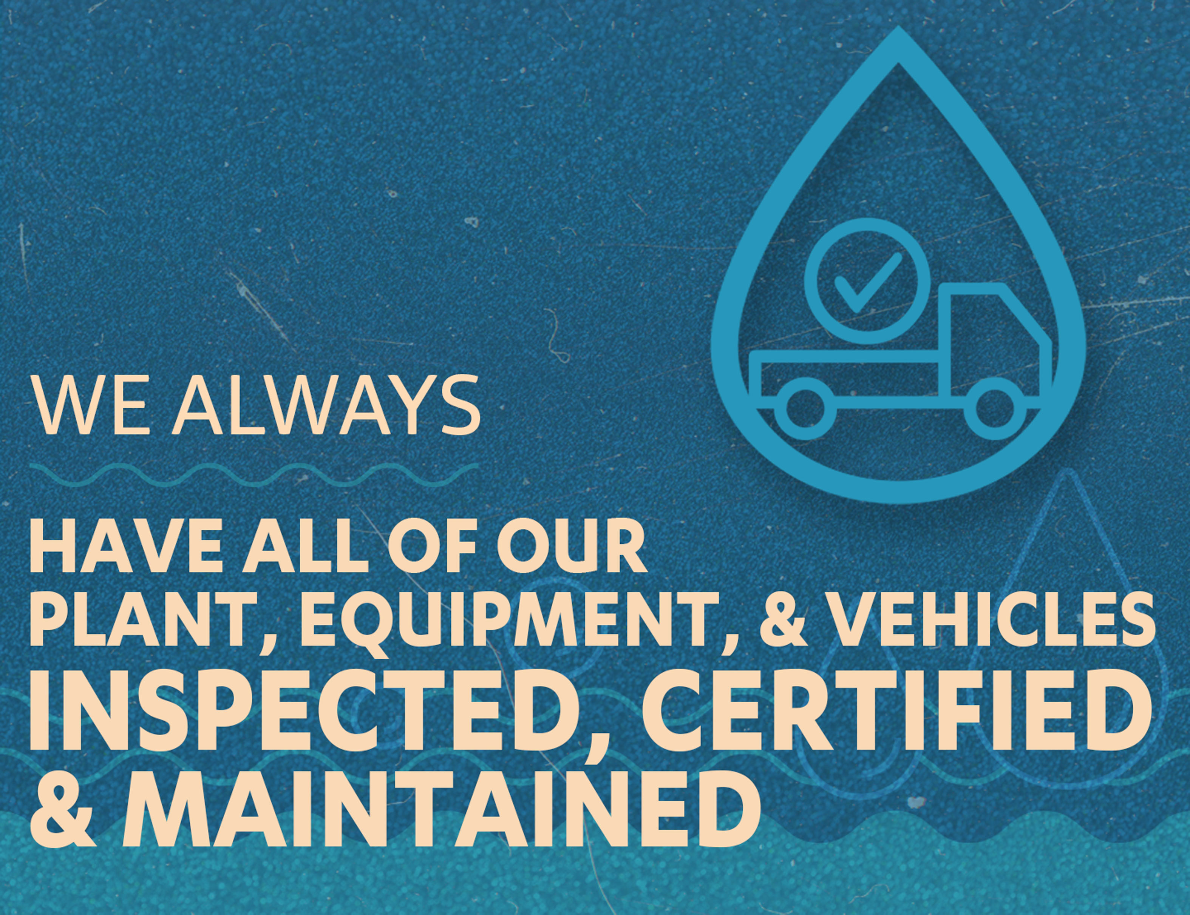
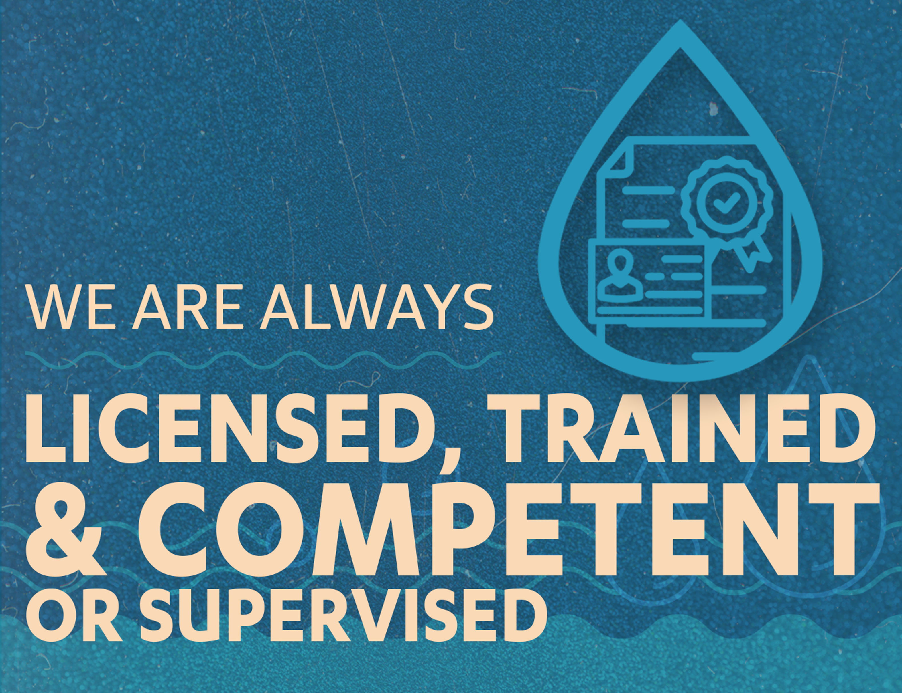
Working at Height – Life Saving Actions
For more information on working at height check out the WorkSafe guidelines here
For more information on scaffolding check out the WorkSafe guidelines here

Slide 13
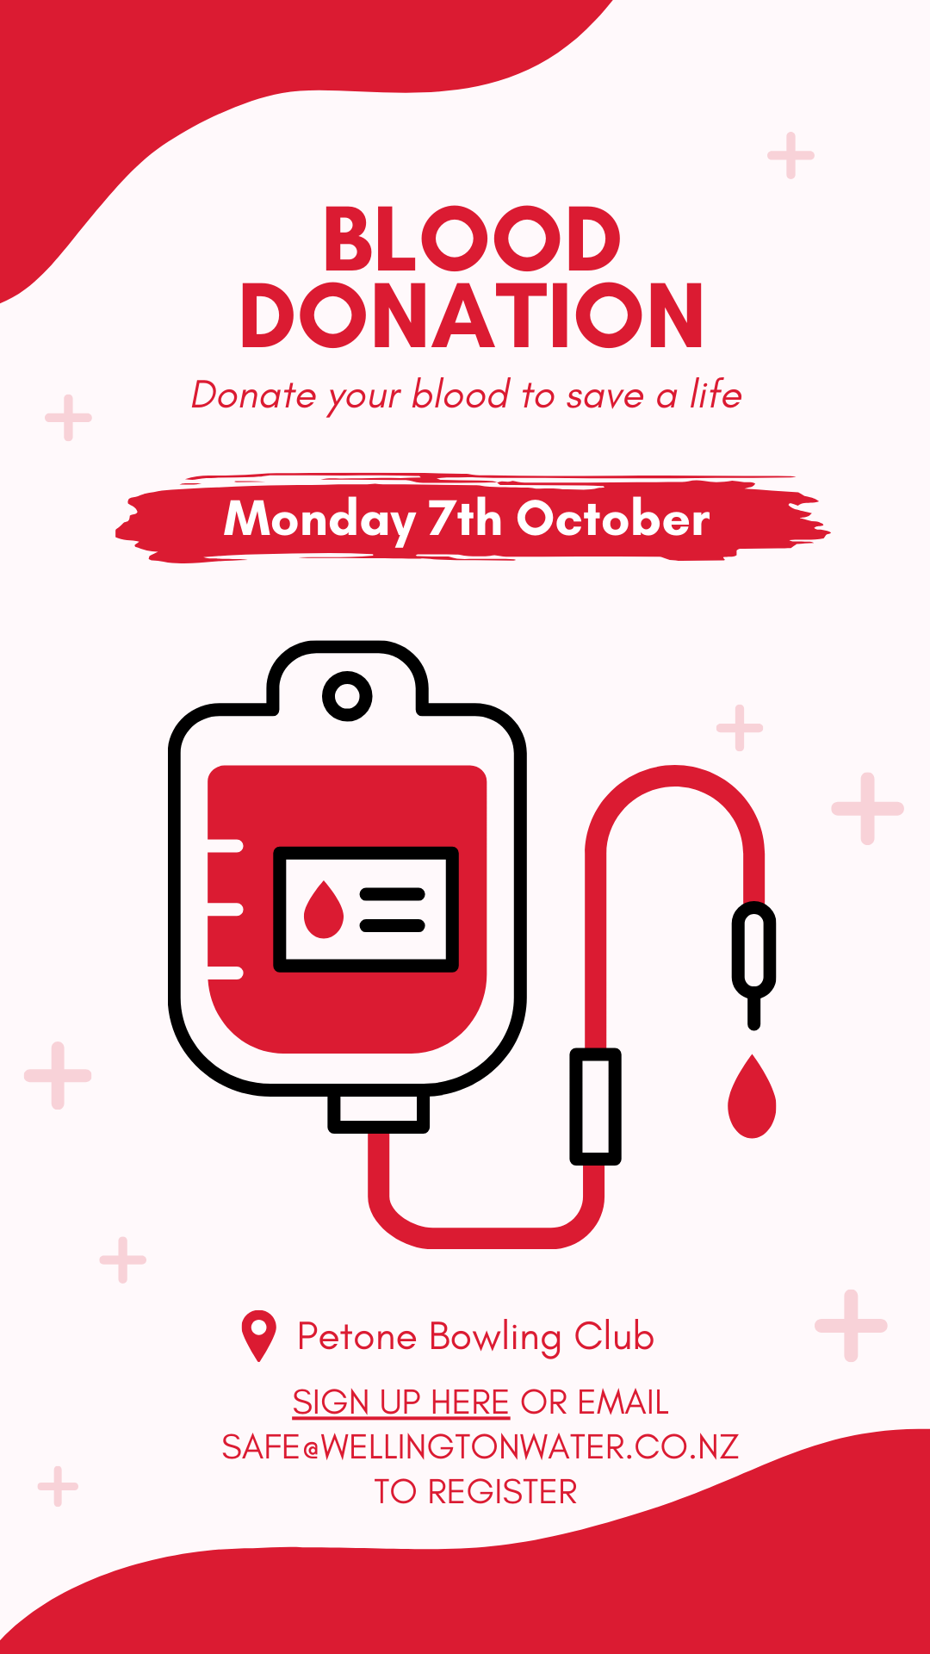
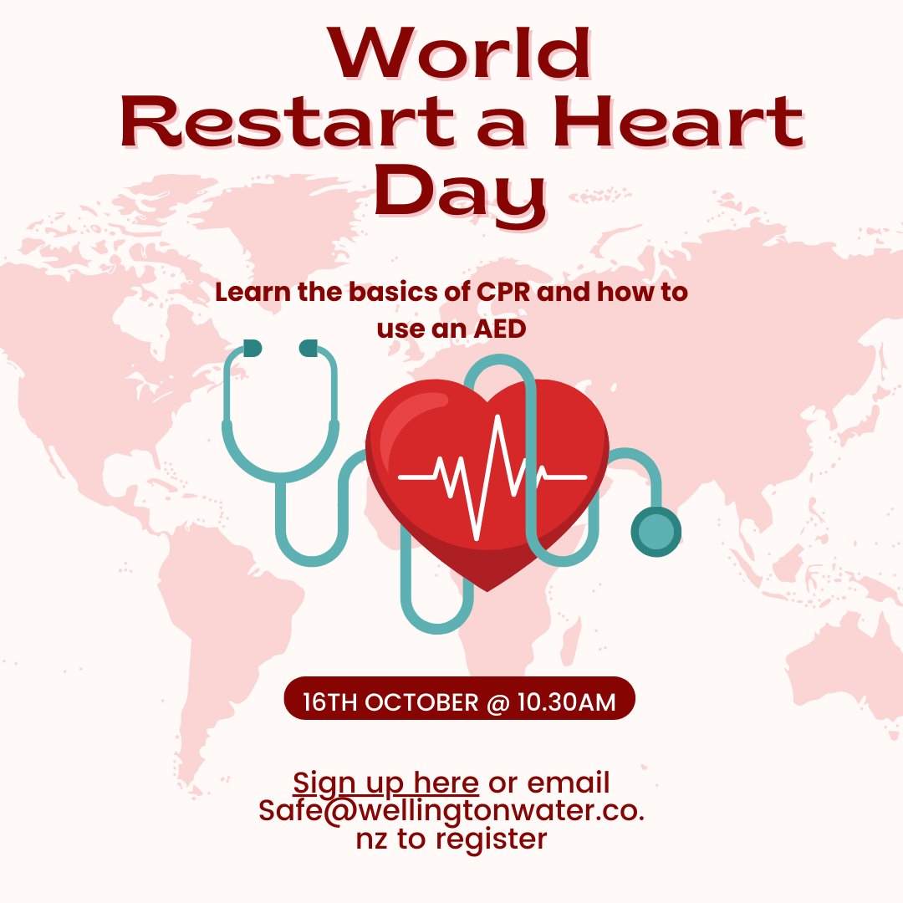
Coming up!
Come donate blood with us!
When – 7th October, shuttles leaving Petone Office at 10.45am and 11.15am
Where – Petone Bowling Club
How – Sign up here or get in touch with the H&S team
In honour of World Restart A Heart Day, Wellington Free Ambulance are coming to Petone Head Office on the 16th October to teach us:
What to do in an emergency
How to recognise someone in cardiac arrest and how to perform CPR
Where to find an AED and how to use it
About the GoodSAM Responder App.
Sign up here or get in touch with the H&S team

Slide 14
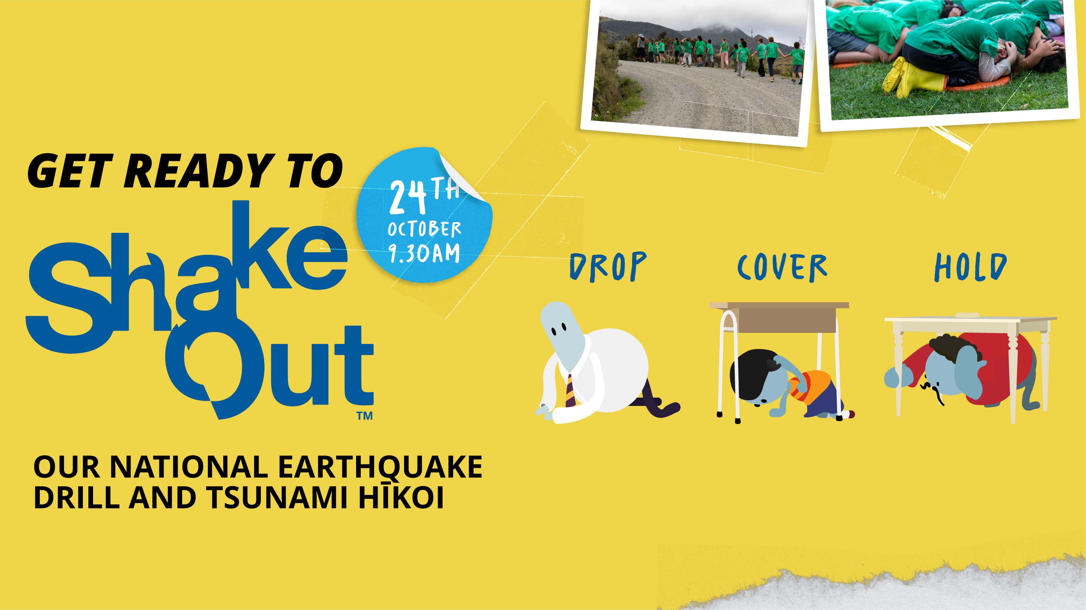
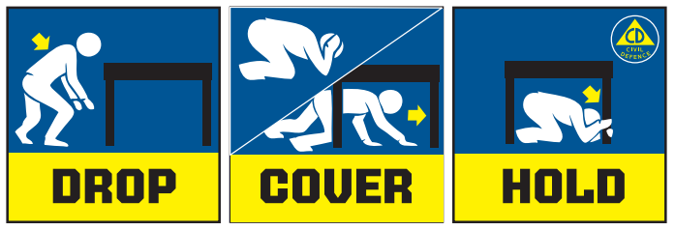
Shakeout
New Zealand ShakeOut is a self-run earthquake drill taking place Thursday 24 October 2024 at 9.30am.
How do we take part?
DROP down on your hands and knees. This protects you from falling but lets you move if you need to.
COVER your head and neck (or your entire body if possible) under a sturdy table or desk (if it is within a few steps of you). If there is no shelter nearby, cover your head and neck with your arms and hands.
HOLD on to your shelter (or your position to protect your head and neck) until the shaking stops. If the shaking shifts your shelter around, move with it.
While you are doing the drill, take note of what might be happening around you. Think about what you might need to do to prepare for a real earthquake.
Ute in Oxidisation pond – West Otago 2013
Reach out to the Risk & Assurance Team for more info

