Slide 1








Customer Operations Group
Dispatch
April/May 2022
There’s lots going on …

Slide 2
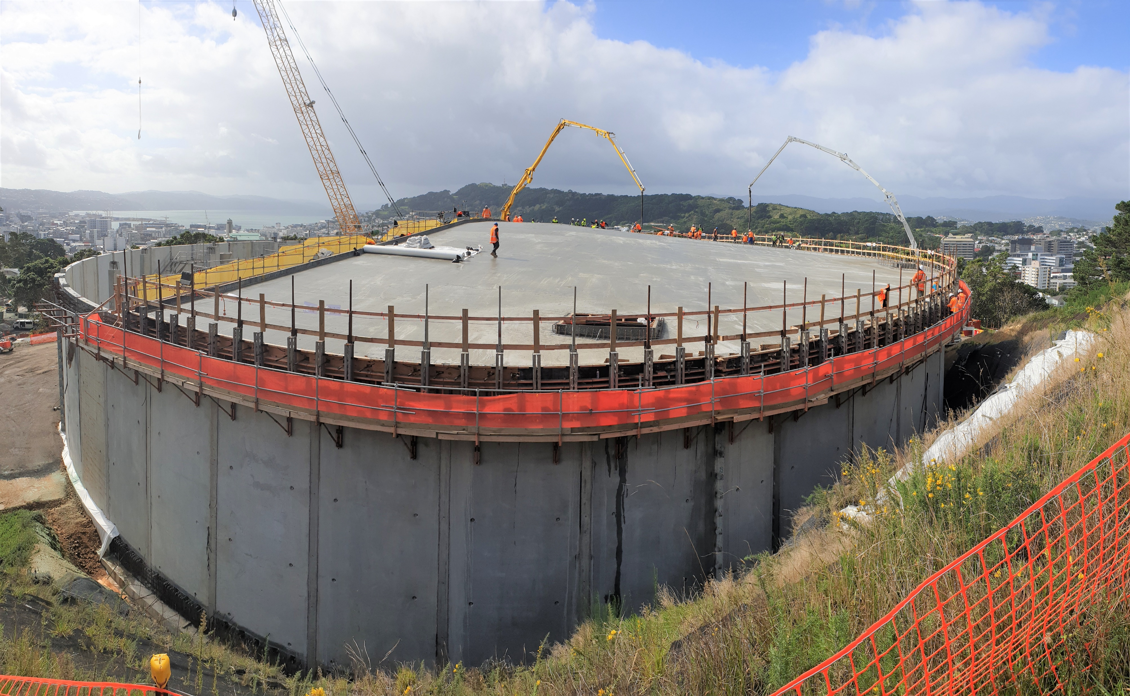
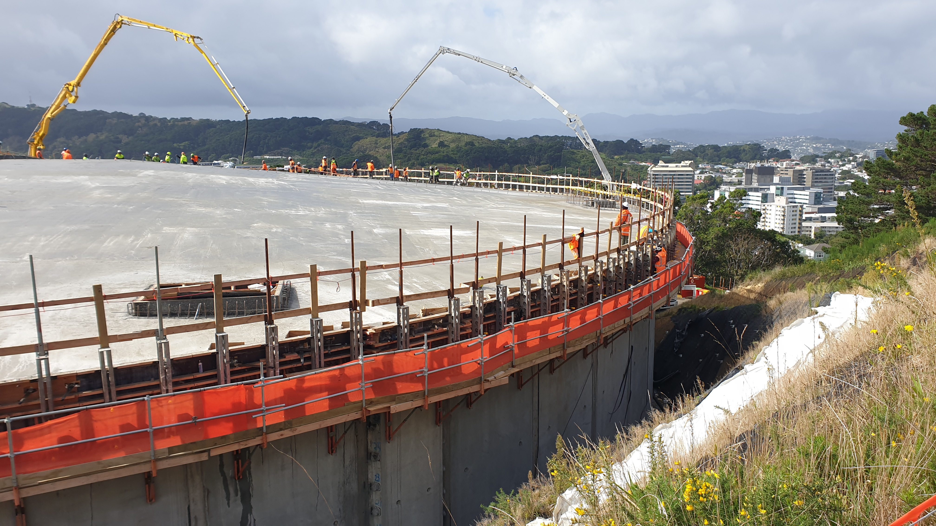
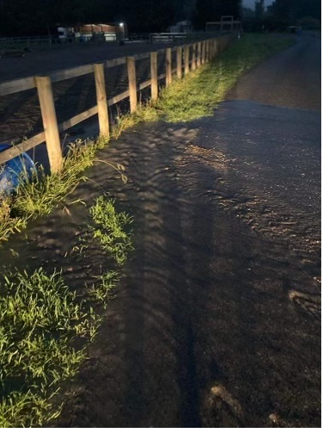

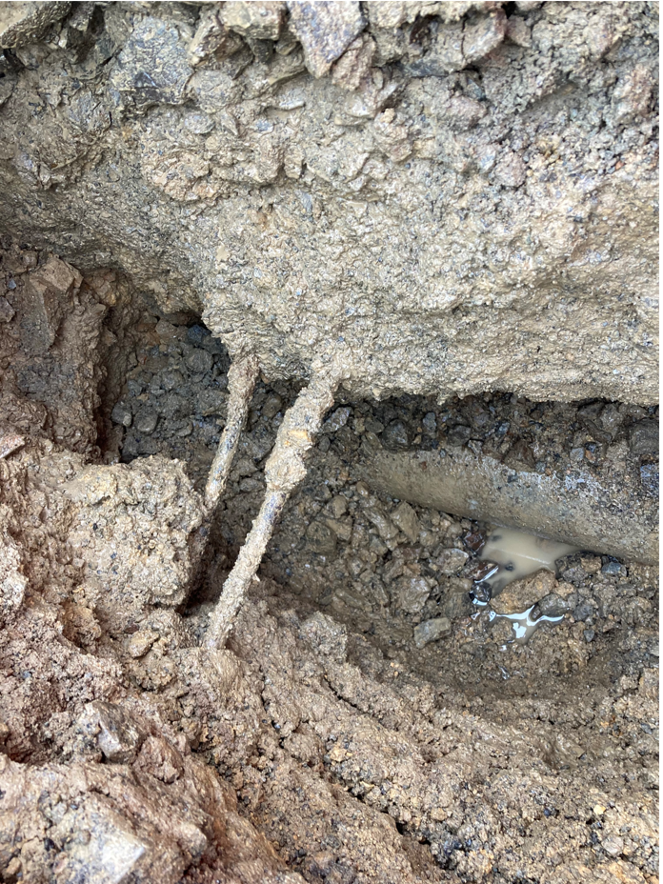
Night Calls
The roof has been poured at the Omāroro Reservoir . The pour started at 3am and was completed 24 hours later – great effort by the site team!
Another night time call out - teams locate a burst pipe in Boar Bush Road Featherston. Determining it was unsafe to undertake the repair at night the team isolated the area so the rest of the town would maintain normal pressure returning to undertake repairs in daylight.
Responding to a burst water main in Buckley Road Southgate the crew discover it affects around 100 properties and that service will be interrupted for at least 8 hours. They arranged for a bulk water tanker to be on site for residents within the hour. The team excavated the site with the assistance of a Hydrovac truck, encountering some thick, steel reinforced, concrete above the pipe which caused difficulty in uncovering the fracture. They believed it to be a horizontal crack in the pipe and replaced the whole section from collar to collar. Their target was to have the work completed by 2200 hours!

Slide 3
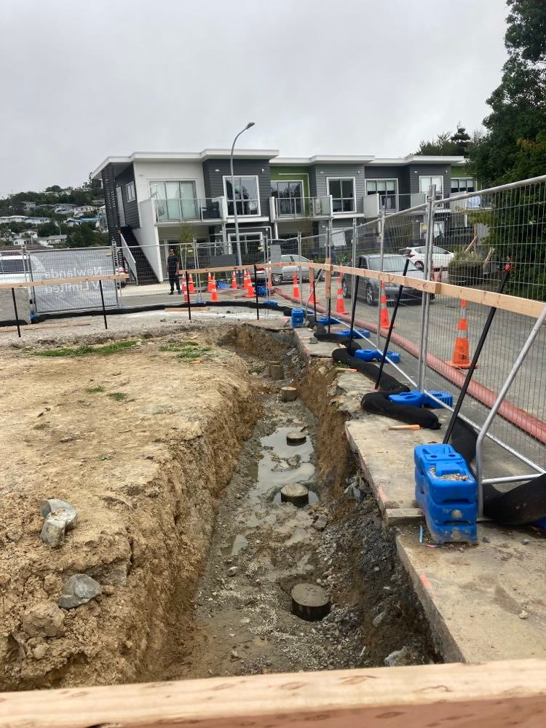
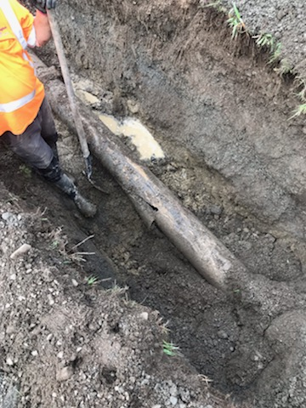
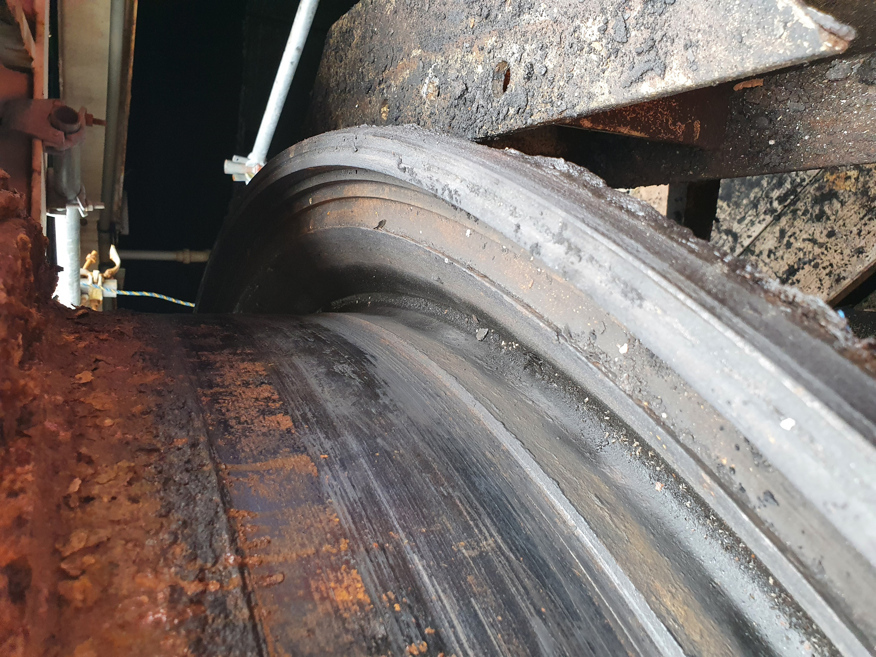
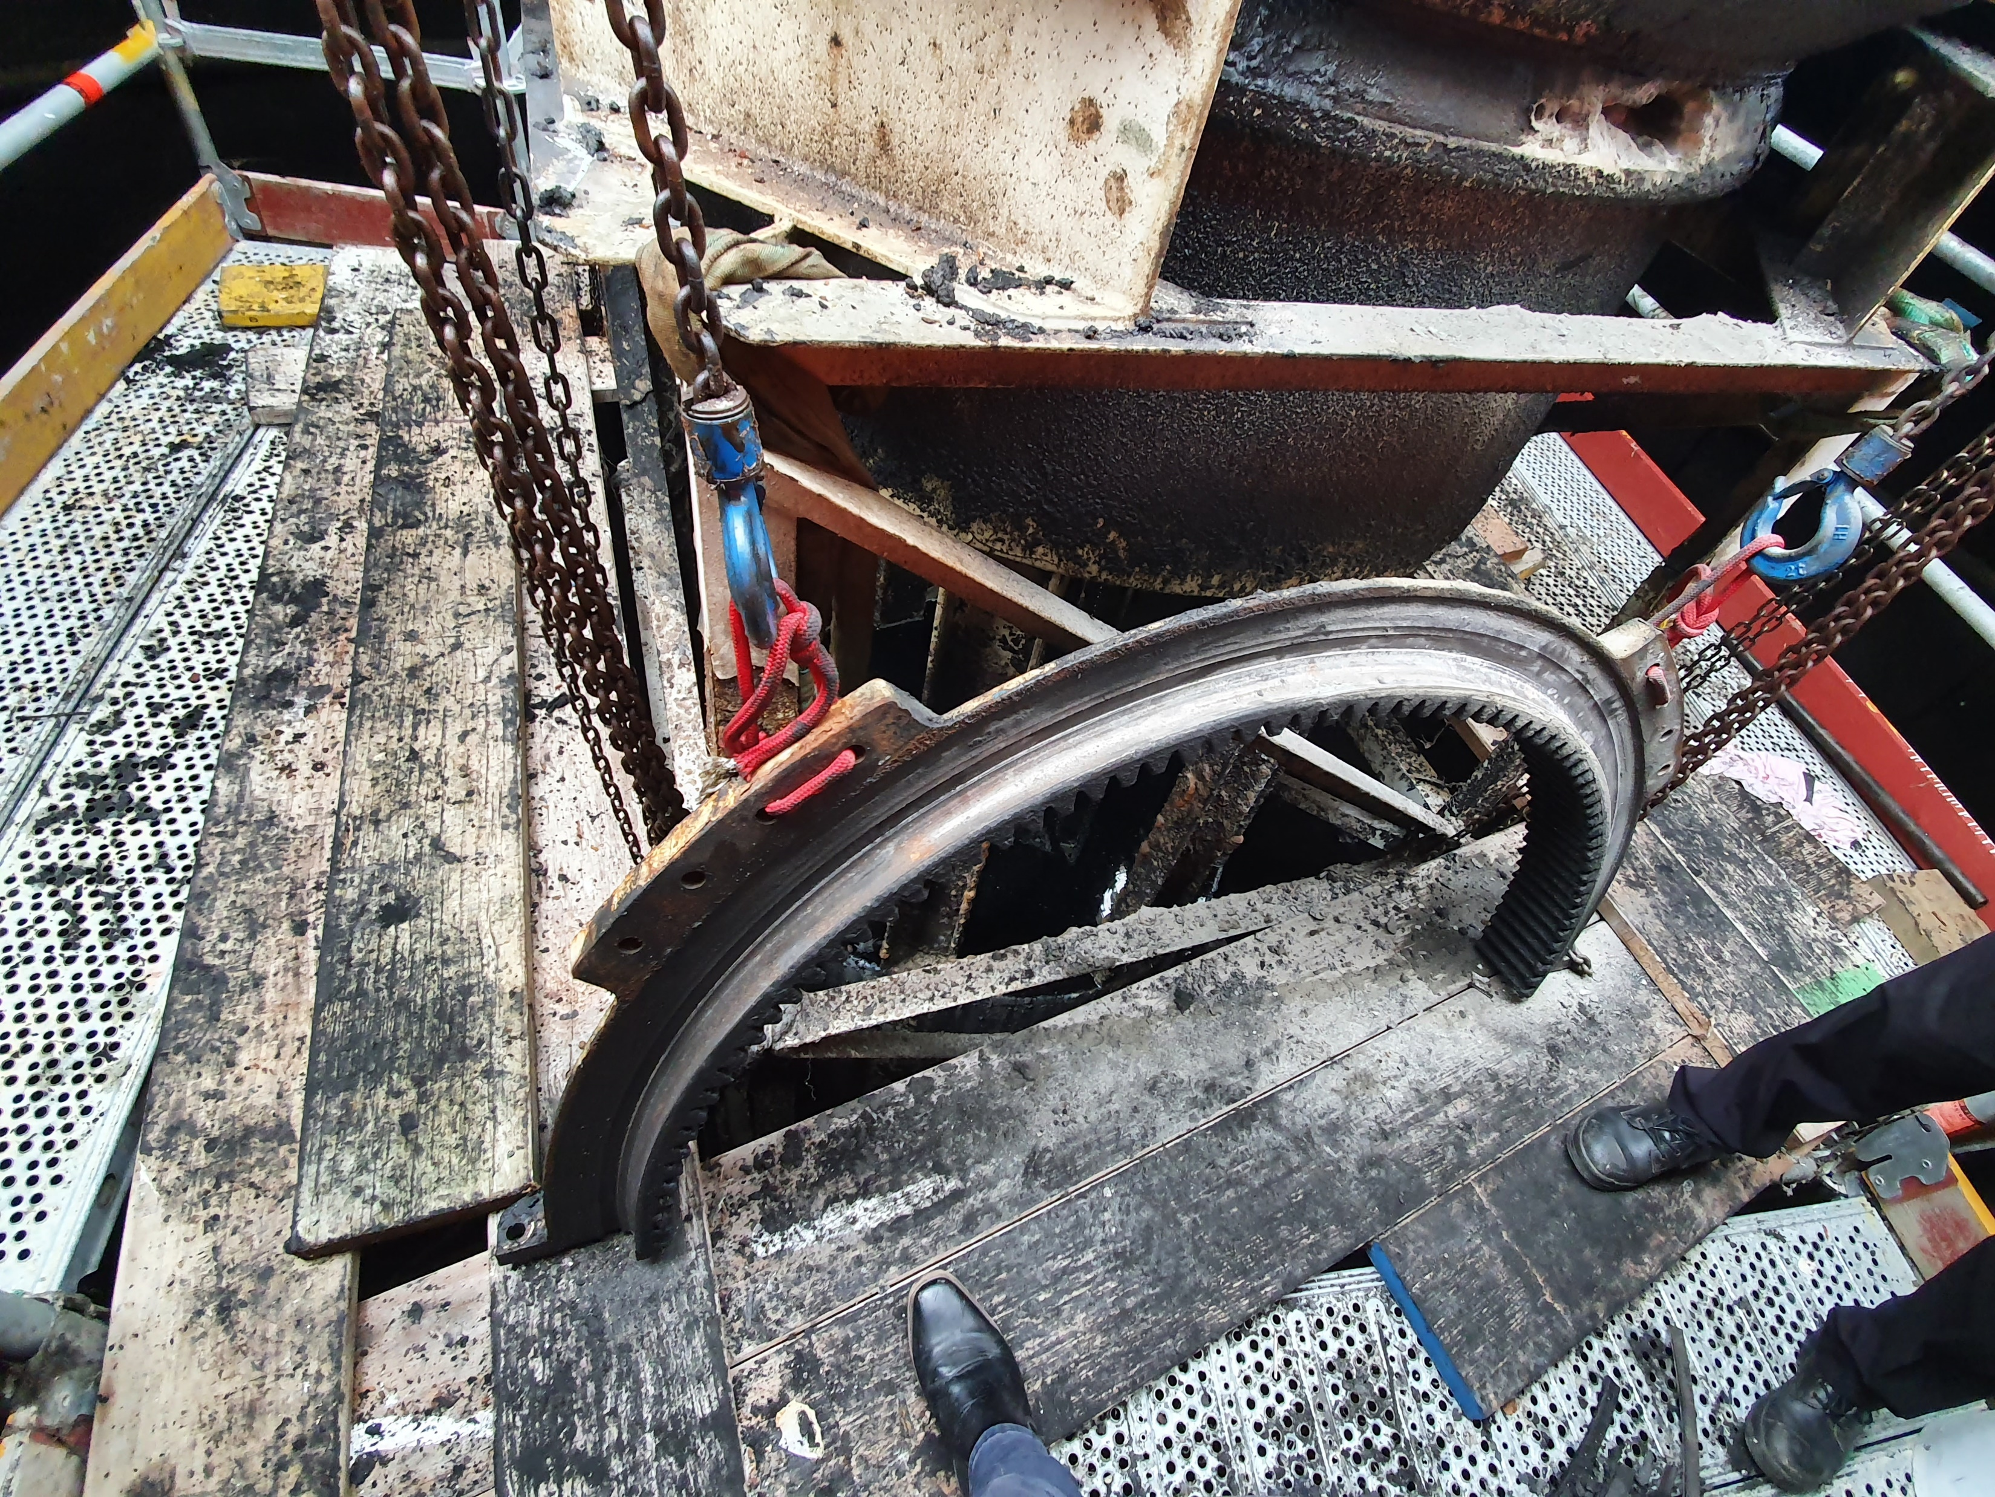
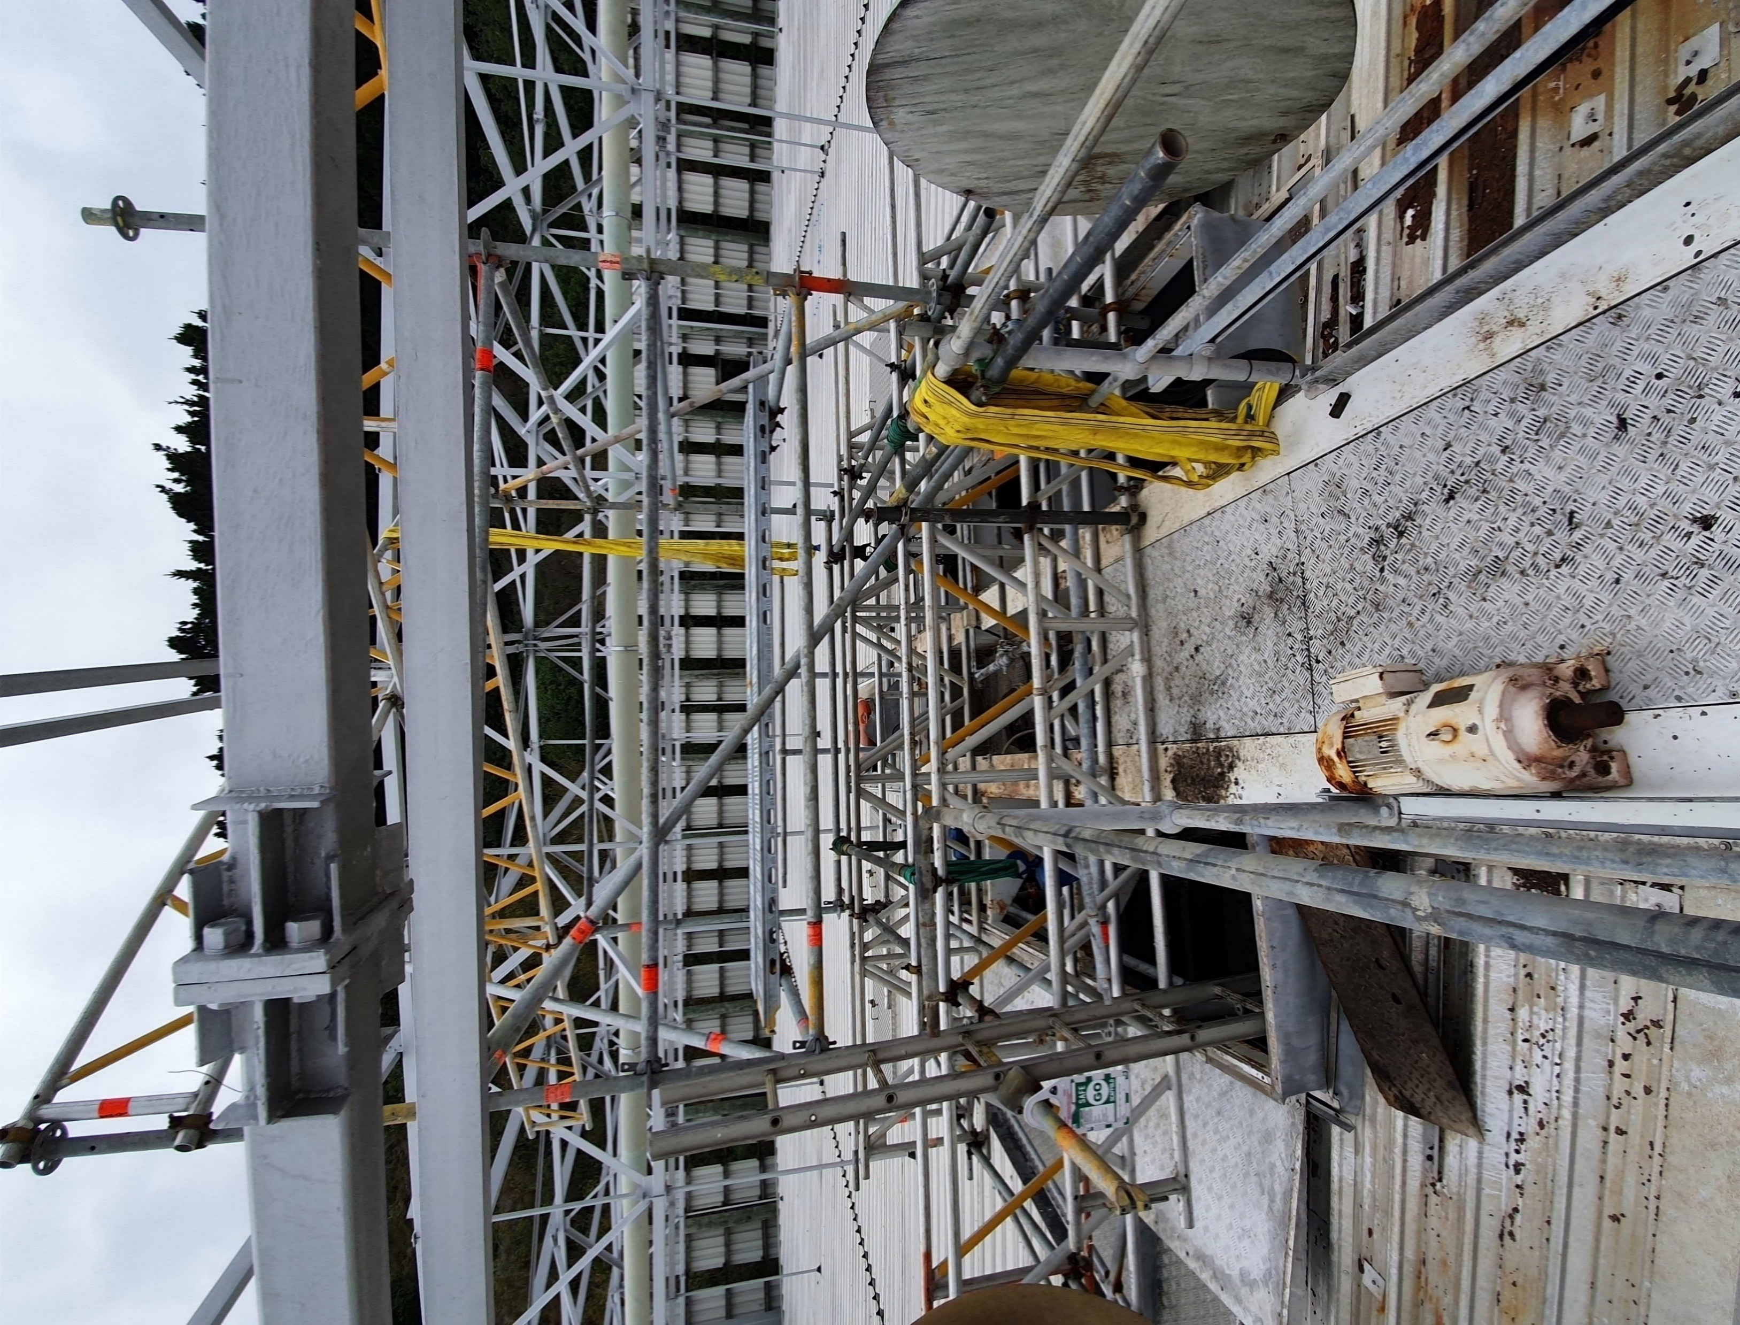
Out in the Field
*Progress at Omaroro Reservoir
Crossing the by-pass sewer Atkinson Road Newlands
Boar Bush Road Featherston
Moa Point - The repair of the scraper drive in Clarifier 3 – complex work owing to the engineering involved and the constraints it imposes on the capacity of the plant

Slide 4
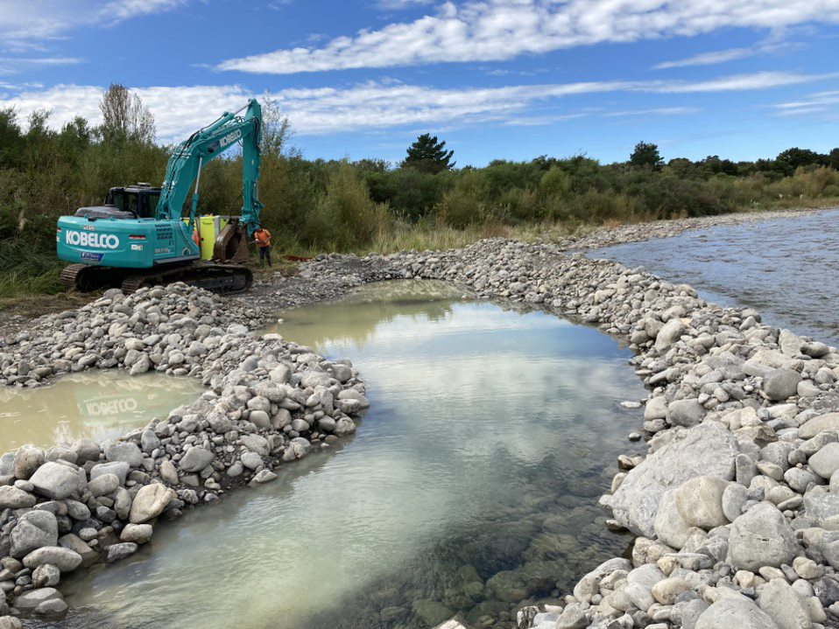
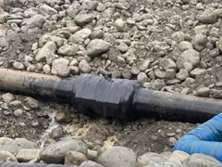
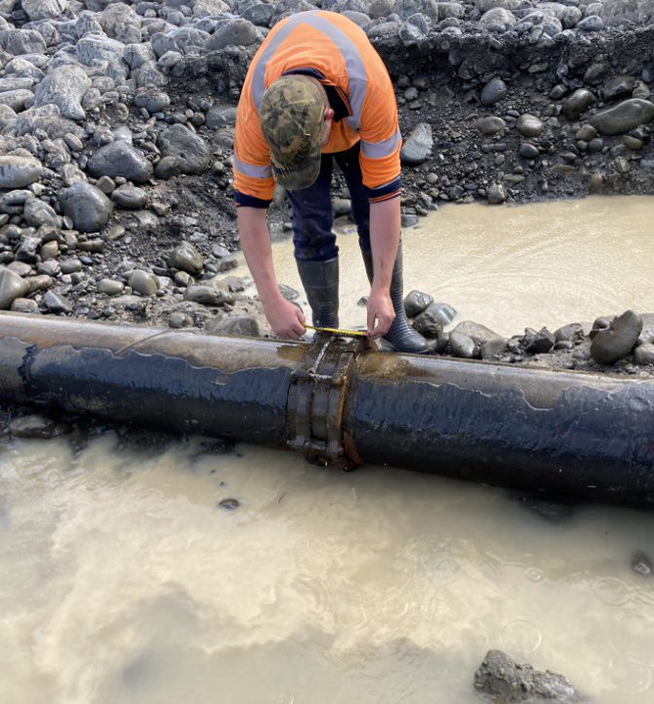
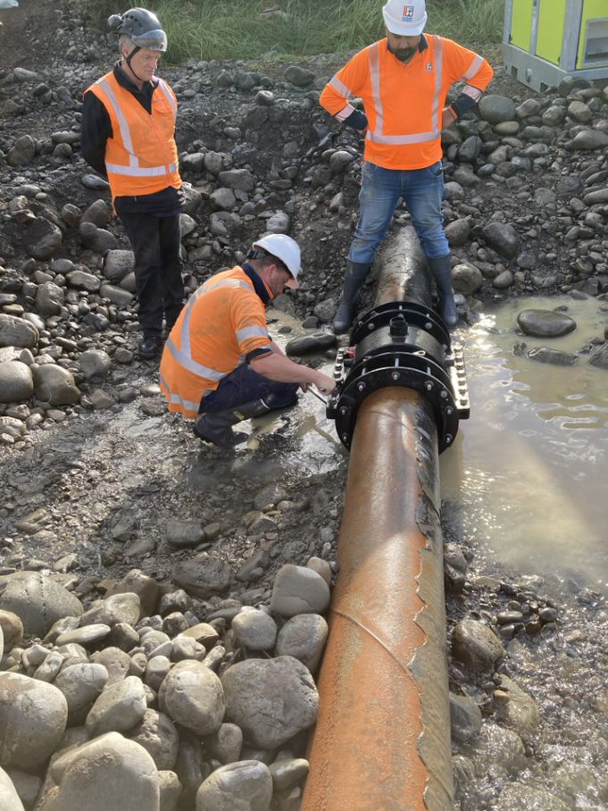
The Tauherenikau Pipeline
The Wellington Water team have now completed the repair to a leaking joint on the drinking water pipeline that crosses the Tauherenikau river.
The pipeline is important asset as it is the sole source of supply for drinking water to Featherston.
The repair is the first step in a longer term project and allows Wellington Water and the South Wairarapa District Council time to consider long-term investment and moving the pipeline to a more stable environment.

Slide 5
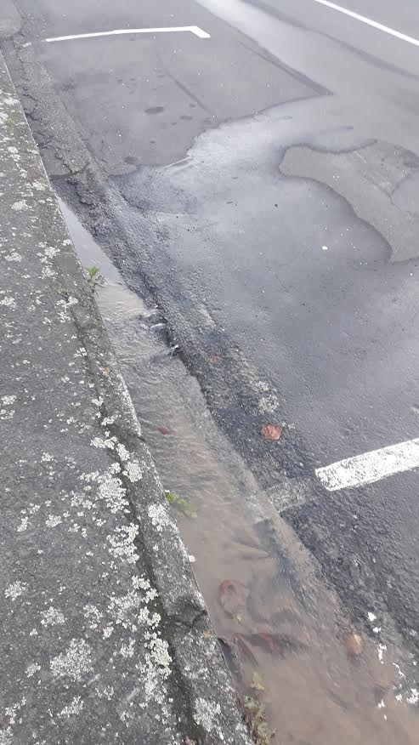
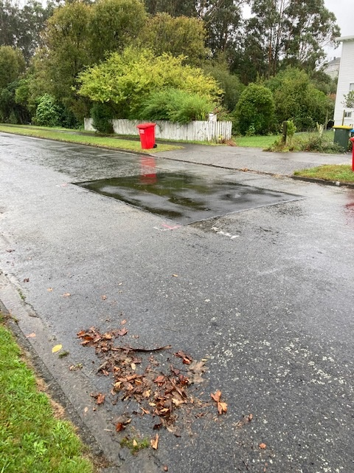

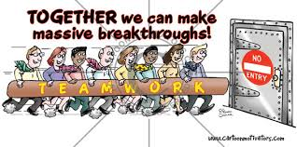
Compliment Corner
Compliment for the crew for leak at 84 Brougham St
It's all sorted!!!!
Nice job at 84 Brougham St.
Thank you on behalf of other residents.
Nick
Hi PCC CC, Can you pass onto WW that their water leak repair job on Mexted Cres looks great Thank you.
But wait …. There’s more…
Please pass on our thanks to the team who fixed the leak which had caused water to bubble up through the road surface outside our property at Singers Rd Korokoro.
In particular, to the person who had to lie on his front in the road with the upper part of his body almost down the hole to reach the pipework requiring fixing.
Much appreciated,
Margaret and Paddy.

Slide 6



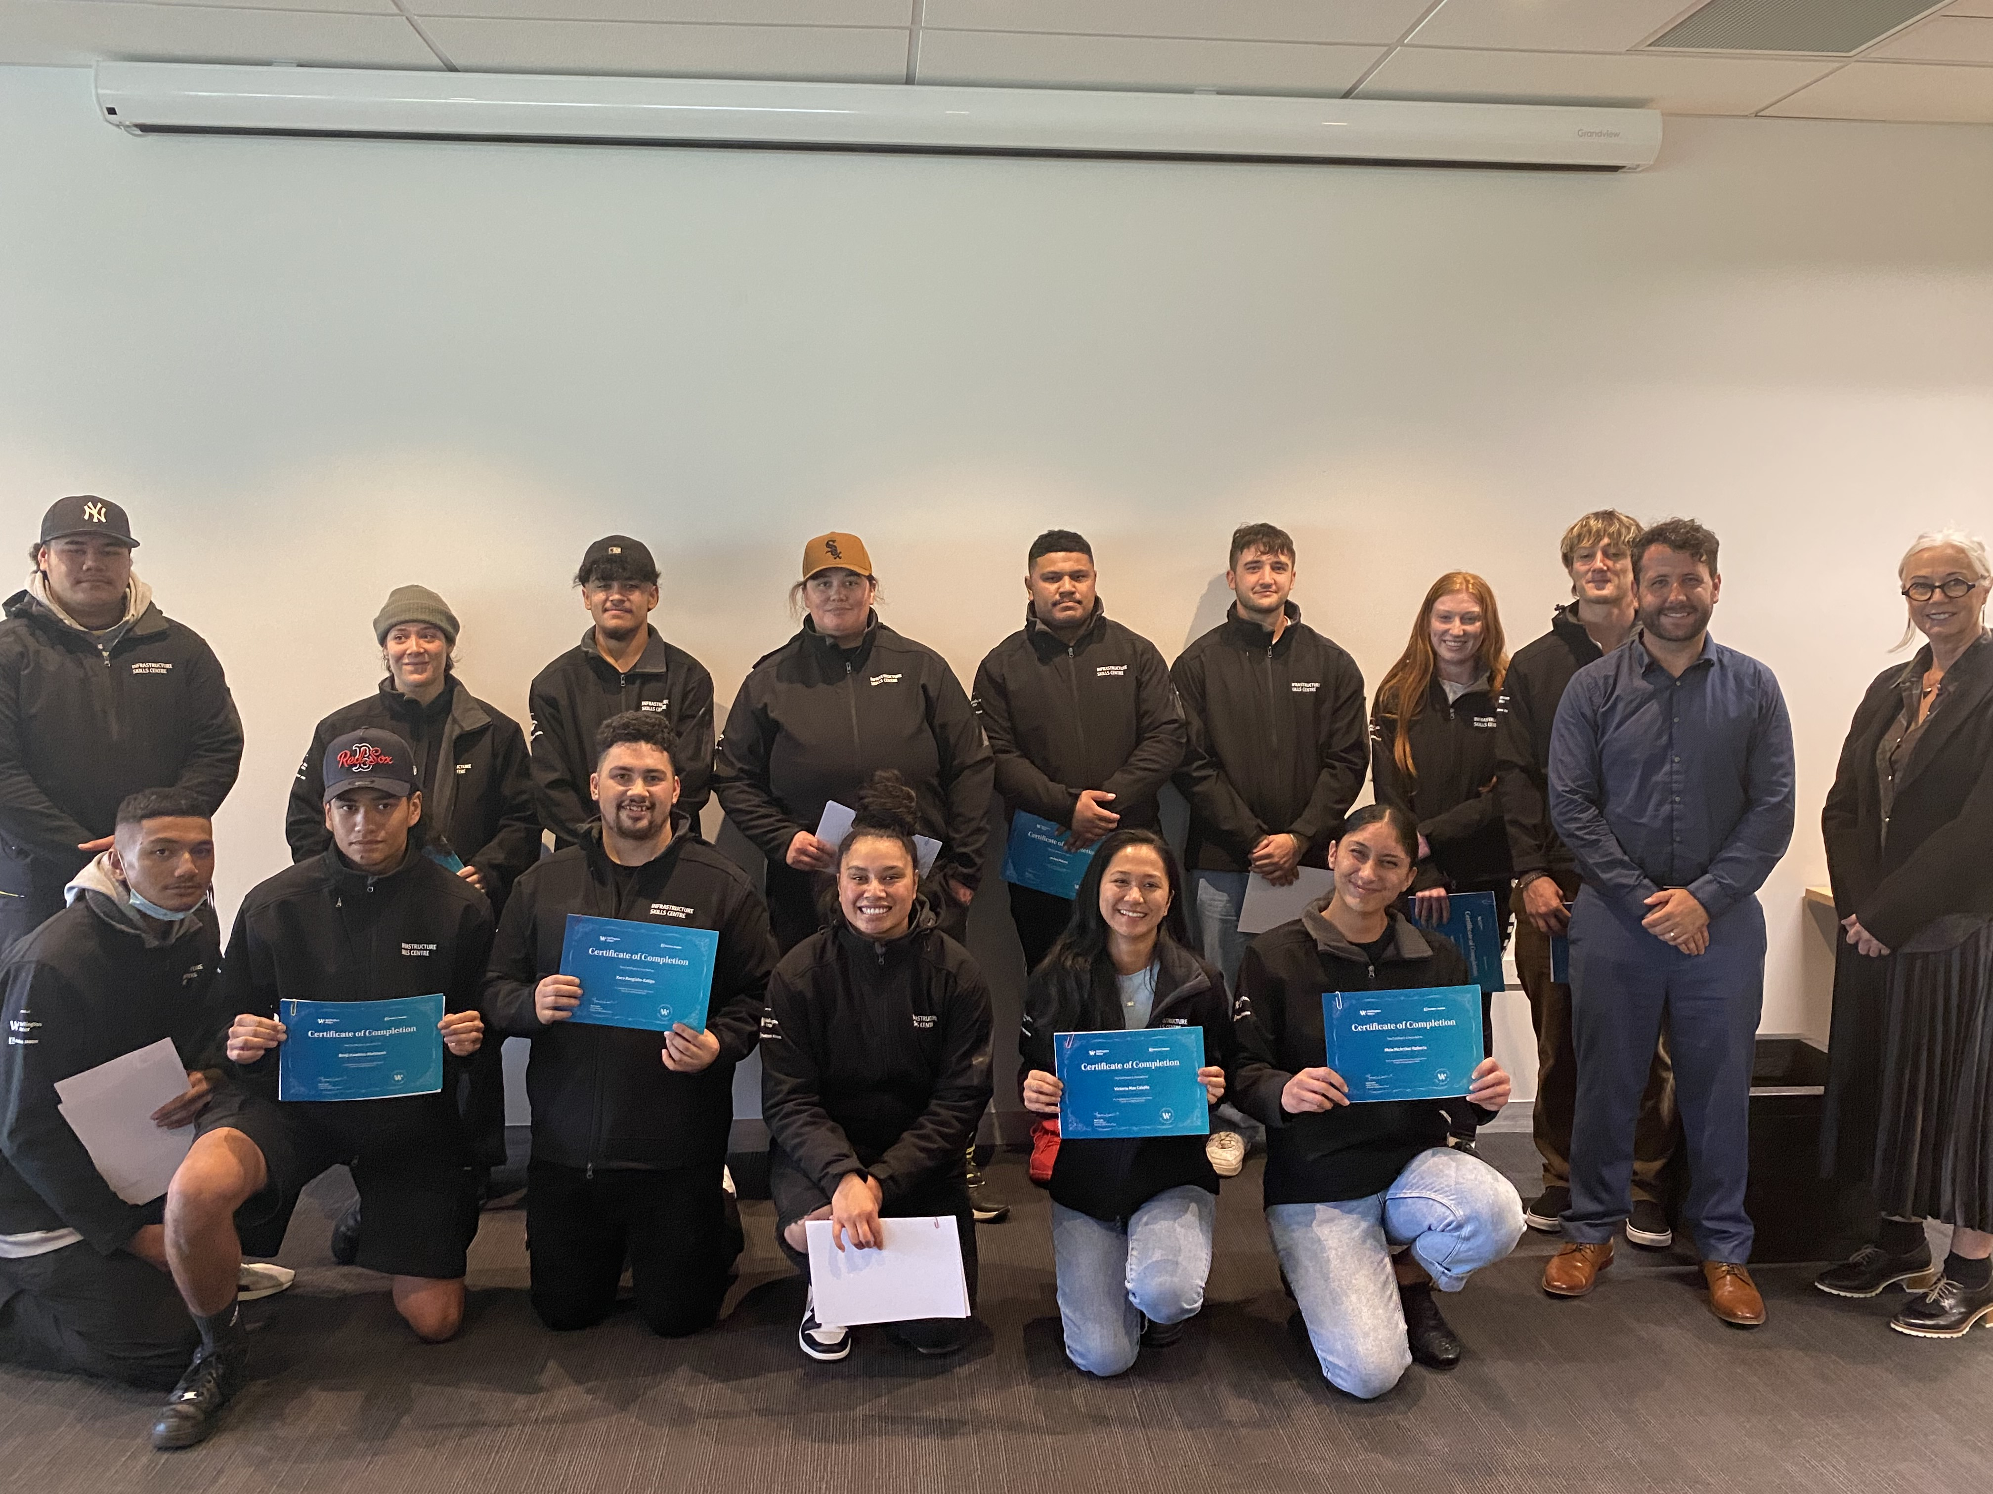
The Health & Safety Team are currently reviewing our Manual looking at improvements to critical areas such as working with asbestos, metallic pipework and updating processes around illness when working with water to name a few.
This manual is a great resource for all staff to utilise so keep it in the truck, your bag or somewhere handy so you can refer to.
Health and safety is always worth your time and everyone has a duty of care to ensure safe practices in the workplace are at the forefront of all we do.
The Graduates of the Inaugural Infrastructure Skills Centre
A proud moment for our first Graduates – their hard work has seen there confidence grow and opportunities open up for them. Fabulous efforts by all involved

Slide 7
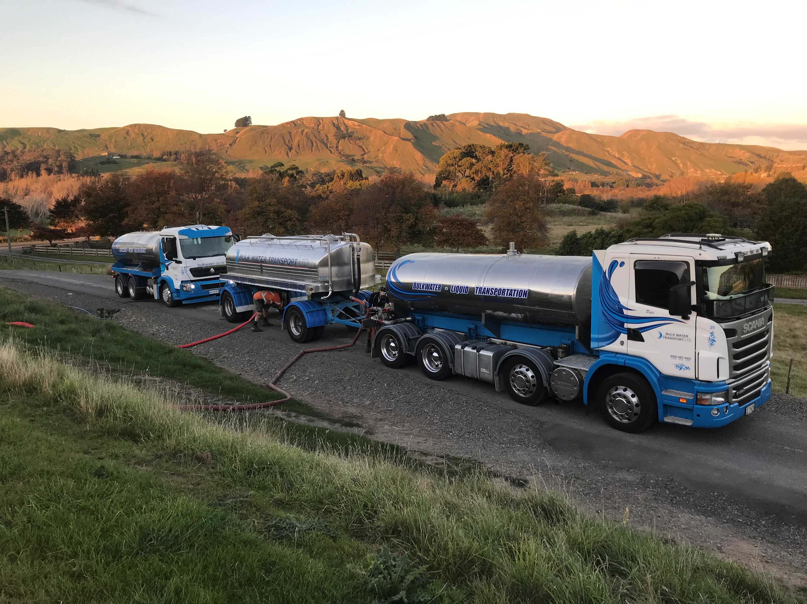

Trucks worked until 11pm bringing water to the Martinborough reservoir during the Ruamahanga Water Treatment Plant incident.
A day in the life of our Incident Coordinator Glenis Bruin
Kia Ora
A subcontractor undertaking a reactive maintenance repair in Mulberry Street shut the water main, not realising one of the valves he shut was the main supply to Maungaraki.
Once we were alerted to the extent of the shut area we undertook a reconnaissance to identify the source of the issue.
Unfortunately due to the hillside nature of the network it is taking time to recharge the network.
However all customers now have service restored since 13:00.
Nga mihi
Glenis

Slide 8




Our monthly
Customer Satisfaction Survey bounced back this month
Results
Mar-22
100
44%
39%
9%
6%
1%
83%
7%
Customer Comments …
It was a prompt service- they turned up they responded very very quickly they did a brilliant job I was very happy.
Just their response their quick response time and their ability to get it sorted out. and their ability to solve the issue- they just get it done quickly.
I was coming home and they were here They were very friendly and at the end of it, a Text was sent advising job completed and if we were satisfied.
The communication from Call Centre is very effective. The workman kept me up to date with progress.
Wellington Water keeps us informed on what happens, which is more the Wellington City Council does with other stuff reported to them. I am satisfied that when they complete the job well.
Base
Very satisfied
Satisfied
Neither satisfied nor dissatisfied
Dissatisfied
Very dissatisfied
DO NOT READ: Don't know
Nett - Very satisfied / satisfied
Nett - Very dissatisfied
If you have something you’d like to share in Dispatch send it through

