Slide 1


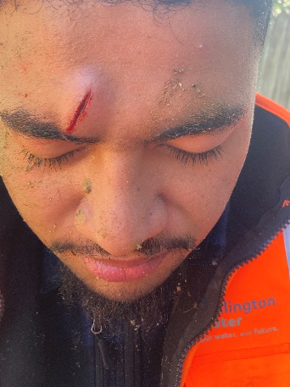

Safety Alert
Line of Fire Hazards – Controlling the Risk
Line of Fire hazards refer to the danger of positioning yourself in a way that you could be struck, overcome by fumes, sprayed, fallen on, or crushed.
Line of Fire risks are present when working around: | Vehicles and Machinery Cranes and Suspended loads Moving Plant and Articulation Points Excavations and Raised Work Platforms Hand tools and Power tools
Incident:
While loading spoil onto a truck, a worker was struck in the head by a shovel. The worker had leaned forward to scoop spoil with a shovel, while another worker simultaneously raised their shovel load, causing the shovel to strike the injured worker.
Solutions:
1. Before starting work, carefully assess the area and take note of ongoing and upcoming activities on-site.
2. Identify and avoid potential hazards, keeping a safe distance from dangerous areas.
  Ask yourself questions like "Could those rocks fall?" "Will that excavator swing around?" "Where will the vehicles be moving?"
3. Stay alert, be aware of your surroundings, and regularly check your work position for safety.
If unsure, relocate to a different area.
4. Anticipation is key to preventing injuries. If you think something might happen, there's a good chance it will.
The "she'll be right, mate, they'll see me" attitude is ineffective.
Safety is everyone's responsibility, speak up if you have any concerns.

Slide 2
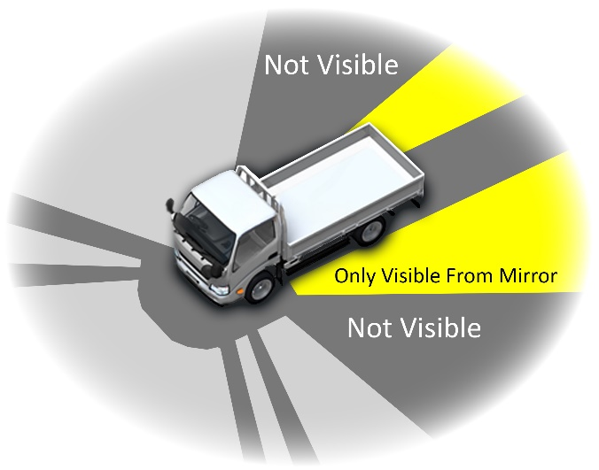
Safety Alert
Line of Fire Hazards – Controlling the Risk
Line of Fire hazards refer to the danger of positioning yourself in a way that you could be struck, overcome by fumes, sprayed, fallen on, or crushed.
Incident:
A worker was having trouble removing a tape key from within a toby box. They have applied more pressure, leading it to suddenly dislodging and smacking them under the jaw. The collision has resulted in chipping one of their teeth.
A worker has struck themselves in the head with a sledgehammer while attempting to break up a slab of asphalt. The sledgehammer was thrust downward into the asphalt, causing a jolting impact that sent the handle into the side of the worker’s head.
Line of Fire - Vehicle movement:
Vehicles and mobile plant movements in and around workplaces are frequently linked with workplace injuries and fatalities.
Heavy vehicles and mobile plant often have severely restricted visibility of ground workers, and large blind spots are common.
Check your surroundings before proceeding with any work.

