Slide 1
Wellington Water Isolations Awareness Training

Slide 2
Contents
This training will take about 30 minutes
You will need speakers or headphones for the videos and a reliable internet connection
The training covers:
Sources of Energy
LOTO procedures
LOTO Equipment
Who completes LOTO
Why we LOTO

Slide 3

Sources of Hazardous Energy
Hazardous energy can be anything that can cause harm. It can be:
Electrical
  AC/ DC sources
  Static charge
  Batteries, capacitors, large cables
  Induced charge
Mechanical
  Moving parts of machinery
  Rams
Hydraulics
  Pressure
  Compressed air
  Fuel lines
  Water lines
  Hydraulic lines
Gravity
  Suspended Loads

Slide 4
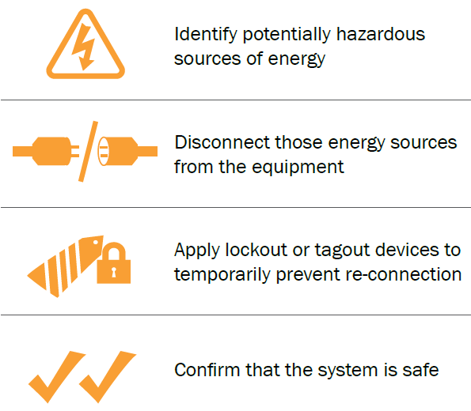
Hazardous Energy
Hazardous energy has routinely cut, crushed, shocked, and burned workers. It can cause fires, explosions, and flooding. These can be prevented with a single, simple approach: turn it off first, and keep if off until maintenance is done.
That’s Isolation/ lockout/tagout (LOTO) in a nutshell.

Slide 5

Lock Out/ Tag Out

Slide 6
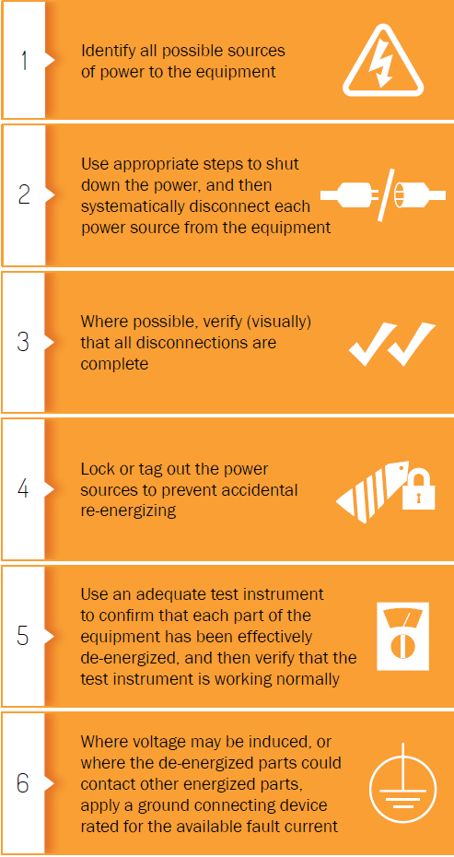
Lock Out/ Tag Out
Lock Out/ Tag Out protects workers from harm
  LOTO prevents hazardous energy coming into contact with the worker
It is important the procedures are followed
Once LOTO is applied
  Prove, Test, Prove
  Ensure the equipment is correctly isolated and there is no way it can turn on while you’re working in the system

Slide 7
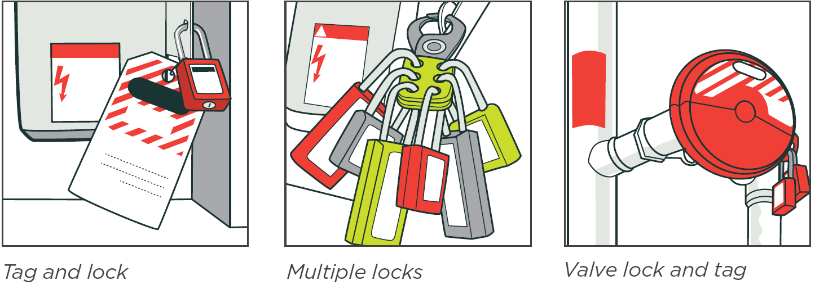
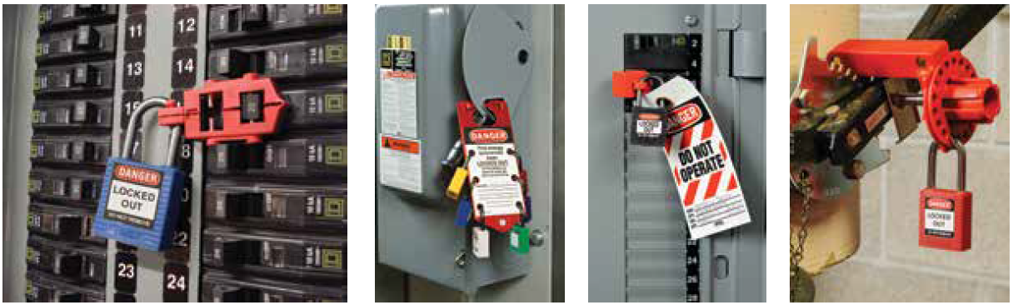
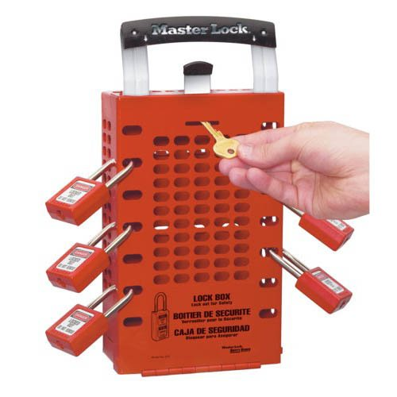
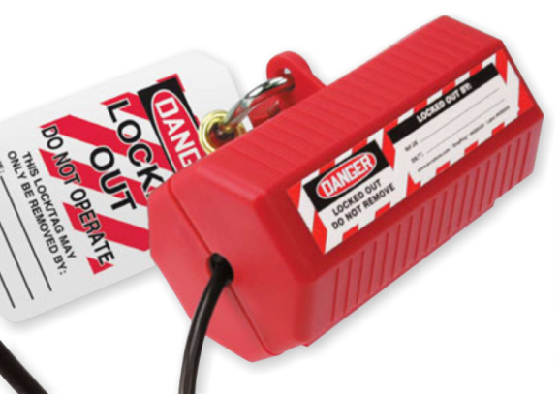
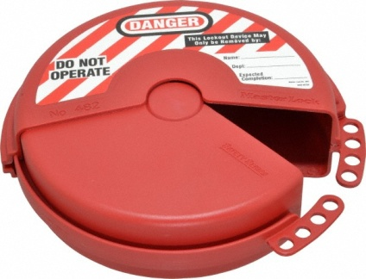
LOTO Equipment
Make sure you have the right equipment for the job
  Have your supervisor provide it before starting the job
Key
  Each worker has their own key and it must not be duplicated
Lock and tag
  Single lock and tag for single worker
Hasp lock
  Allows multiple workers to add LOTO
  Cannot be removed until the last worker has finished working on the system
Lock box
  Allows multiple workers to add LOTO
  Single LOTO at hazardous energy source, key is placed in box and individual locks placed on box
Valve locks
  Goes on valves or taps
Power cord lock
  Plug is placed inside and locked

Slide 8
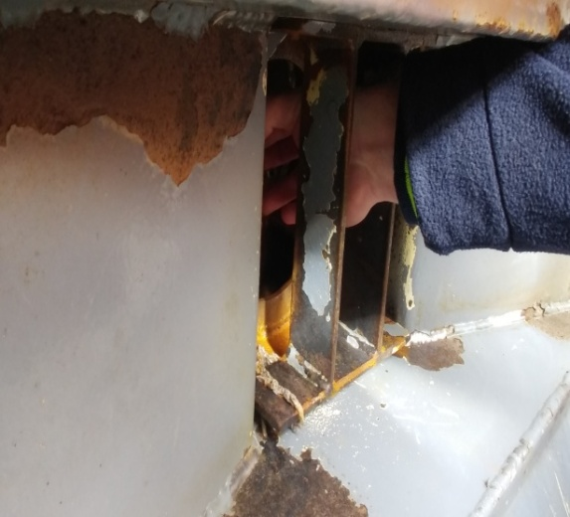
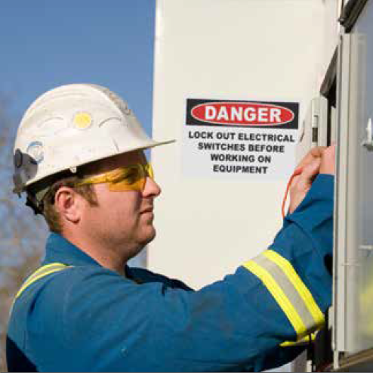
Who should complete LOTO?
The person most likely to be harmed by the hazardous energy source
All people working on the system should apply their own LOTO
Task supervisor
If you’re swapping shifts, take your lock off, and have the new person apply their own
If you can’t complete your own LOTO you need to verify the existing LOTO is in place
  Checklists
  Visual Inspection
  Point and confirm
A competent person needs to sign the LOTO Permit

Slide 9
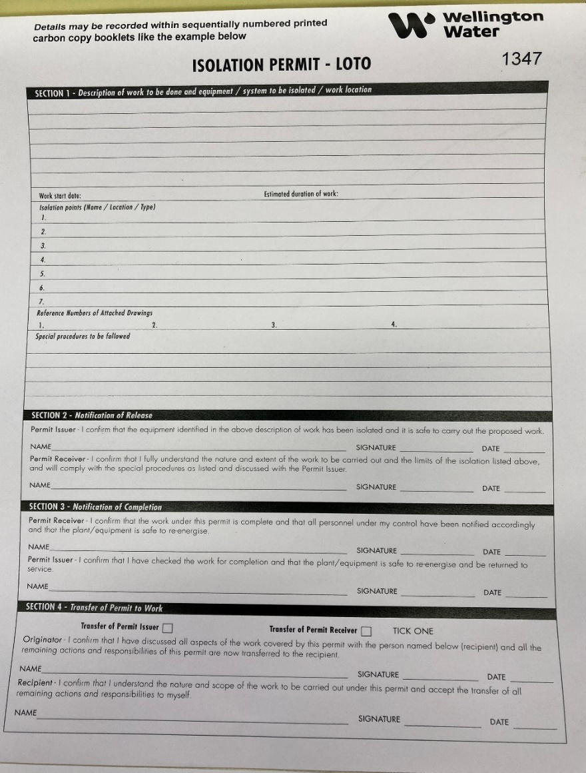
Isolation Permit
List the work being undertaken, the equipment being isolated, and any other procedures
Link the LOTO Permit to other permits and your RCP
Discuss the permit and all work with everyone taking part
If the permit issuer is unable to close the permit it must be transferred to another permit issuer using the section on the isolation permit.
If Isolation point is unable to be locked out, another control must be used in conjunction with the lock out tag to reduce the risk of the point being switched back on. This control must be noted on the permit or Risk Control Plan.

Slide 10
Who can remove LOTO?
LOTO can only be removed by the worker that put it in place
In the event that locks/tags, are inadvertently left in place by the worker, these shall only be removed after
the Team Leader has undertaken a thorough investigation of the whereabouts of the lock owner, the
person’s identity, and permission is given to remove the lock on their behalf.

Slide 11
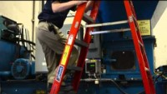
What happens of LOTO isn’t applied?

Slide 12
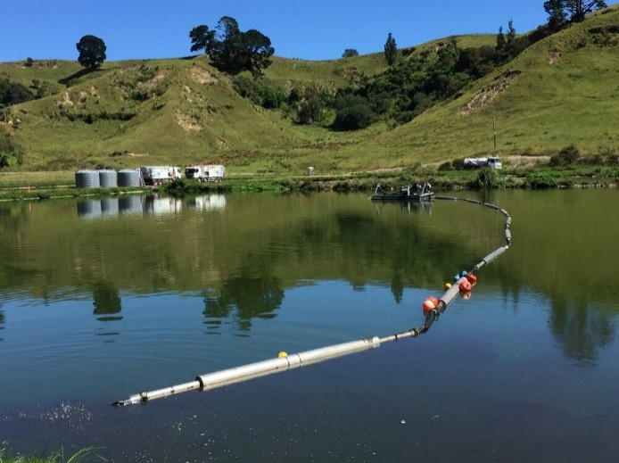
What happens when LOTO isn’t applied?
Sludge dewatering equipment
The dredge (right) became clogged and was pulled to shore to remove the debris
The machine was switched off on the controls – no LOTO
While the workers hand was unclogging the machine (left) he heard the motor start to turn on.
Thankfully he was familiar with the machinery and was able to pull his hand out in time
The outcome could have been much worse

Slide 13
What happens when LOTO isn’t applied?
Wellington Water Examples
Moa Point WWTP – “Unclear details on 'Do not operate' lock out tag, lock had to be cut off to put equipment back on-line.”
Seaview WWTP – “Observed 2 Milliscreen contrashear units locked out but with no identity tags attached.”
Pope St Pump Station – “During the installation of a hydrant at pope street pump station. No LOTO was conducted as apart of the shutting and opening of valves and the shutdown of the pump station.”
Have there been any other times you’ve seen LOTO applied incorrectly, or not applied at all?

Slide 14

Conclusions
LOTO is an important process to protect yourself, and your workmates
Use the correct tools to Lock Out and Tag Out hazardous energy
Each worker should have their own lock applied
Each worker can only remove their own lock

