Slide 1
Hazardous Substances Training

Slide 2
What you will learn
This training will cover
Classification
Exposure
Labelling
Safety Data Sheets
Signage
Storage
Emergency
Tracking
Wellington Water examples
Questions

Slide 4
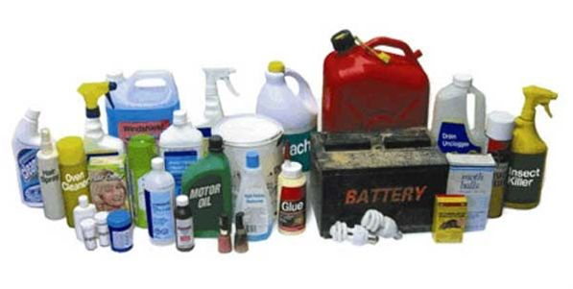
Overview
109 New Zealanders died in the workplace in 2019
Estimated 500 - 800 New Zealanders die from occupational illness every year
Approx. 220 related to asbestos
WorkSafe administers hazardous substance regulations
Previously carried out by Environmental Protection Agency
Hazardous substances are substances that are:
Explosive
Flammable
Oxidising
Toxic
Corrosive
Toxic To The Environment (Ecotoxic)

Slide 5
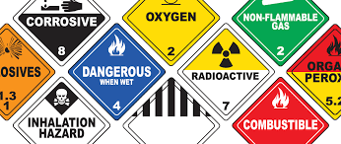
Why Hazardous Substances Training
Health and Safety at Work (Hazardous Substance) Regulations 2017 came into force 1 December 2017
Hazardous Substances regulated by WorkSafe
Previously NZ Environmental Protection Agency
No longer require Approved Handlers
Being replaced with ‘everyone will be trained’

Slide 6
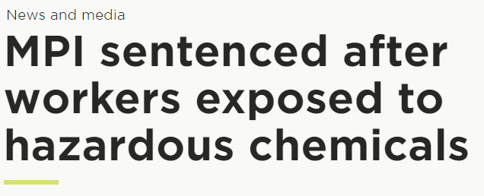
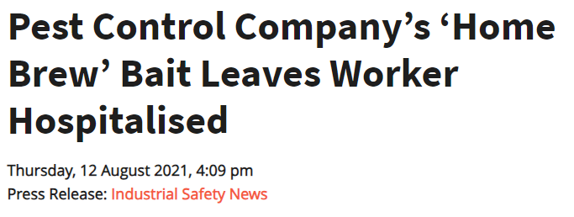

Slide 7
Classification
Hazardous substances are classified according to their hazardous properties, and often have more than one class (eg diesel is class 3,6 and 9).
The HSNO classes are:
Class 1 – Explosives
Class 2 – Flammable gases
Class 3 – Flammable liquids
Class 4 – Flammable solids
Class 5 – Oxidising substances
Class 6 – Substances toxic to people
Class 8 – Corrosive substances
Class 9 – Substances that are toxic to the environment

Slide 8
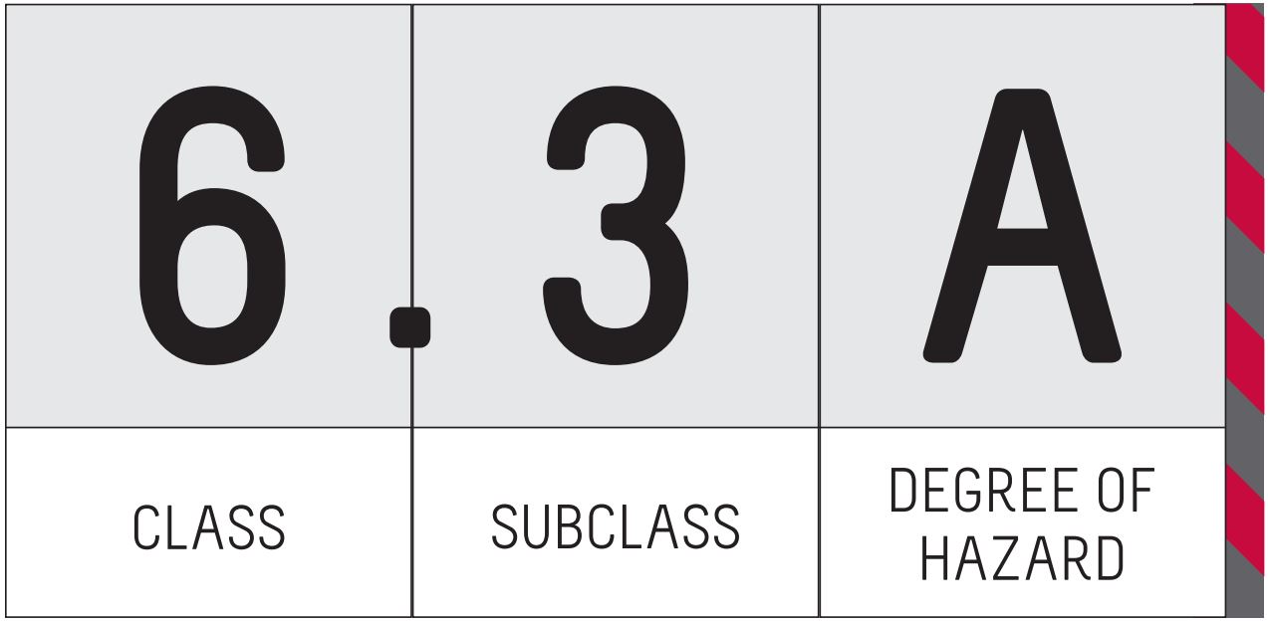
HSNO Classification System
The HSNO system uses numbered classes and subclasses to indicate the hazardous properties of a substance
For example, for a substance classified as 6.3A
6 is the class, which indicates the substance is toxic to people
3 is the subclass, which indicates the type of toxicity, for example, irritating to the skin
The letter A indicates the degree of hazard, with A being the highest hazard
Therefore a hazardous substances classified as 6.3A is highly irritating to the skin

Slide 9
HSNO Classification System
Class 3.1 - Flammable Liquids
3.1A
Petrol
Aviation gas
3.1B
Methylated Spirits
3.1C
Kerosene
Turpentine
3.1D
Diesel
Class 6 - Toxic Substances
6.1 | 6.3 | 6.4 | 6.5 | 6.6 | 6.7 | 6.8 | 6.9
Acutely Toxic | Skin Irritant | Eye Irritant | Sensitisation | Mutagen | Carcinogen | Reproductive/ development | Target Organ

Slide 10
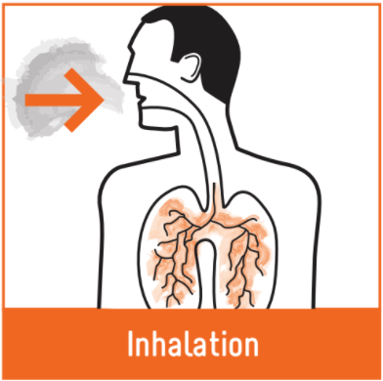
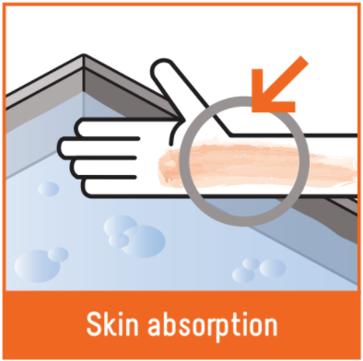
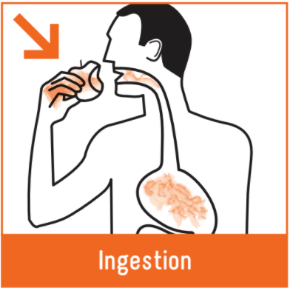
Exposure
Hazardous substances are bad for your health and can slowly kill you. They can get into your body three ways:
Inhalation is the most likely route of exposure (e.g. breathing in petrol).
Immediate effects from solvent exposure include headaches, forgetfulness, drowsiness, feeling dizzy and/or nauseous, irritability and mood changes, and irritation of the eyes, lungs and skin.

Slide 11
Exposure
Long-term effects can be serious and include:
Personality changes
Sleep disorders
Memory loss
Cancer
Damage to internal organs like the liver and kidneys
Damage to an unborn child
Fertility problems
Death

Slide 13
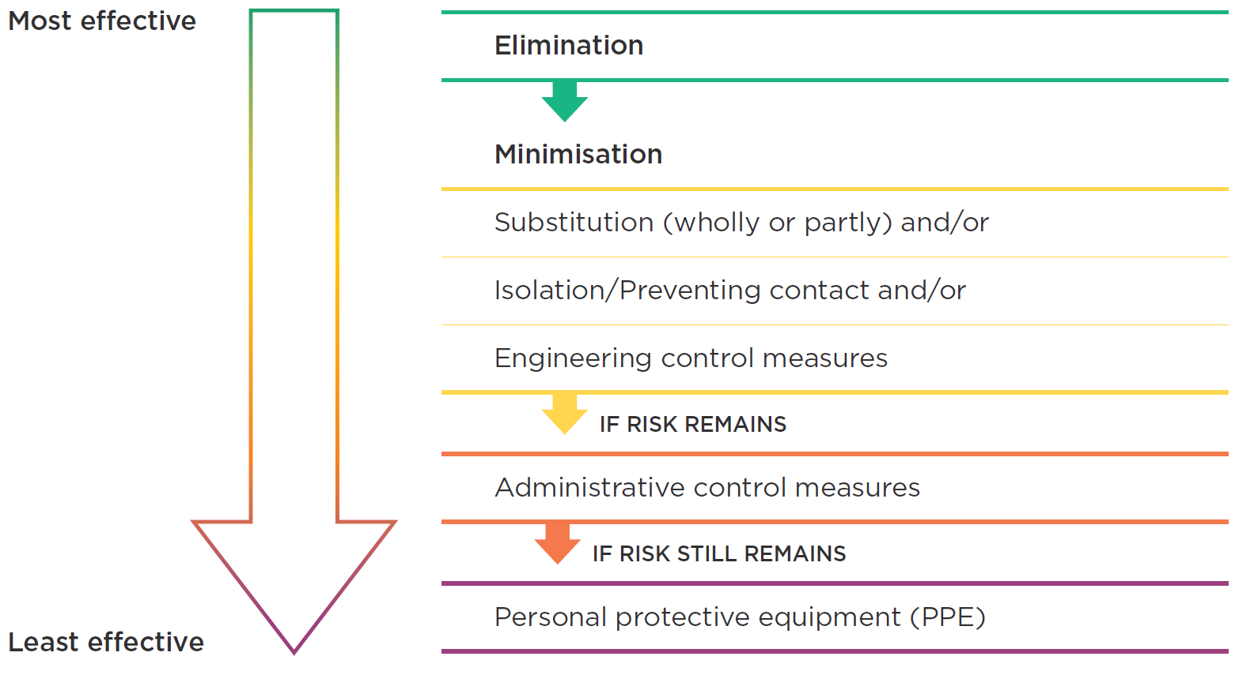
Controlling Exposure

Slide 14
Controlling Exposure
Personal Protective Equipment (PPE)
Neck to toe cover
Gloves
Safety glasses
Respirator
Must be appropriate for the substance

Slide 15
Labelling
Substances sold to Wellington Water must be correctly labelled
Substances used by Wellington Water must be correctly labelled
Substances stored by Wellington Water must be correctly labelled.
Labels must have an emergency contact
Pictograms
Flammable liquids | Toxic (acute, irritant, chronic | Corrosive | Environmental Hazard

Slide 16
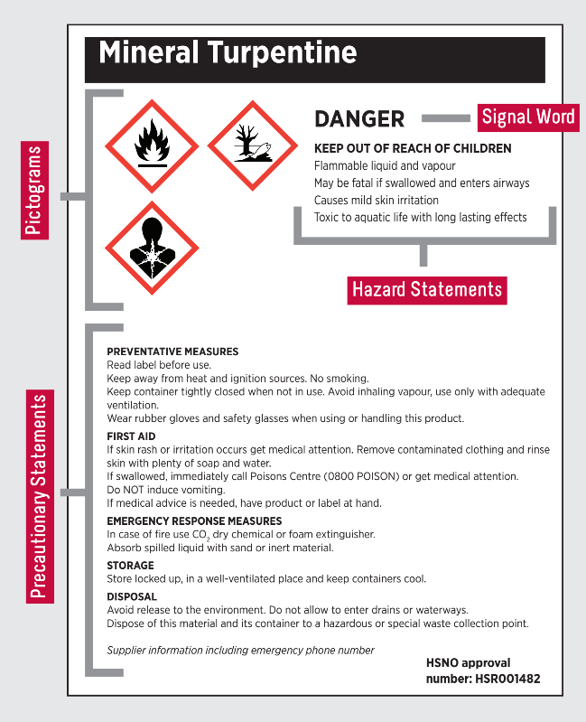
Labelling
Signal words
DANGER, WARNING, CAUTION, POISON
Hazard Statement
May cause skin irritation
Precautionary Statement
Use only outdoors or in a well-ventilated area
Wear nitrile gloves and safety glasses

Slide 17
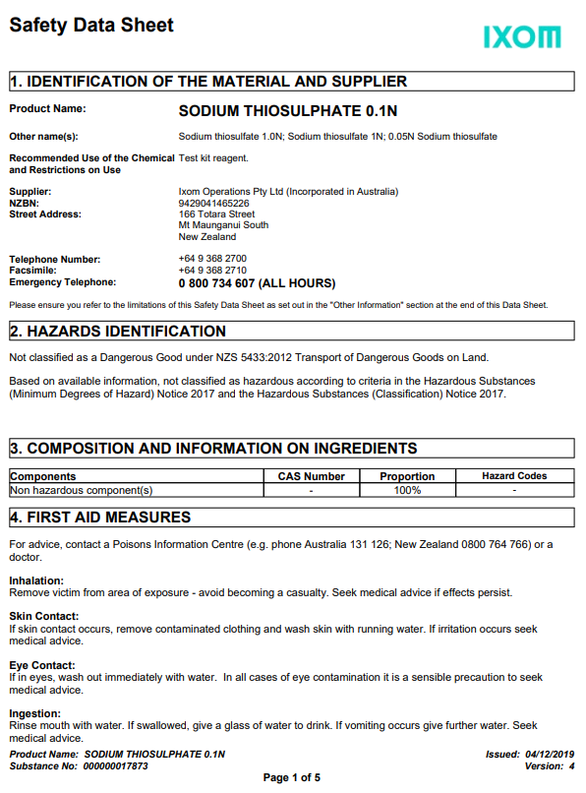
Safety Data Sheets
SDS (safety data sheets) are required under the HSNO Act, and Health and Safety at Work (Hazardous Substance) Regulations and must be produced within 10 minutes if asked
An SDS provides important information about the hazards of a
substance:
How to handle, store, transport and dispose of it safely
First aid information
PPE requirements
Emergency procedures

Slide 18
Signage
Above certain quantities, signs must be used for hazardous substances. Requirements depend on the hazardous property
It’s best to have signs even if trigger quantities are not met as emergency services rely on them
HSNO Class | Quantity
3.1A* – Extremely flammable liquid or vapour | 50 L
*Petrol, E10, Avgas (includes slops) | 250 L
3.1B – Highly flammable liquid or vapour | 250 L
3.1C – Flammable liquid or vapour (e.g. kerosene) | 1000 L
3.1D – Combustible liquid (e.g. diesel) | 10 000 L
8.2B – Corrosive liquid | 250 L or 250 kg
9.1A – Very toxic to aquatic life | 100 L or 100 kg
9.1B, 9.1C – Toxic, or harmful to aquatic life | 1000 L or 1000kg

Slide 19
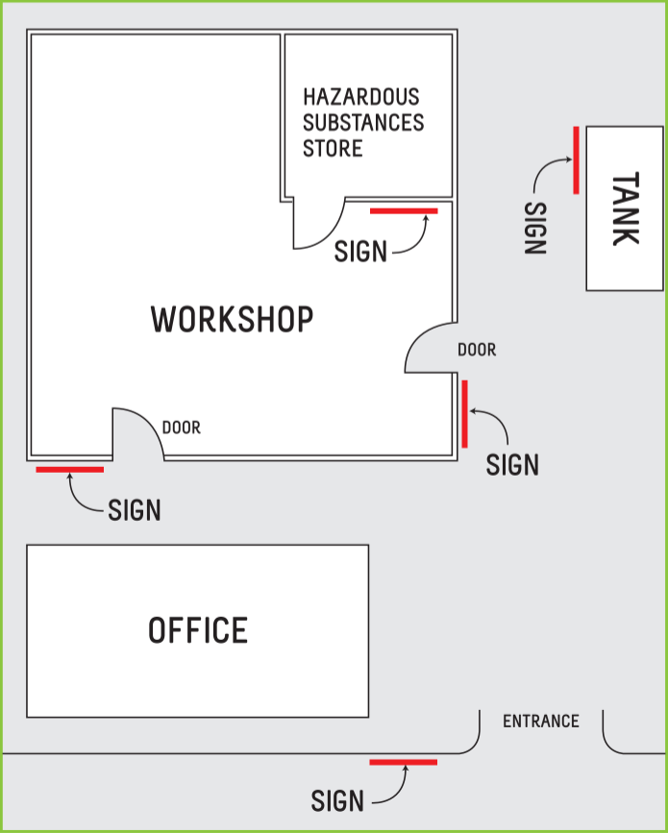
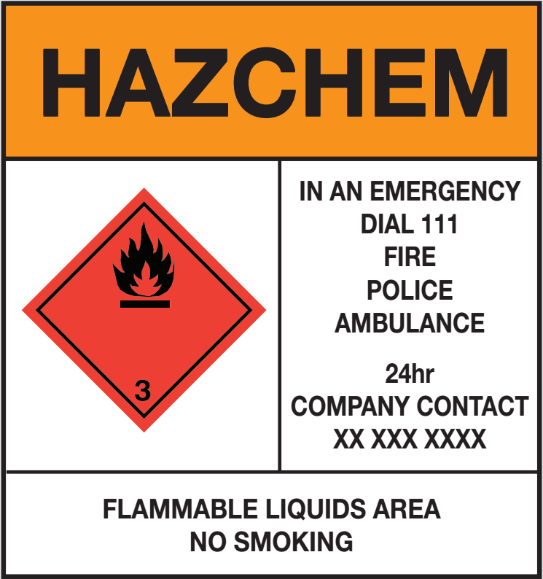
Signage
There are specific requirements for what must be on signs and where they are located
The H&S team can help with this

Slide 21
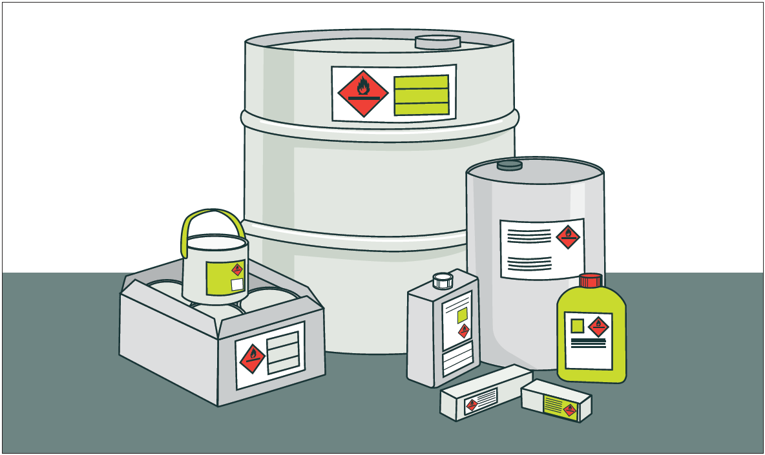
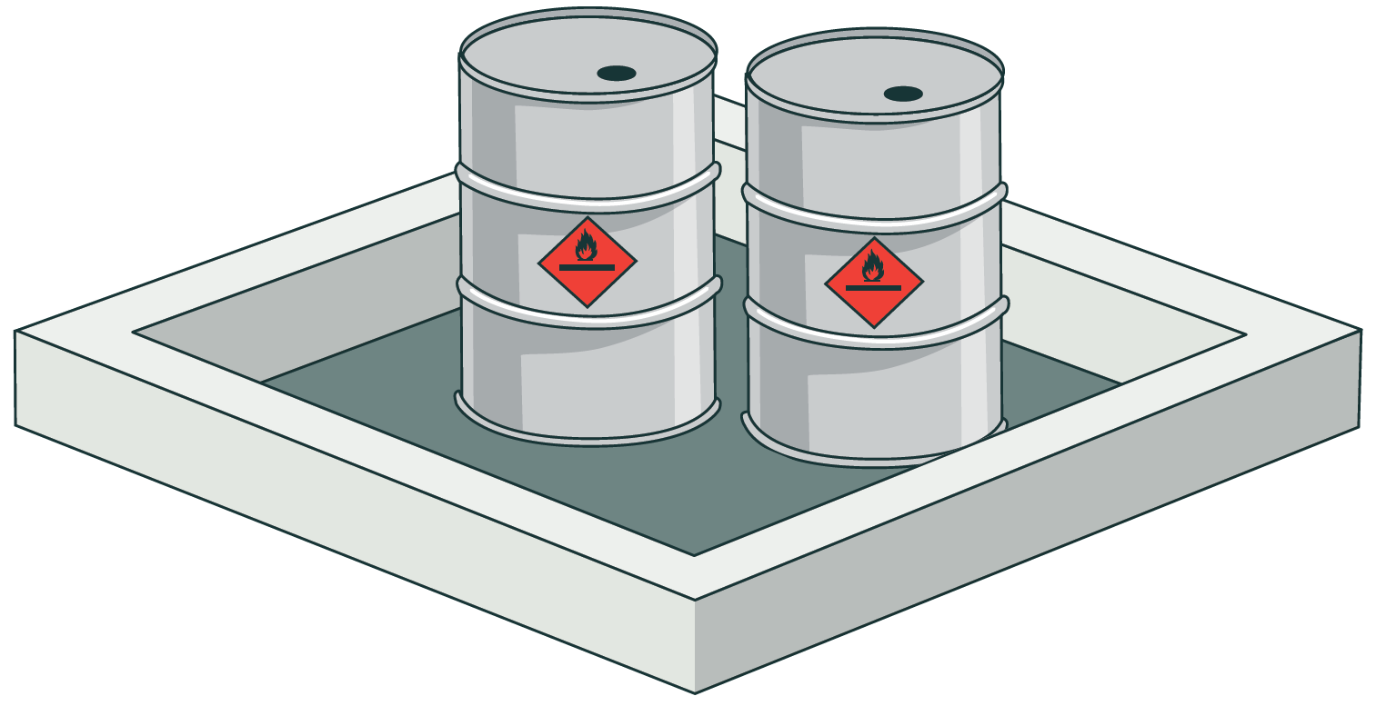
Storage
Hazardous substances must be stored in a way that reduces their chances of accidental release
Customer supplied containers are best for this
NEVER store them in food or drink containers
Check SDS for special requirements
Incompatibilities
Containers must be labelled
Including waste containers
Test certificate

Slide 22
Storage - Incompatibility
When incompatible hazardous chemicals come into contact with each other, the chemicals can react to cause:
Fire
Explosion
Toxic, Flammable Or Corrosive Vapours
Segregation is 3 m* or more horizontally
Must not be stored vertically
*5 m for oxidisers (e.g. sodium hypochlorite in solid form)
If in doubt check the SDS
Class | 3 | 6.1 | 8 | 9
3
6.1
8
9
 | These substances are generally compatible
 | These substances are compatible except where they are acidic and alkali
 | These substances are generally not compatible

Slide 23
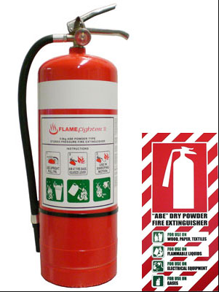
Emergency Prepardness
Know what to in an emergency
All offices, plants, and depots using or storing hazardous substances have a plan
Have the appropriate emergency equipment in the right places
First aid kits
Fire extinguishers
Use the right one for the right job
Only use when safe to do so
Spill kits

Slide 24
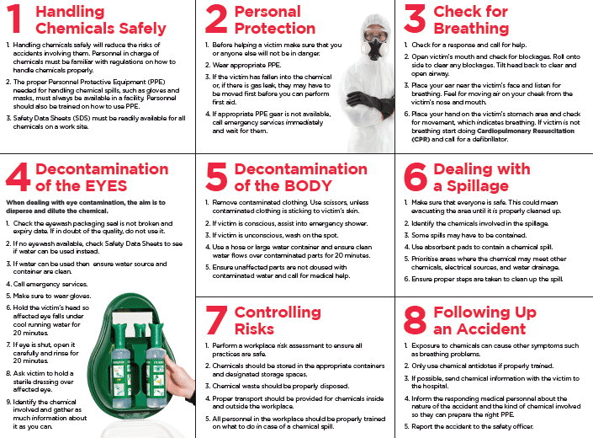
First Aid

Slide 25
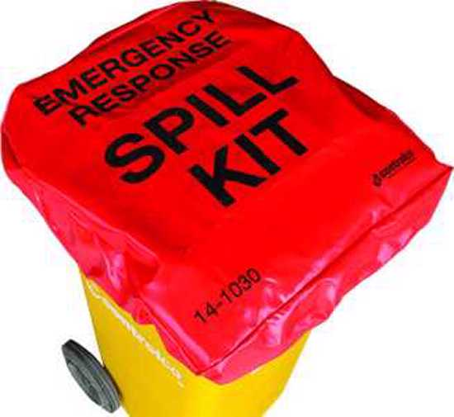
Spill Response
Learn the location of spill kits in your workplace
Ensure they are topped up with the relevant supplies
Stop and assess the situation
Identify the substance and assess the risk
Seek help if you need it - let the site manager know
Protect yourself - use PPE
Shut off the source if safe to do so
Contain the spill and protect drains
Clean up the spill
Bag, label and dispose of it appropriately
Refill the spill kits and report the spill

Slide 26
Wellington Water Hazardous Substances

Slide 27
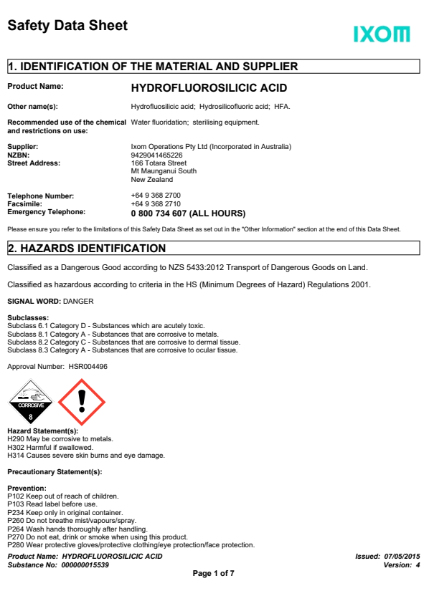
Hydrofluorosilicic Acid
Also known as "Liquid Fluoride“
PPE:
• Chemical goggles
• PVC gloves (long)
• Impervious coveralls
• Face shield
• PVC Safety Gumboots
• If risk of inhalation exists self-contained breathing apparatus (SCBA) or
Air-line respirator
Incompatibilities
• Hydroflourosilicic Acid
• Hydrochloric Acid
• Citric Acid
• Activated Carbon
Notes:
Click ctrl and the SDS picture to bring up the SDS sheets

Slide 28
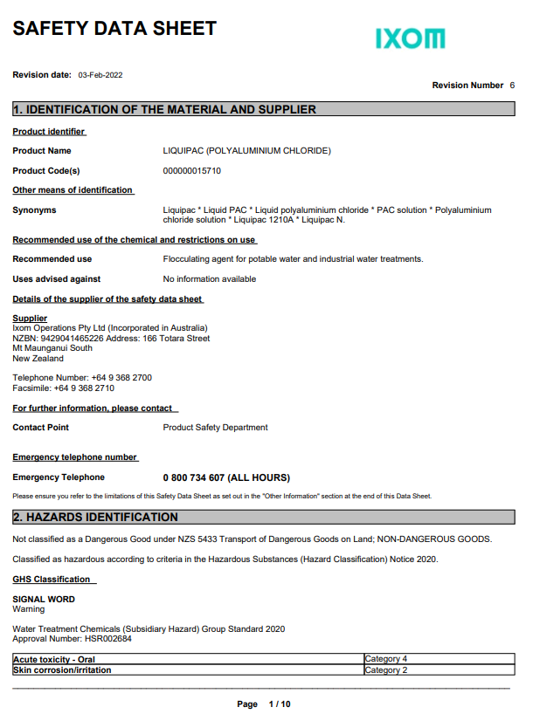
Poly-aluminium Chloride
PPE:
• Impervious coveralls
• Safety shoes
• Chemical goggles
• Gloves
Incompatibilities
• Calcium Hypochlorite
Notes:
Click ctrl and the SDS picture to bring up the SDS sheets

Slide 29
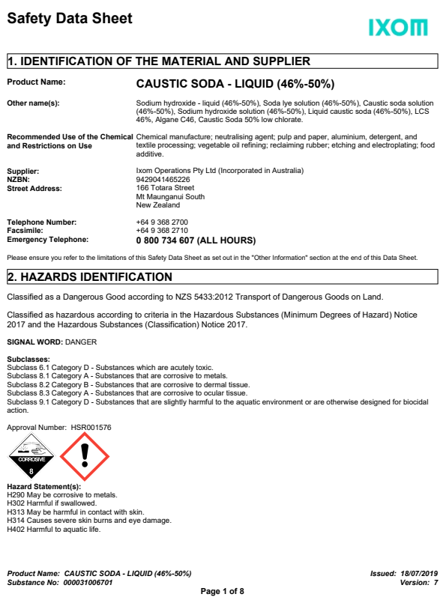
Caustic Soda
PPE:
• Chemical goggles or safety glasses with eye shields
• PVC gloves (long)
• Respirator with appropriate filter
• Impervious coveralls
• PVC Safety Gumboot
Incompatibilities
• Hydroflourosilicic Acid
• Hydrochloric Acid
• Citric Acid
Notes:
Click ctrl and the SDS picture to bring up the SDS sheets

Slide 30
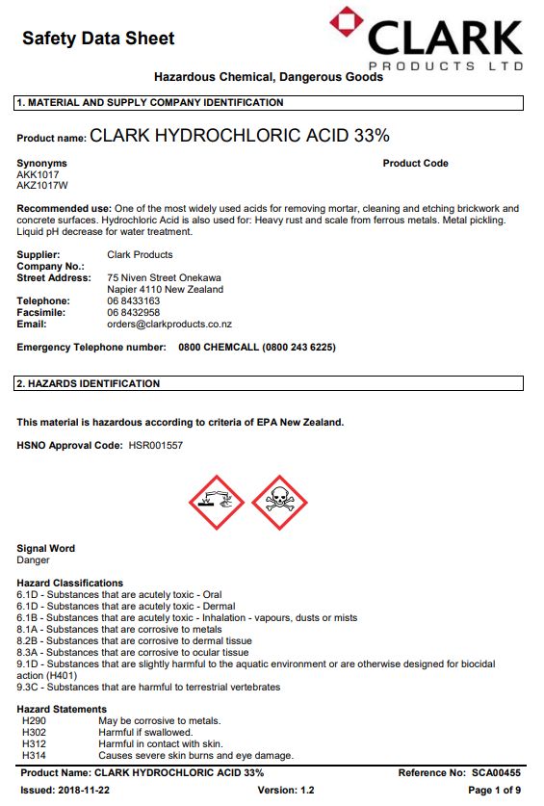
Hydrochloric Acid
PPE:
• Chemical goggles or safety glasses with eye shields
• PVC gloves (long)
• Impervious coveralls
• PVC Safety Gumboots
• Respirator with vapour/mist filter for acid
• Face shield [if not using SCBA]
Incompatibilities
• Calcium hydroxide
• Sodium hydroxide
• Sodium Hypochlorite
• Sodium Fluorosilicate
Notes:
Click ctrl and the SDS picture to bring up the SDS sheets

Slide 31
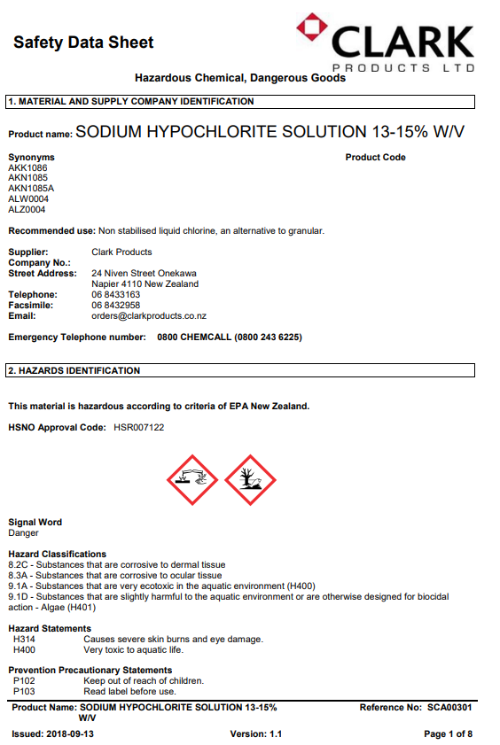
Sodium Hypochlorite
PPE:
• Chemical goggles
• PVC gloves (long)
• Impervious coveralls
• Face shield
• PVC Safety Gumboots If risk of inhalation exists
• Self-contained breathing apparatus (SCBA) or Air-line respirator
Incompatibilities
• Hydroflourosilicic Acid
• Hydrochloric Acid
• Citric Acid
• Activated Carbon
Notes:
Click ctrl and the SDS picture to bring up the SDS sheets

Slide 32
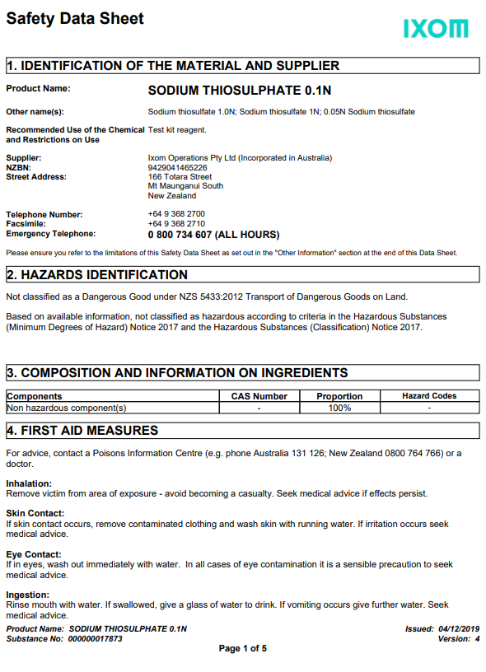
Sodium Thiosulphate
PPE:
• Safety glasses
• Gloves
Use:
In water treatment, sodium thiosulphate is used to dechlorinate tap water including lowering chlorine levels for use in aquariums, swimming pools, and spas (e.g., following superchlorination) and within water treatment plants to treat settled backwash water prior to release into rivers. The reduction reaction is analogous to the iodine reduction reaction.
Notes:
Click ctrl and the SDS picture to bring up the SDS sheets

Slide 33
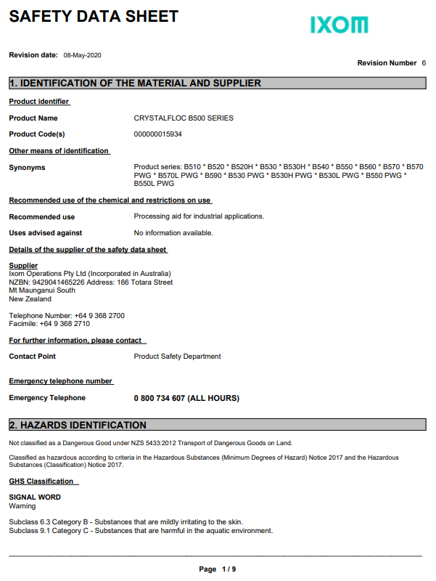
Crystal Floc B570
PPE:
• Impervious coveralls
• Safety shoes
• Safety glasses
• Gloves
• Dust mask
When spilt, this can be very slippery, so it needs to
be thoroughly cleaned up
Notes:
Click ctrl and the SDS picture to bring up the SDS sheets

Slide 34
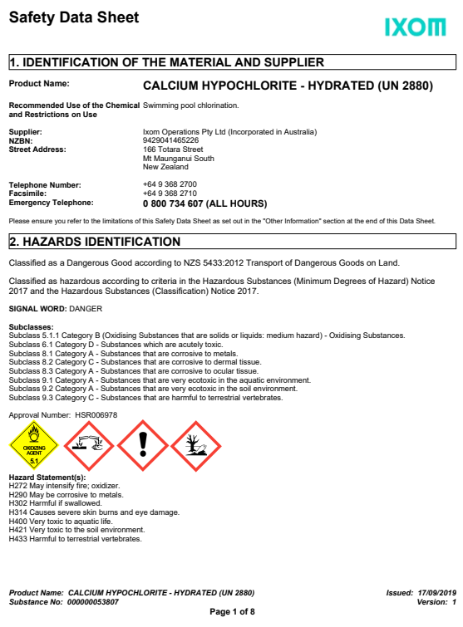
Calcium Hypochlorite
PPE:
Rubber boots
Overalls
Gloves
Apron
Chemical goggles
Respirator
WARNING: To avoid a severe reaction, ALWAYS add
material to water and NEVER water to material.
Notes:
Click ctrl and the SDS picture to bring up the SDS sheets

Slide 35
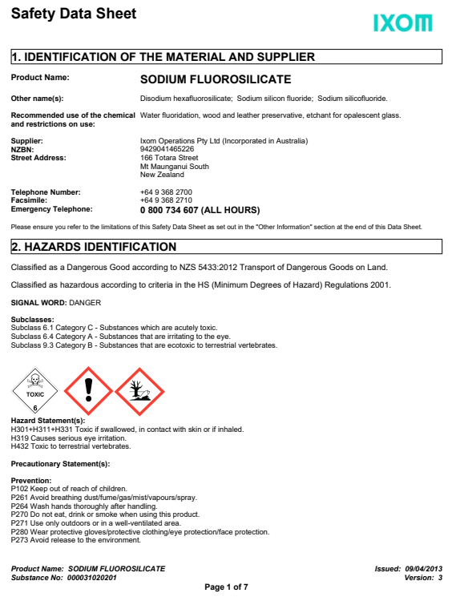
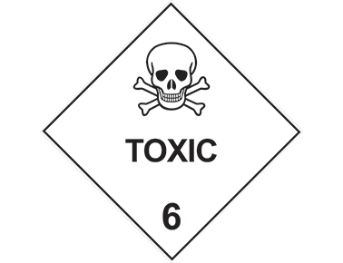
Sodium Silicofluoride
PPE:
• Chemical goggles
• PVC gloves (long)
• Impervious coveralls
• PVC Safety Gumboots
• Respirator with appropriate filter
Incompatibilities:
• Hydroflourosilicic Acid
• Hydrochloric Acid
• Citric Acid
Notes:
Click ctrl and the SDS picture to bring up the SDS sheets

Slide 36
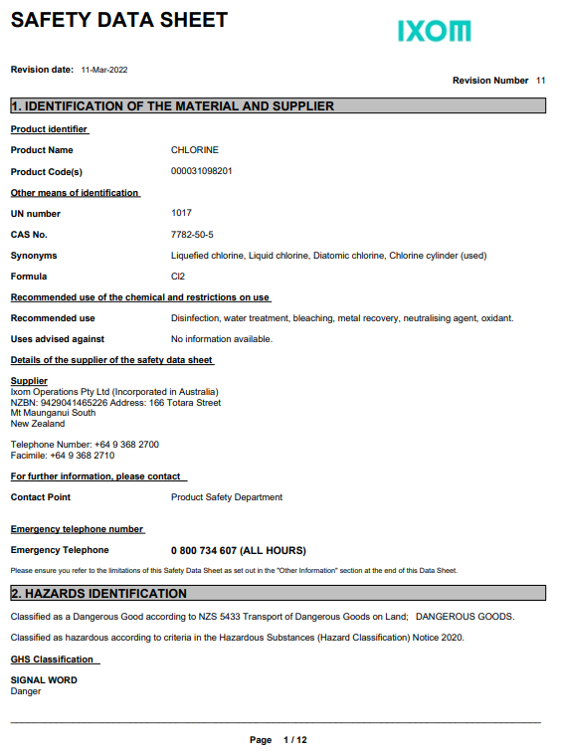
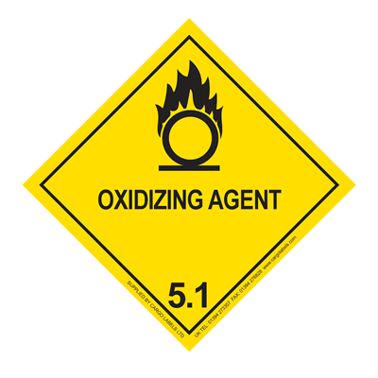
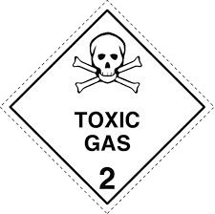
Chlorine Gas
PPE:
• Chemical goggles
• PVC gloves (long)
• Impervious coveralls
• PVC Safety Gumboots
• Faceshield [if not using SCBA] If risk of inhalation exists
• Self-contained breathing apparatus (SCBA) or
Air-line respirator
Incompatibilities:
• Acetylene
• Diesel
Notes:
Click ctrl and the SDS picture to bring up the SDS sheets

Slide 37
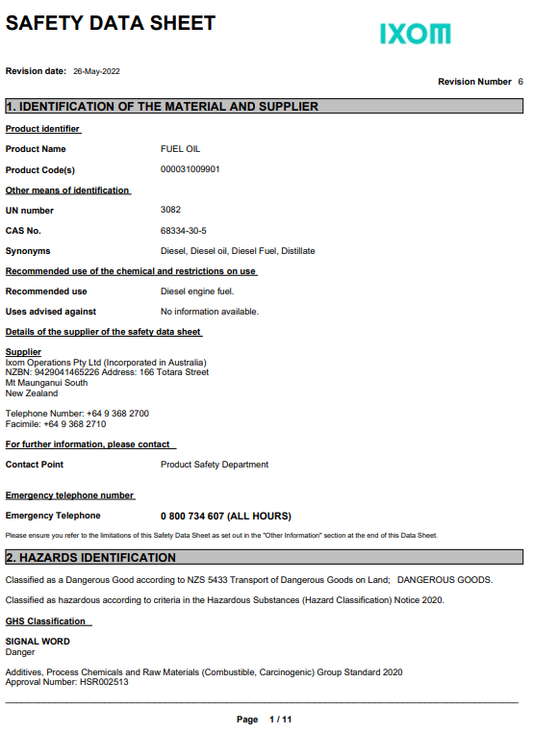
Diesel
PPE:
• Safety glasses
• PVC gloves (long)
• Impervious coveralls
• PVC Safety Gumboots
Incompatibilities:
• Chlorine
Combustible, may be harmful (acute), mild skin irritant, suspected
carcinogen (chronic), hazardous to the aquatic environment
Hard to ignite, but can fuel already burning fires or create vapour
Notes:
Click ctrl and the SDS picture to bring up the SDS sheets

Slide 38
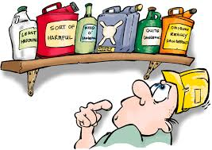
Other chemicals and hazardous substances
Sprays, paints, lubricants, adhesives, cleaners
Often flammable and toxic ​
Keep away from ignition sources​
Use in well-ventilated areas​
Outdoors​
Mechanical ventilation​
Wear PPE​
Gloves​
Safety glasses​
Respirator

Slide 39
Key Learnings
Read the SDS before using for the first time
Familiarise yourself with:
Hazards
Controls
PPE requirements
Emergency response
Know what you are working with
Always have the SDS available
(Electronically is OK)
Before starting work
Check all PPE
Right PPE for the right job and substance
Check equipment
Check containers no leaks, appropriate for substance
Hazardous substances are inherently dangerous but can be handled, used, and stored safety in proper controls are used.
Any questions check with supervisor or the health and safety team
Only work if it is safe to do so

Slide 40
Any Questions?

Slide 42
NOTES FOR CHANGES
Add picture etc of hazardous substances in situ at WWL
Spend more time on classification
More detail on what stuff can do to you - e.g., HFA, CL2, Fl2 becoming dusty - teaspoon or Sodium Fluoride can kill you
Blow up SDS to make it bigger
More detail on evacuation detail
Picture of ERP tube

