Slide 1
Health, Safety and Wellbeing Update
March 2024

Slide 2

Contents
Critical Risk Stats
Safety topic of the month
Wellbeing
WorkSafe updates

Slide 3
Critical Risk Stats
In February there were 46 reported critical risk related incidents, this is a decrease from January 2024 (50) and February 2023 (66)
Traffic/Pedestrian Movement is our highest reported critical risk this month with 19 reports, followed by Vehicles/Mobile Equipment at 12 reports.

Slide 4
Safety topic of the month
Aggression and Violence

Slide 5

Topic of the month – Aggression & Violence
Aggression and violence can cause serious harm to emotional, behavioural, and physical health. Not only does this impact individuals, but it can impact the team and the workplace
Violence can take many forms – ranging from physical assault and verbal abuse to intimidation and low-level threatening behaviour.
These behaviours usually come from the public however we can see them from our whānau, friends and colleagues.
Aggression and violence can have an impact on everyone, including those who may witness an incident.
There can be physical harm, but serious or persistent verbal abuse or threats can also have a serious effect on mental health.
Violence or threats of violence are never acceptable.

Slide 6
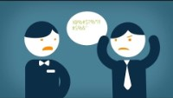
Topic of the month – Aggression & Violence

Slide 7

Topic of the month – Aggression & Violence
When someone's anger is escalating or they are being aggressive, they may not be able to think clearly or understand what will happen next. They may also not care about what happens as a result of their actions.
Avoid:
Touching the person
Confrontation or being seen as a threat. This includes avoiding standing above the person or making rapid movements towards them
Raise your voice or argue with them
Staring or glaring, which can be seen as threatening
Pointing, clenching your fists, or crossing your arms
Smiling or laughing excessively, as this can be confused as rudeness
Trust your instincts. If the situation does not feel safe, and de-escalation is not working, then get to safety and call your manager or police.

Slide 8

Topic of the month – Aggression & Violence
Wherever you work, here are some of the basic techniques you can use to calm situations down and prevent violence and aggression:
Be polite, use a calm voice
Be patient
Show you are interested, don’t cross your arms or look at your phone/watch
Turn a little side on to show you are approachable and non threatening
Maintain eye contact
Relax your posture, keep your arms by your side and use open palm gestures
Keep a safe distance, allow for personal space
Show empathy and acknowledge their feeling
If you encounter any aggression or violence, please remember to report it via Q-Pulse or See it, Report it. Our EAP providers (EAP Services for WWL and Raise Mental Health for FH) are also available.

Slide 9


Wellbeing Calendar

Slide 10

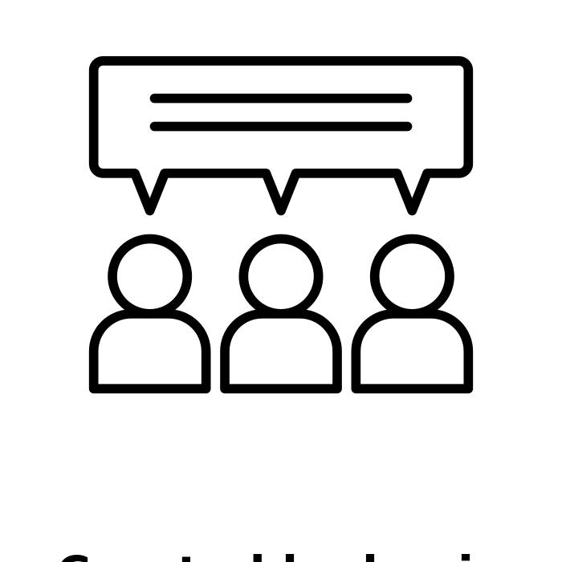
WorkSafe Updates
Woman looses lower leg after being struck by a forklift
A woman was waiting to collect whiteware from Trade Depot when she was struck by a forklift suffering injuries so severe, her left leg had to be amputated
Trade Depot was found to have no effective traffic management plan in place to keep moving vehicles and pedestrians separate
WorkSafe also found the lights on the forklift were not working at the time of the incident
Apprentice builder killed by falling framing
An apprentice builder was killed when timber framing fell on him at a building site in March 2022
The victim was tasked to move the framing but was not given the tools to do so safely
The supplier delivering the framing had a hiab and could have lifted it into place, avoiding the tragic death
See other WorkSafe updates here
Discussion point:
Are we managing forklifts and other traffic on our sites effectively?

