Slide 1
October 2024

Slide 2
Critical Risk Stats
In September there were 21 critical risk related reports, this is an increase from September 2023 (12) and a decrease from August 2024 (33)
Mobile Plant & Equipment is our highest reported critical risk this month with 6 reports, followed by Hazardous Substances at 5 reports

Slide 3
Safety topic of the month
Working at Height

Slide 4
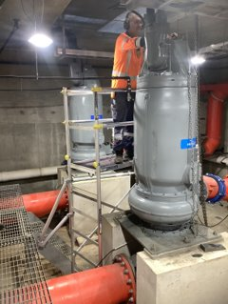
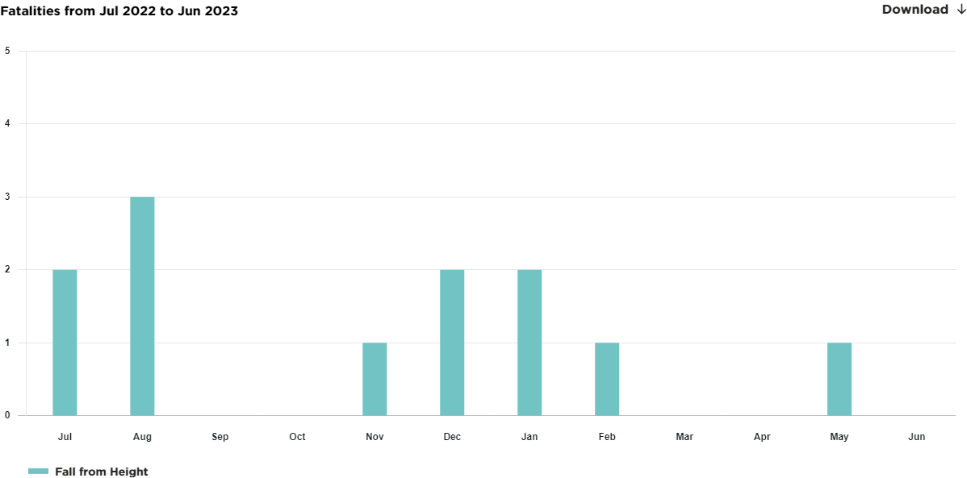
Working at Height
Working from any height, above and below ground level, where you can fall has the potential to cause significant injury or death
We should always try to prevent falls first. If we can't prevent them, we should use safety equipment to protect people from falling
Fatalities caused by “ Fall from Heights” July 22 – June 23 Fatalities WorkSafe New Zealand Fatalities Register

Slide 5
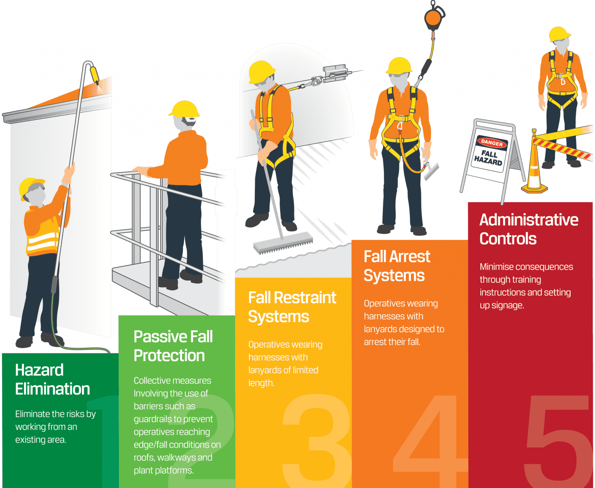
Working at Height – Controlling the Risk
Work at height means working in a place where a person could be injured if they fall from one level to another. This can be above or below ground level.
Avoid working at height whenever you can
If you have to work at height, or work where there is a risk of falling, make sure you put controls in place to keep yourself and other people safe.
Discussion points:
What tasks do you do that involve working where you can fall? What controls do you have in place?

Slide 6
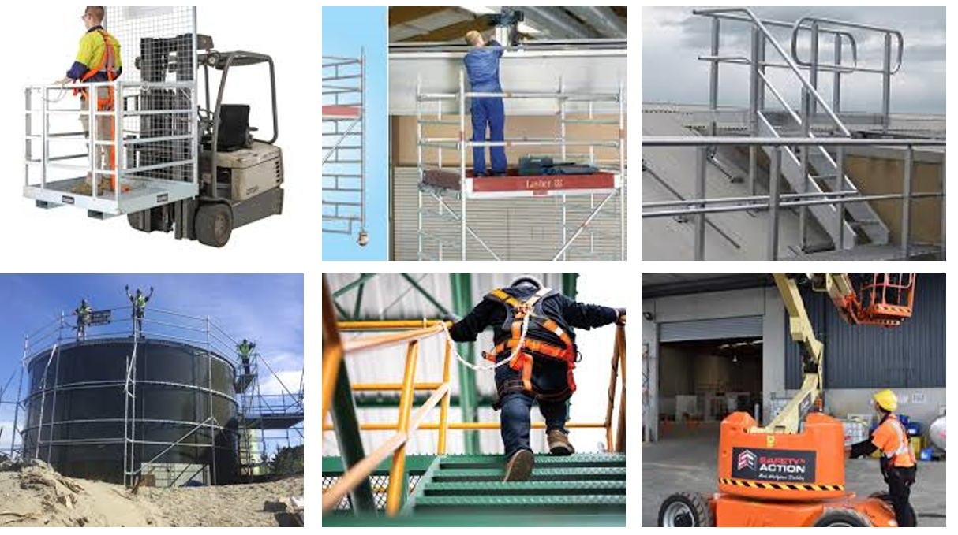
Working at Height – Fall Protection
Fall protection can take a number of forms including:
Edge protection systems
Guardrails
Kickboards
Barriers
Scaffolding/Mobile Scaffolding
Mobile elevating work platforms (MEWPs)
Forklift Safety Cage/Man Cage
Fall arrest systems
Fall restraint systems
Training, inspection and equipment maintenance are critical for these control measures to be effective.

Slide 7
Working at Height - Training
Training & Administrative controls include risk control plans, permits to work, work instructions, risk assessments, excavation checklists, fall prevention procedures, training in the use of EWP’s, harnesses, scaffolding and retrieval equipment, PPE fall arrest and lanyard systems
Doing nothing is not an option
If you need any training speak to your Team Leader or Manager

Slide 8
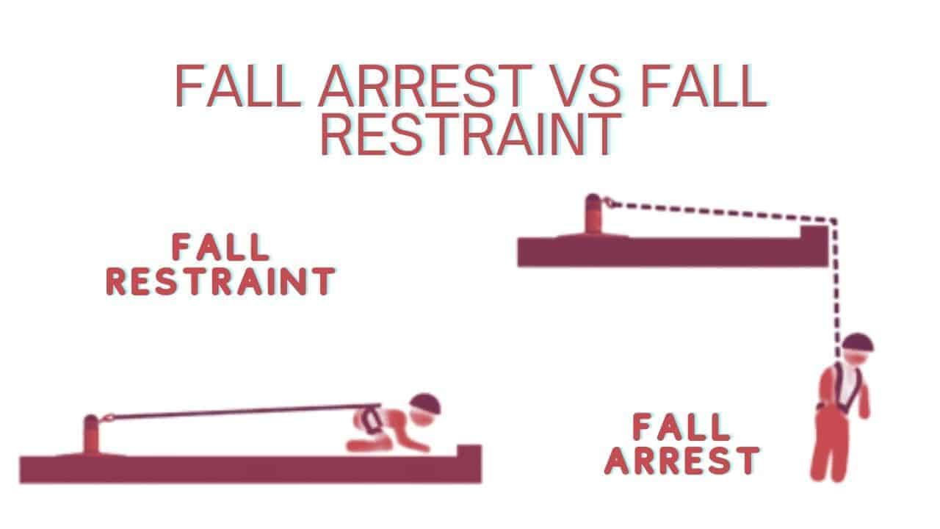
Working at Height – Fall Arrest and Fall Restraint
A fall restraint system is designed to prevent a worker from falling.
A fall arrest system is designed to support and hold a person in the event of a fall.
It typically consists of a harness, lifeline, and anchor point.
Fall arrest systems should only be used if you can’t eliminate the risk of a fall.
These may include a personal safety harness, rope access system, industrial rope system, travel restraint system, or a catch platform.
Discussion points:
Have you got a harness or lanyard? Is it in good condition?
Take a moment to check your training – in need of a refresher?
All equipment must be currently certified and inspected prior to use.
All operators must have the right training for the task.
Equipment that is damaged or fails inspection for any reason must be locked and tagged out and removed from service.

Slide 9
Topic of the month – Working at Height

Slide 10
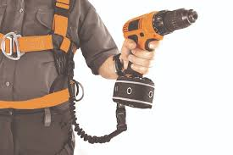
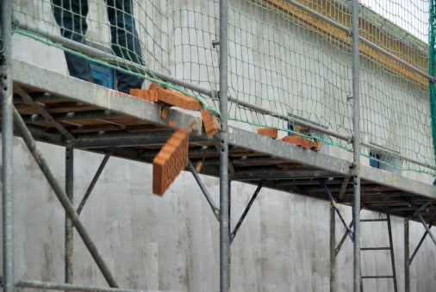
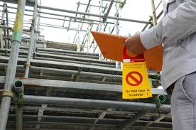
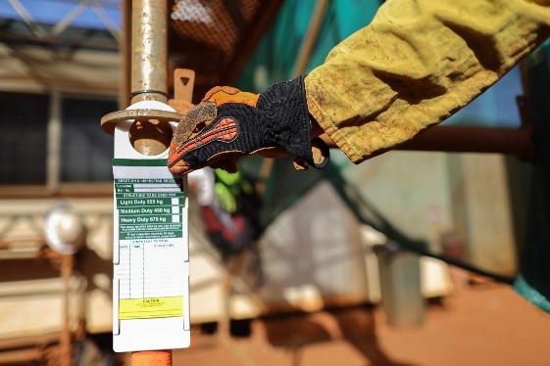
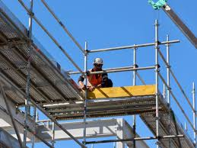
Working at Height – Scaffolding and Tools
Scaffolds less than 5m must be built by an experienced competent person in scaffolding.
Any scaffold greater than 5m must be built by a qualified scaffolder.
All scaffolds must have a “Scaff Tag”- attached after completion and must be inspected. A Scaff Tag is internationally used and recognized.
Controls must be in place to ensure that objects/tools cannot fall and injure someone when working at height.
These controls may include:
Kickboards to prevent falling objects
Exclusion Zones
Lanyards, tool tethers or drop ropes on tools
Store materials/equipment securely to prevent movement
Discussion points:
Did you know an object with a mass of 1kg becomes fatal to a person when dropped around 10 meters.
A can of spaghetti weighs 420grams
Don’t forget:
Any work where there is a risk of falling 5 metres or more must be notified to WorkSafe

Slide 11
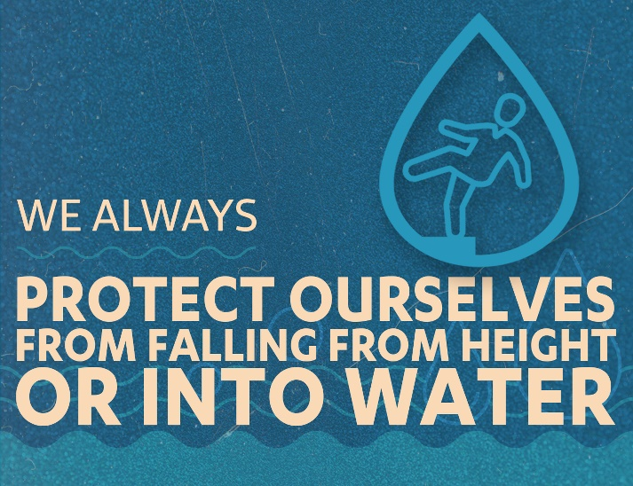
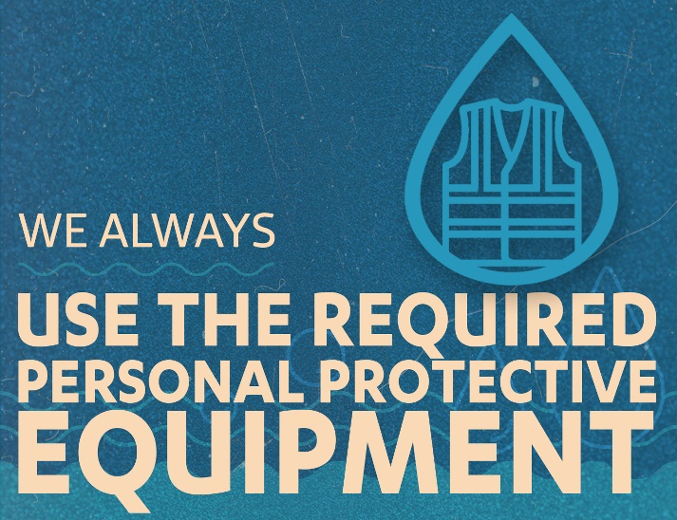
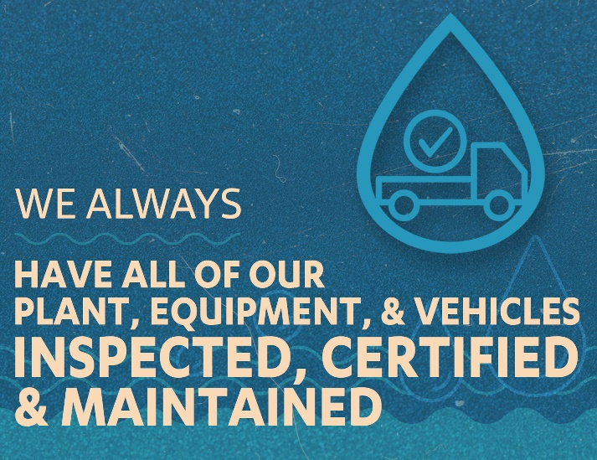
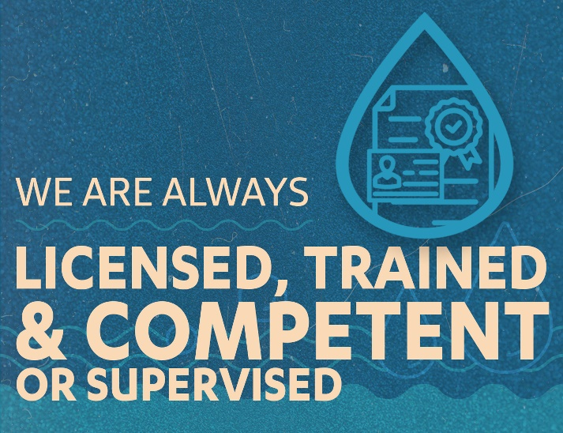
Working at Height – Life Saving Actions
For more information on working at height check out the WorkSafe guidelines here
For more information on scaffolding check out the WorkSafe guidelines here

