Slide 1
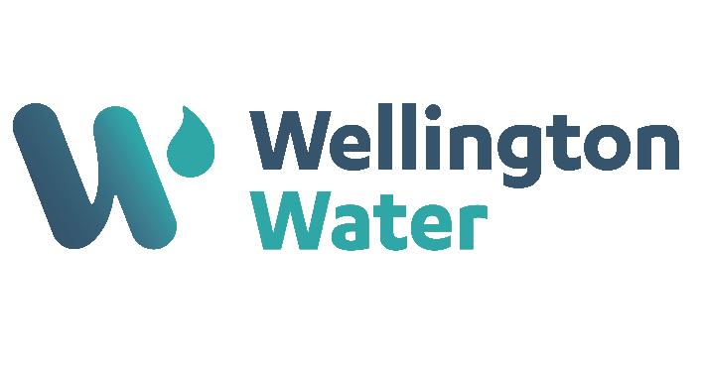
May 2024

Slide 2
Critical Risk Stats
In April there were 43 reported critical risk related incidents, this is a decrease from March 2024 (55) and a decrease from April 2023 (57)
Vehicles/Mobile Equipment is our highest reported critical risk this month with 13 reports, followed by Traffic/Pedestrian Movement at 11 reports.

Slide 3
Safety topic of the month
Mobile Plant and Equipment

Slide 4
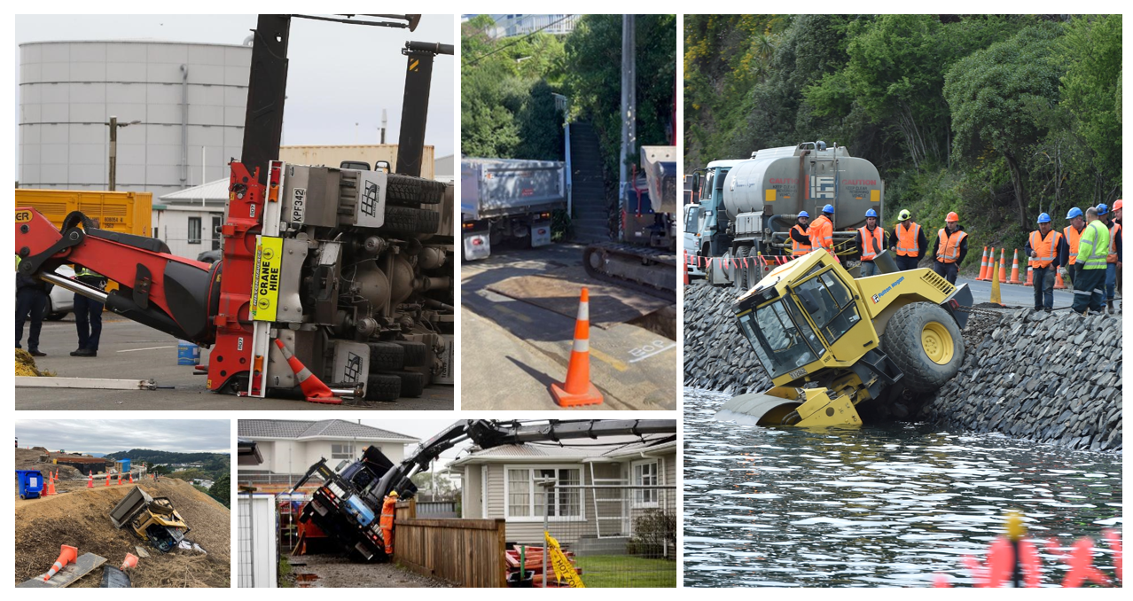
Topic of the month – Mobile Plant and Equipment
Mobile plant and equipment can be a major cause of significant harm on site.
Everyone needs to ensure we are controlling the risks involving Mobile Plant and Equipment so that no one in our Wellington Water whānau gets hurt.

Slide 5
Danger Zones and Blind Spots

Slide 6
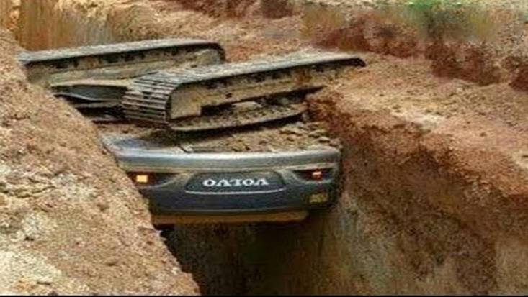
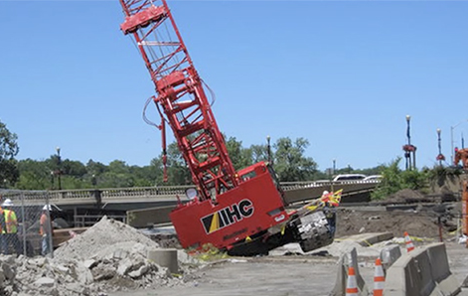
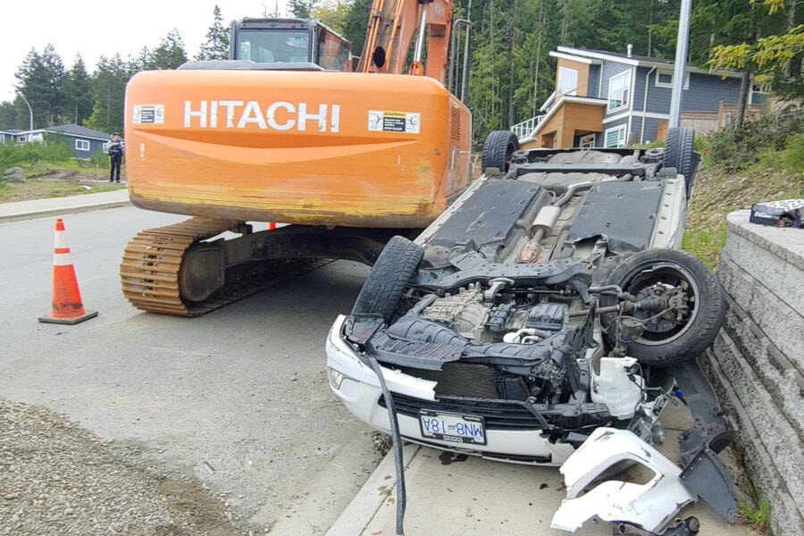
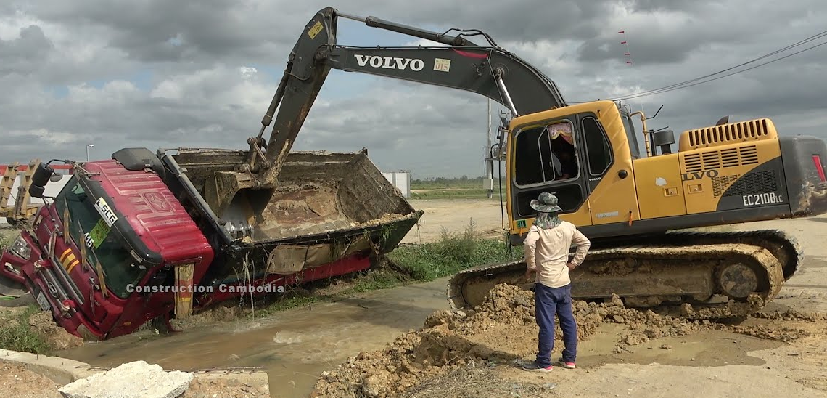
Topic of the month – Mobile Plant and Equipment
Uncontrolled movement to, from, and within the worksite
Mobile plant can move unexpectedly at any time, not just forward and backward but also move up, down, out, swing around, slew, pivot or extend in many different directions.
People using mobile plant in an unsafe manner
This includes exceeding safe speeds, exceeding load limits, or operating the equipment while under the influence of drugs or alcohol
Mobile plant operating on uneven surfaces or potentially unstable ground
This can lead to rollovers or other accidents
Multiple vehicles or mobile plant operating at the same time in the same area
This can create a lot of traffic and confusion, which can increase the risk of accidents
People and mobile plant sharing the worksite
People can be easily struck by or crushed by mobile plant

Slide 8
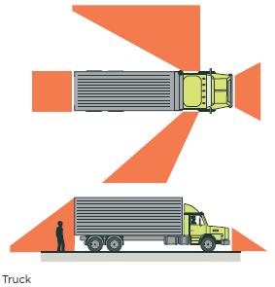
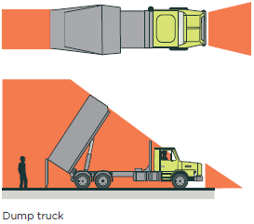
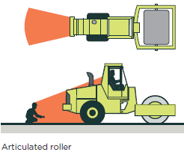
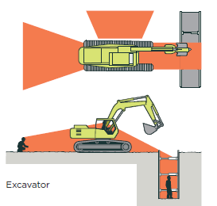
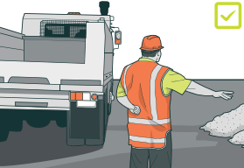
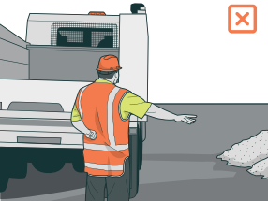
Topic of the month – Mobile Plant and Equipment
Keep Clear of the Gear
People will always come off second best vs. machinery
Always work where the operator can see you
Do not approach mobile plant when it is in operation
Stop work if you see someone enter a blind spot, or danger zone
Get the operators attention and make eye-contact

Slide 9
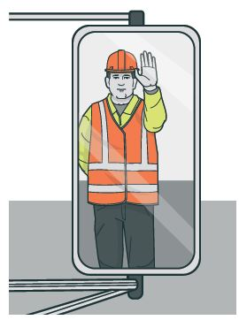
Topic of the month – Mobile Plant and Equipment
We always focus when operating and ignore distractions
We always do a prestart check
We always wear our seatbelt
We always use a spotter
We are always trained, licensed and competent
We always wear the correct PPE
If you see something that is unsafe, speak up and let the operator know.
Look out for yourself, your coworkers, and members of the public.

Slide 10
WorkSafe Updates
Workplace commits to spending $1.15m on safety
An uncontrolled release of geothermal steam happened at a Mercury power station in 2021
No one was hurt, but an investigation found there weren’t enough safety precautions in place
Mercury signed an agreement with WorkSafe, known as an enforceable undertaking, to improve safety
This includes:
Testing self-driving vehicles to inspect the station safely.
Leadership training to promote a strong safety culture.
Training for workers on how to spot hazards and stay safe in risky situations.
Sharing safety information with other companies in the industry.
See the April 2024 Energy Safety Business Update here and other WorkSafe updates here

