Slide 1
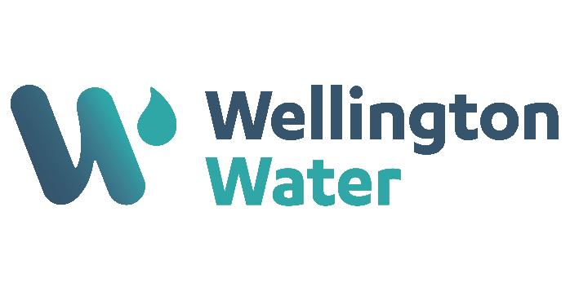
August 2024
Silverstream Pipe Bridge

Slide 2
Critical Risk Stats
In July there were 32 reported critical risk related incidents, this is a decrease from June 2024 (58) and July 2023 (78)
Hazardous Energy (Working with Services) is our highest reported critical risk this month with 11 reports, followed by Mobile Plant & Equipment at 7 reports.

Slide 3
Safety topic of the month
Working Around Water

Slide 4
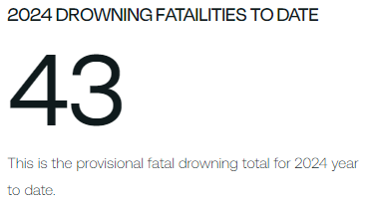
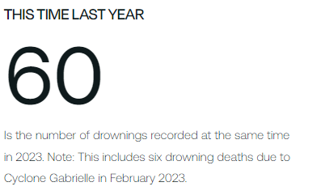
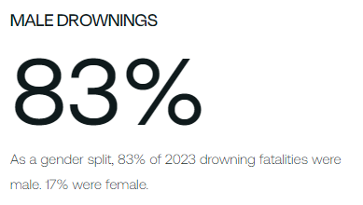
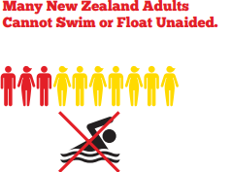
Topic of the month – Working around water

Slide 5
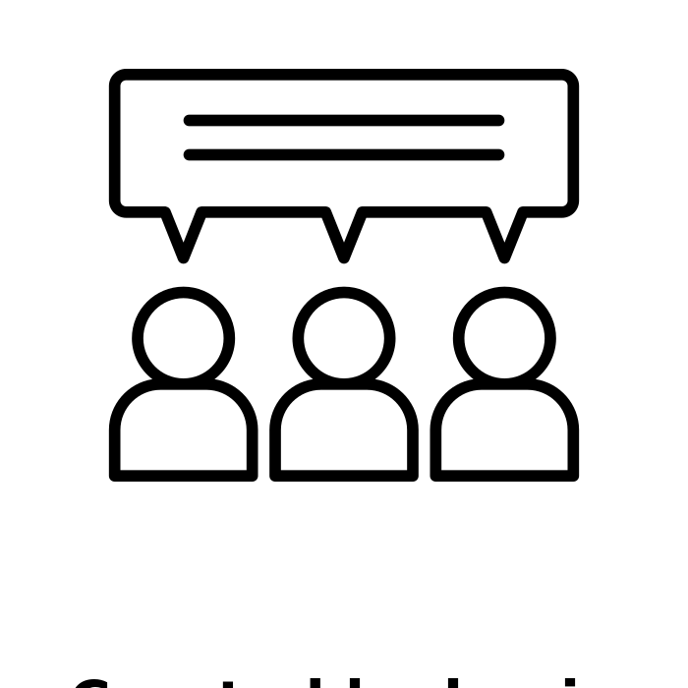
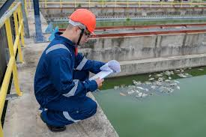
Topic of the month – Working around water
When working in or around water, you should think about all the possible dangers and how to stay safe.
Guard rails, fences and other barriers should be in place. If fencing or guarding is not reasonably practicable, PPE must be properly planned, and workers trained and supervised.
Discussion point:
Where do you interact with bodies of water? Are the risks controlled when you do?
The risk assessment process should include assessment of all the hazards associated with:
Slips and falls into the water – have you got the appropriate footwear and PPE
Inundation by upstream waters
Whether the current is too strong or if the water is flowing sufficiently fast to carry a person away
Where work is on or over water, any hand tools should be restrained using a tool leash that is attached to the person’s wrist
What to do in case of an emergency, such as someone falling into the water

Slide 6
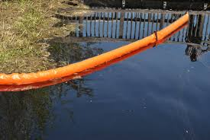
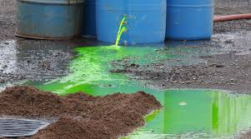
Topic of the month – Working around water
All equipment and materials used on or above the water should be firmly secured at all times.
Any hazardous substances or chemicals must be stored in an approved container with appropriate bunding to contain any spill.
Where environmental contaminants are required to be used on or over the water the volume of product should be kept to a minimum and contained in suitable leak proof receptacle at all times.
Discussion point:
Do you have current Safety Data Sheets for the chemicals you use? Have a chat to your supplier if you don’t, or reach out to the H&S team
A spill kit and Safety Data Sheets (SDS) must be available at the work location at all times.

Slide 7
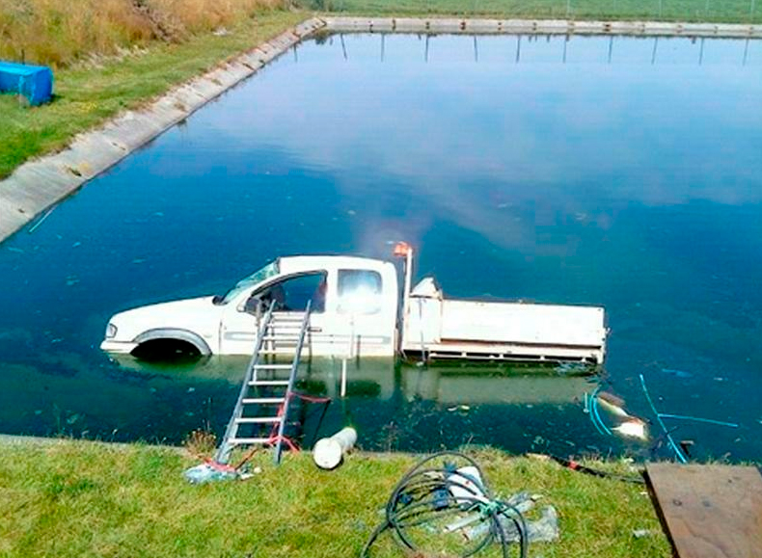
Topic of the month – Working around water
Working near any body of water can result in fatal drowning without the right equipment to keep us safe
We always lock out and isolate before starting work
We always have an exit/evacuation strategy
We are always trained and competent
We always have a rescue plan and equipment
Ute in Oxidisation pond – West Otago 2013

