Slide 1
Health, Safety and Wellbeing Update
April 2024

Slide 2
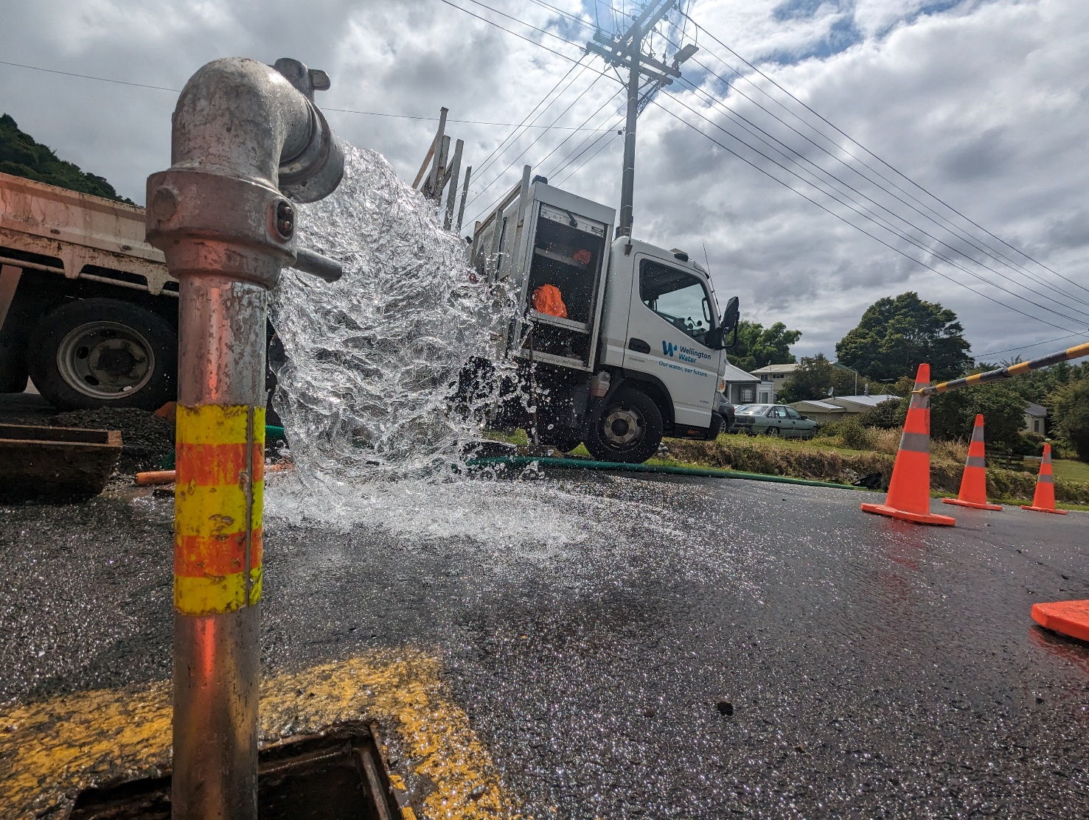
Contents
Critical Risk Stats
Safety topic of the month
Wellbeing
ConstructSafe updates
WorkSafe updates

Slide 3
Critical Risk Stats
In March there were 53 reported critical risk related incidents, this is an increase from February 2024 (50) and a decrease March 2023 (90)
Vehicles/Mobile Equipment is our highest reported critical risk this month with 24 reports, followed by Traffic/Pedestrian Movement at 14 reports.

Slide 4
Safety topic of the month
Fixed Plant and Equipment

Slide 5
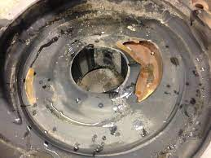
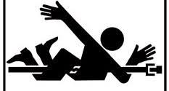
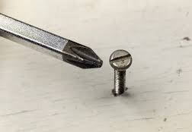
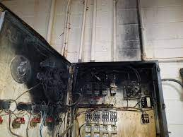
Topic of the month – Fixed Plant and Equipment
Fixed plant and equipment have many moving parts that have the potential to cause entrapment or crush injuries which could result in serious harm or death
Moving parts such as gears, belts,
chains, and other moving parts can
cause entanglement, crushing,
and amputation.
Poor maintenance - lack of regular inspections, servicing, and repairs can increase the risk of breakdowns and malfunctions.
Improper use - operating equipment beyond its capacity, for unintended purposes, or without proper training can be dangerous
Sharp objects such as exposed blades, edges, and other sharp elements can lead to cuts, punctures, and lacerations.
Inadequate guards - missing or damaged guards, safety switches, and other protective measures leave workers vulnerable.
Electrical hazards such as faulty wiring, ungrounded equipment, and improper use can cause sparks, fires, shocks, burns, or even electrocution
Environmental factors - harsh conditions like extreme temperatures, moisture, or dust can accelerate equipment wear and tear.

Slide 7
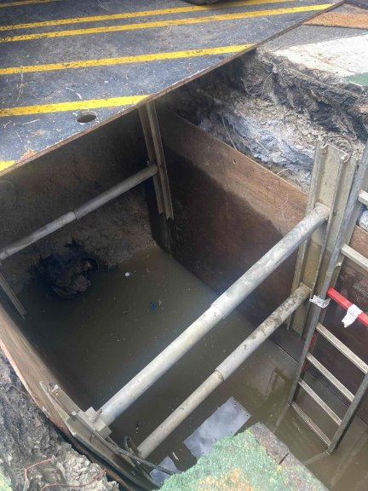
Topic of the month – Fixed Plant and Equipment
Operators must have the required training and certification.
Ensure a pre check is competed prior to use.
Report any defects and incidents.
Complete a Risk Control Plan (RCP) with other team members before use (if needed)
Wear the appropriate PPE.
Do not operate if not competent to do so.
Do not operate if any equipment if it is worn or faulty.
Do not overload or extend the equipment beyond its safe working range.

Slide 8
Lock Out/ Tag Out

Slide 9
Topic of the month – Fixed Plant and Equipment
Hierarchy of controls
Eliminate | Modify or design the equipment to eliminate the hazard Eliminate human interaction Eliminate pinch points
Isolate | Engineering controls Guarding, including inter-locked guards Noise insulation, enclosures and guarding as required Operator control devices such as emergency cut-offs, emergency stops, alarms and self-regulating controls Warning devices such as automatic audible alarms, motion sensors, lights, radio sensing devices and lights
Minimise | Administrative controls Lock out tag out (LOTO) process Inspections and maintenance Standard operating procedures and job safety analyses PPE Training Records

Slide 10
Topic of the month – Fixed Plant and Equipment
We always ensure equipment is guarded, certified, inspected and maintained
We always do a prestart check and ensure equipment is in good condition
We always have LOTO in place
We are always trained and competent
We always wear the correct PPE
We always follow a safe operating process
For more information, check out WorkSafe here, or reach out to the Health and Safety team

