Slide 1
June 2024

Slide 2
Critical Risk Stats
In May there were 78 reported critical risk related incidents, this is an increase from April 2024 (61) and a decrease from May 2023 (98)
Traffic/Pedestrian Movement is our highest reported critical risk this month with 34 reports, followed by Vehicles/Mobile Equipment at 20 reports.

Slide 3
Safety topic of the month
Excavations, Trenching and Tunnelling

Slide 4
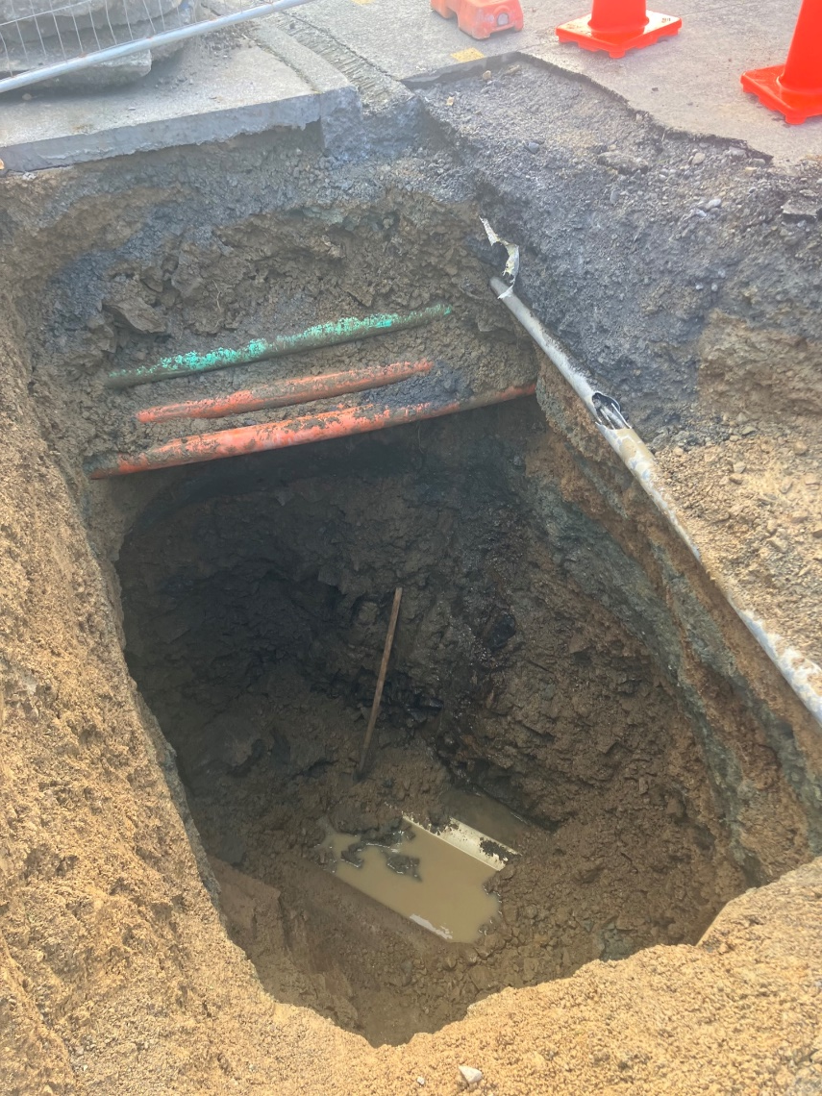
Topic of the month – Excavations, Trenching and Tunnelling
Trenching and excavations can collapse quickly and without warning. This can cause serious injuries such as crushing, or bury people in the trench, resulting in suffocation and death
All excavations, no matter what depth, can be risky.
Ground collapse can occur quickly and without warning, giving you no time to escape, especially if the collapse is extensive.
A buried worker is likely to die of suffocation before help arrives - either the head is buried, or the chest is so restricted by the ground’s weight the worker cannot breathe

Slide 5
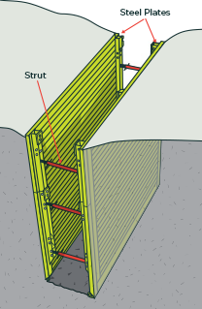
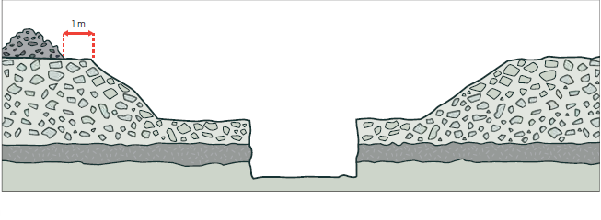
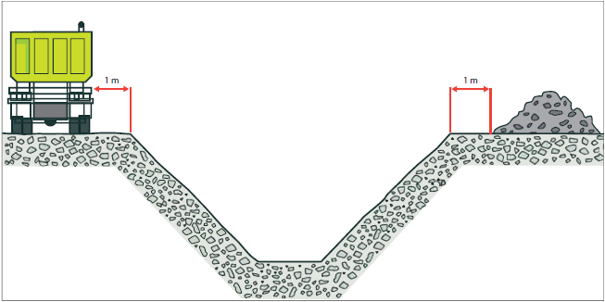
Topic of the month – Excavations, Trenching and Tunnelling
Example of a trench shield
There are three types of controls for preventing ground collapse
Benching and battering is the horizontal stepping or sloping of the face, side, or wall of an excavation.
Shoring prevents collapse by providing support to excavated faces to prevent soil moving and ground collapsing
Shields do not ensure ground stability but protect workers from ground collapse, by preventing the collapsing material falling onto them.
Example of benching
Example of battering

Slide 6
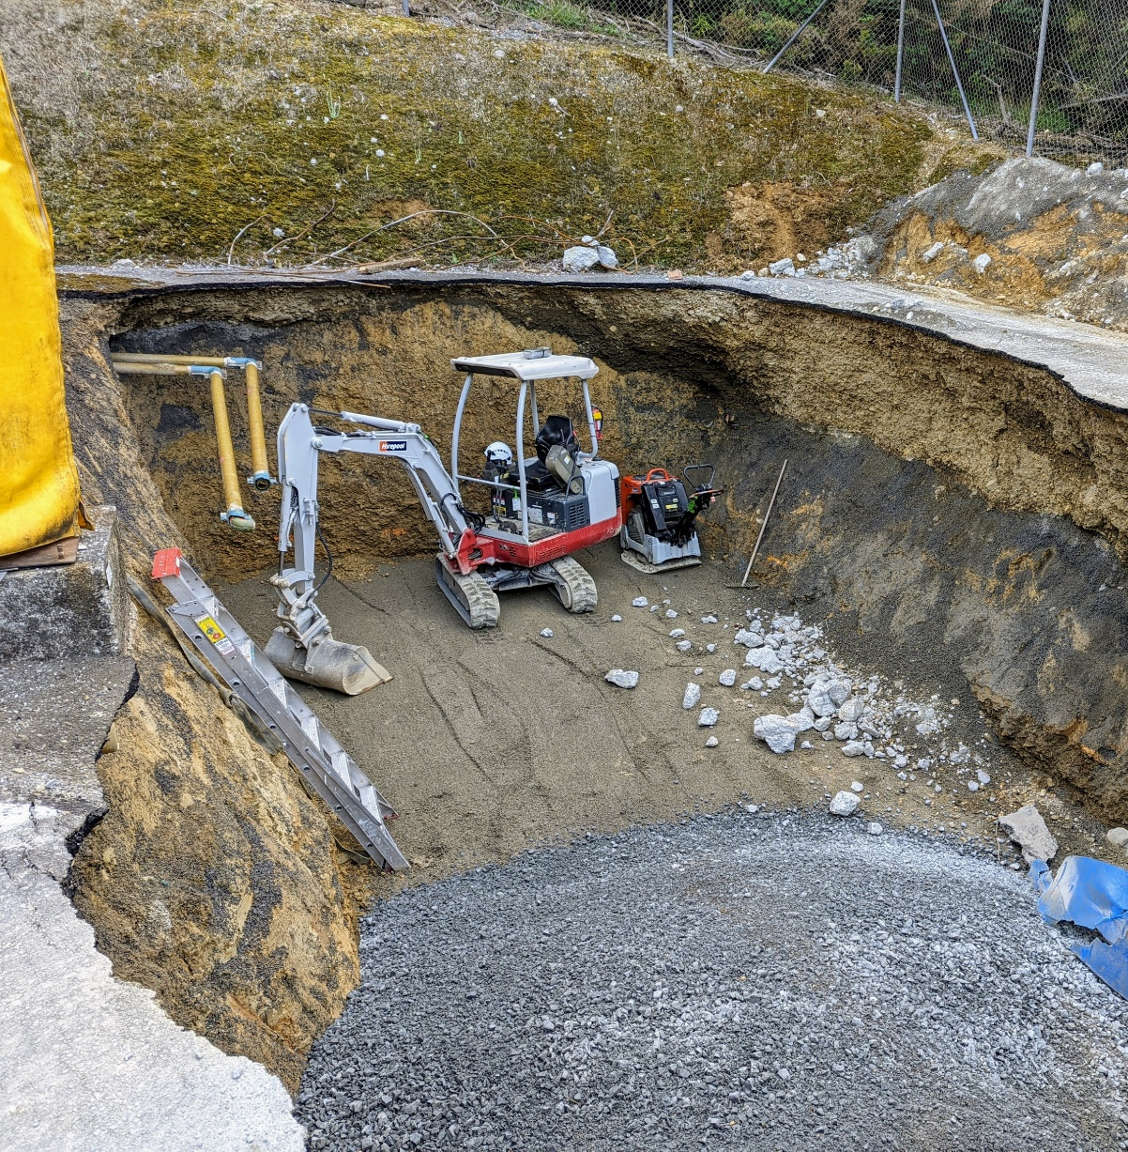
What wrong with these pictures?
Excavated materials within 1 m of edge
Material overhanging above
No benching or shoring
Excavation potentially undermined adjacent building
Workers in excavation without protections against collapse
No safe access
Potential fumes collecting at lower level

Slide 7
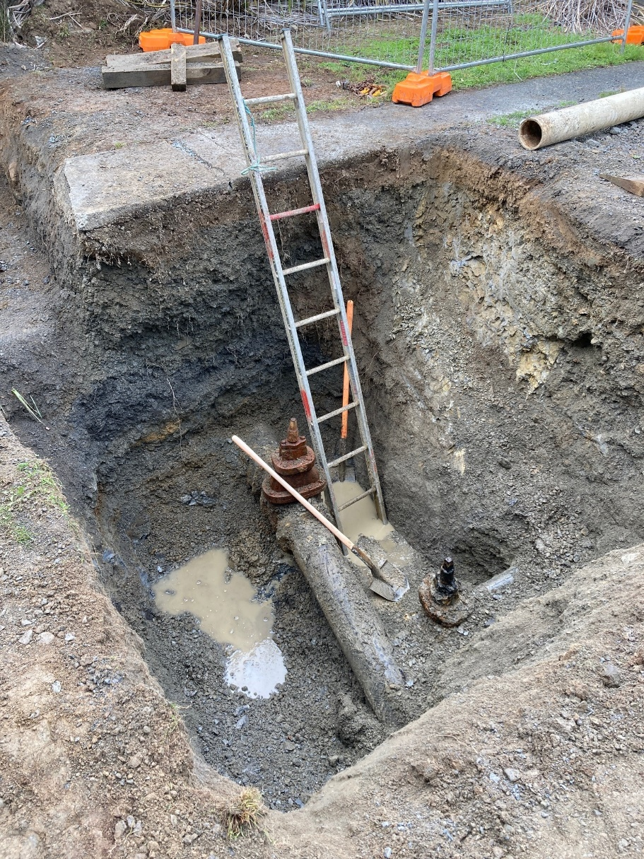
What wrong with these pictures?
Footpath cracking due to undermining
Excavated material stored withing 1 m of edge
No shoring or battering
Workers in excavation with no protection from collapse

Slide 8
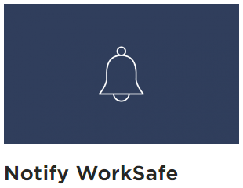
Topic of the month – Excavations, Trenching and Tunnelling
WorkSafe must be notified 24 hours before work starts if work is being done in:
a drive, excavation, or heading and someone is required to work with a ground cover overhead
an excavation in which any face has a vertical height of more than 5 metres and an average slope steeper than a ratio of 1 horizontal to 2 vertical
a pit, shaft, trench, or other excavation more than 1.5 metres deep and having a depth greater than the horizontal width at the top

Slide 9
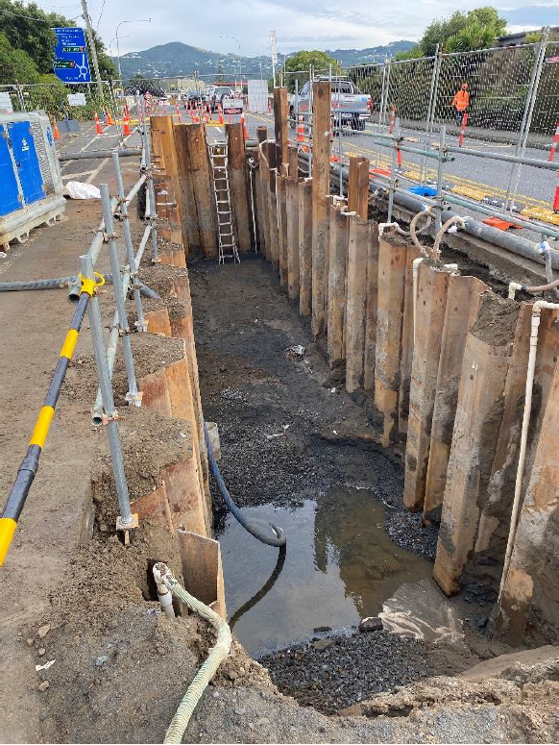
Topic of the month – Excavations, Trenching and Tunnelling
Prevent collapse – shore, bench, or batter back. Do not assume ground will stand unsupported.
Prevent people and materials falling in – with barriers strong enough not to collapse if someone falls against them. Store materials and equipment at least 1 m from the edge.
Provide safe access to get in and out.
Check the excavation each day before starting work and after any event that may affect its stability.
Complete your Excavation Permit
Avoid underground services and make sure not to undermine nearby structures - use safe digging practice and dig away from them.
Seaview Rd, Lower Hutt

Slide 10
Topic of the month – Excavations, Trenching and Tunnelling
All excavations deeper than 1.5 m must be shored, or cut back (benched), or be otherwise determined as safe to work in
All excavations must be covered or fenced off
All excavations, no matter the depth, must be safe to work in
Where there is a risk of collapse, it must be controlled before starting work
Always have an exclusion zone in place
Always have a safe entry and exit
Always have shoring/benching/shields in place
Always complete your permits and planning
Always ensure you’re trained and competent
Always wear the right PPE

Slide 11
WorkSafe Updates
Forklift brake failure causes serious injuries
A worker parked a forklift on a slope after using it and engaged the handbrake.
The handbrake has failed and the worker attempted to stop the forklift rolling down the slope. The forklift has tipped over onto the worker resulting in a punctured lung and broken back
An investigation found the forklift was not maintained or serviced resulting in a $240,000 fine, and $62,269 reparations imposed on the business
Young trainee worker killed on the job
An apprentice worker was fixing the hydraulics on a log loader when the vehicles boom fell and crushed him.
An investigation found the company did not have an effective procedure for the repairs, and the young worker was given inadequate instruction and supervision.
This tragic case is about the failure to manage a critical risk – it was utterly preventable and avoidable. As a result of that, a family is now deprived of a son, grandson, brother, and partner.

Slide 12
WorkSafe Updates
Unsafe machinery costs digits and dollars
Three workers suffered multiple injuries as a result of unsafe machinery in a manufacturing business.
In 2022, on two separate occasions, workers had two fingers amputated and another finger degloved.
Again in 2022, another worker had three fingers partially amputated while using a punch and forming press.
The business was fined on each separate incident, totaling over $520,000 with reparations of over $100,000.
Electrical worker prosecuted by WorkSafe and sentenced to home detention
An electrical worker was engaged by a property owner to remove an extraction light and fan and install a new power point.
During installation, the electrical worker failed to identify correctly how the cable was originally connected, resulting in the metal work of new rangehood being energized with 230VAC.
Twenty days later another contractor has then touched the metal work of the range hood and received a fatal electric shock.
The investigation identified several failings, most importantly that the electrical worker had failed to fully undertake mandatory testing as required under legislation. The electrical worker was sentenced to 8 months home detention and ordered to pay $150,000 in reparation
See other WorkSafe updates here

