Slide 1
Health, Safety and Wellbeing Update
February 2024

Slide 2

Contents
Critical Risk Stats
Safety topic of the month
Wellbeing
WorkSafe updates

Slide 3
Critical Risk Stats - February
In January there were 43 reported critical risk related incidents, this is the same as
December (43) and a decrease from January 2023 (66)
Vehicles/Mobile Equipment is our highest reported critical risk this month with 16 reports, followed by Traffic/Pedestrian Movement at 10 reports.

Slide 4
Safety topic of the month
Traffic Management

Slide 5
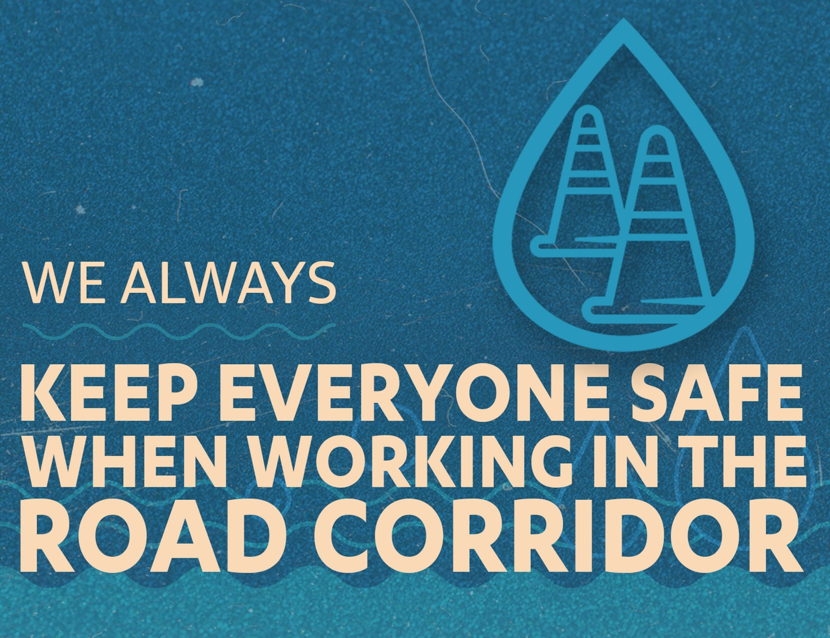
Topic of the month – Traffic Management
Traffic management is essential to control all traffic, cyclists and pedestrians safely, and to prevent serious harm or fatalities to our workers and other road users.

Slide 6
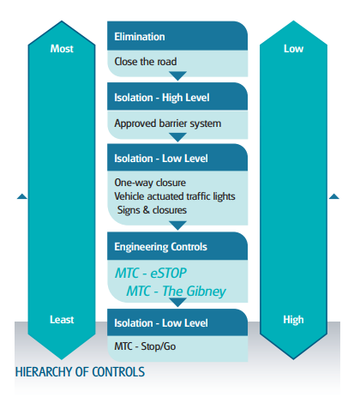
Topic of the month – Traffic Management
When we working in and around live traffic, we need to:
Implement and manage exclusion zones
Ensure pedestrians are isolated from traffic and mobile equipment
Signage and markings but be visible and clearly demarcate pedestrians and vehicles
Lateral and longitudinal safety zones and tapers must have no working vehicles or workers in them at all times
Temporary traffic management
Where people are working in the road corridor there must be an approved Traffic Management Plan (TMP) in place.
Traffic management is not just when we are working on the road, it relates to all traffic movements on any, and all worksites including yards, depots and greenfield sites away from public roads.
Consider traffic movements and flow, cyclists, parking and other activities like refuelling
Ensure workers are trained and competent, and TTM equipment is fit for purpose and compliant

Slide 7
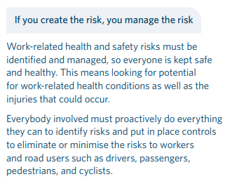
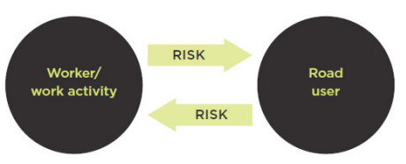
Topic of the month – Traffic Management
Everyone is responsible for safety
Everyone has obligations to both workers and road users.
Everyone gets the highest level of protection reasonably practicable.
Everyone needs to proactively identify risk and put in place controls to eliminate or minimise the risks as far as reasonably practicable.

Slide 8
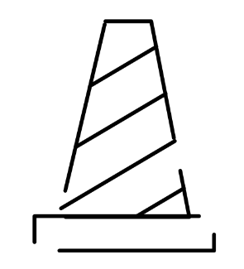
Topic of the month – Traffic Management
We are always restrained when working from the back of a truck
We always have a spotter
We always have a safety zone
We always separate people from plant
We always have an effective plan in place
For more information check out the New Zealand guide to temporary traffic management here

Slide 9

WorkSafe Updates
Worker nearly buried alive in trench collapse
A worker was in a 3m x 2m trench when one of the sides gave way, engulfing the worker up to his head.
The worker suffered a collapsed lung, broken rib cage, a broken sternum and broken collar bone. He now lives with post-traumatic stress disorder from the incident.
The trench had been built with a flat floor and steep vertical sides, rather than shored up with shields or battered into a safe slope to keep the sides stable. There had also not been any geotechnical assessment of the site to check the soil stability before work began.
Anyone digging such a deep trench should be aware of the possibility of collapse and should take proper precautions. We know how to dig trenches safely – it’s not hard to take the necessary safety measures
See other WorkSafe updates here

Slide 10
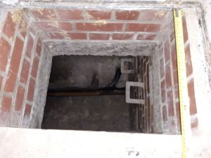
News from around the world
Kettering General Hospital NHS Foundation Trust has been fined after an employee was found unconscious in a manhole
The worker was rescued and treated but suffered a traumatic brain injury and has ongoing problems with memory loss and nerve damage
An investigation found the manhole was not identified as a confined space, therefore there was a failure to properly risk assess the task.
The investigation also highlighted that no confined space training was given to workers
The trust failed to prevent entry of employees into confined spaces at the site – which was custom and practice for a number of years.
The trust also failed to identify a safe system of work or method statement for clearing blocked drains and no precautions were identified to reduce the risk of injury.

