Slide 1
Health, Safety and Wellbeing Update
September 2023

Slide 2
Contents
Noteworthy Incidents
Sharing Something Goods
Critical Risk Stats
Safety topic of the month
Wellbeing topic of the month
WorkSafe updates

Slide 3
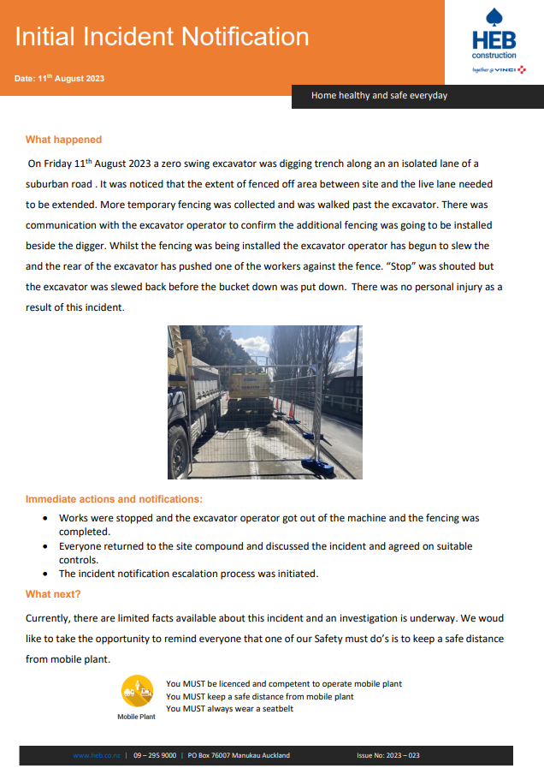
Noteworthy Incidents
While excavating a trench, the team set out to extend the site fencing to maintain the appropriate protections for the site. Two workers were installing the fencing panel adjacent to the excavator. The operator was aware of their presence and the machine was not operating. As the workers moved to install the fencing, the digger driver lifted the bucket and slewed anti-clockwise. This resulted in the back of the digger pushing one of the workers into the fence
Take away tips:
Always keep a safe distance from mobile plant.
Be aware of your surroundings and the blind spots of mobile plant operators.
Communicate clearly with mobile plant operators before working near their equipment.
Be prepared to take evasive action if necessary.
Report any unsafe conditions to your supervisor immediately.

Slide 4
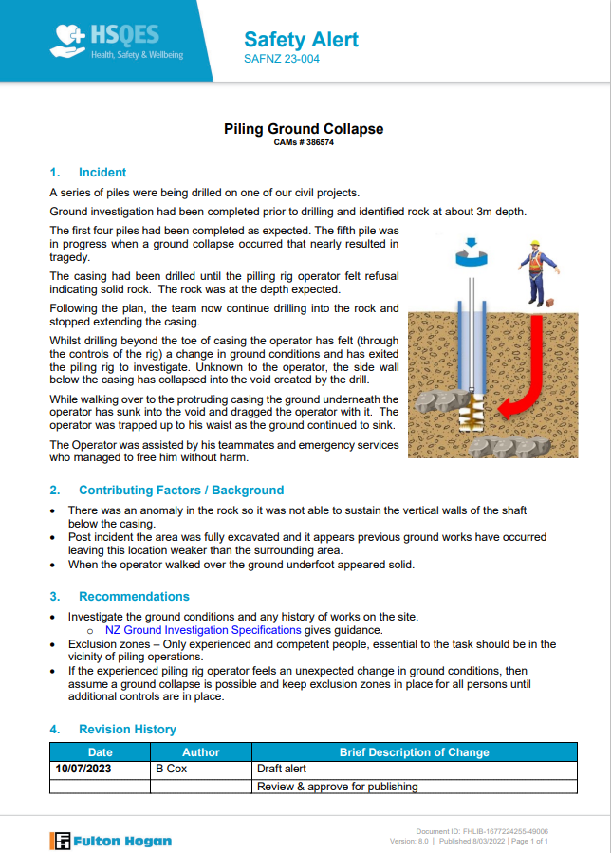
Noteworthy Incidents
Following the incident at Te Marua Water Treatment Plant where worker was partially buried under collapsed ground, Fulton Hogan have released this safety alert.
Take away tips:
Only experienced and competent people should be in the vicinity of piling operations
If there is an unexpected change in ground conditions, assume a ground collapse is possible, and maintain an exclusion zone until further controls are in place

Slide 5
Something Good
We’ve had some great feedback and compliments from residents and customers about our teams out and about, including from a church where a funeral was being held and the site team moved their planned work area for the funeral
If you have any cool stories to share, please send them to safe@wellingtonwater.co.nz

Slide 6
Critical Risk Stats - August
In August there were 82 reported critical risk related incidents, this is a increase from July (68) and an increase from August 2022 (31)
Vehicle/Mobile Equipment is our highest reported critical risk this month with 36 reports, followed by at Working with/near Services at 16 and Traffic/Pedestrian Movement at 14.
If you’re interested in seeing other stats please let us know!

Slide 7
Safety topic of the month
Hazardous Substances

Slide 8
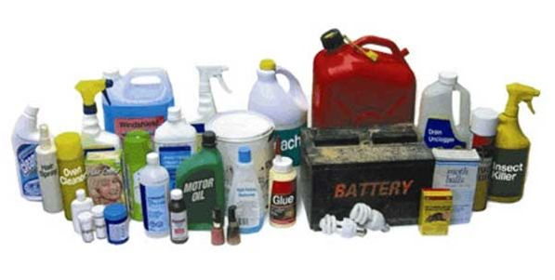
Safety topic of the month – Working with hazardous substances
From 2010 to 2018, 397 people in New Zealand died as a result of hazardous substances.
Chemicals hazards and toxic substances have the potential to cause serious harm or death when inhaled or ingested or exposed to. This harm could be acute and immediate or gradual and lifelong.

Slide 9
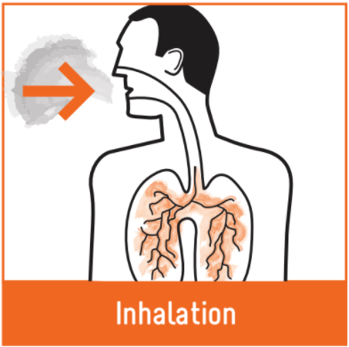
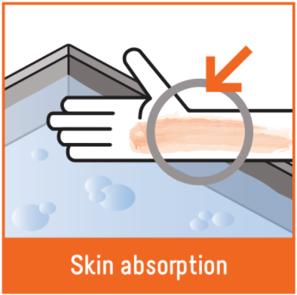
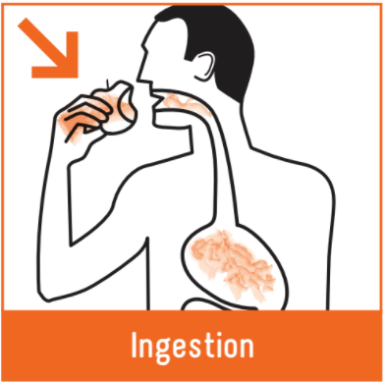
Safety topic of the month – Working with hazardous substances
Hazardous substances are bad for your health and can slowly kill you. They can get into your body three ways:
Inhalation is the most likely route of exposure (e.g. breathing in petrol).
Immediate effects from solvent exposure include headaches, forgetfulness, drowsiness, feeling dizzy and/or nauseous, irritability and mood changes, and irritation of the eyes, lungs and skin.

Slide 12
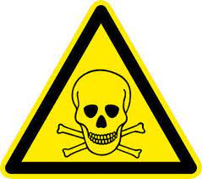
Safety topic of the month – Working with hazardous substances
Read the Safety Data Sheets (SDS) before using a hazardous substance.
Know what you are working with, and familiarise yourself with the hazards, controls, PPE requirements and what to do in a spill or emergency.
Before staring work
Check all PPE, make sure it’s the right PPE for the substance and in good condition
Check the equipment you are about to use
Check the storage containers have no leaks
Only work if it is safe to do so

Slide 14
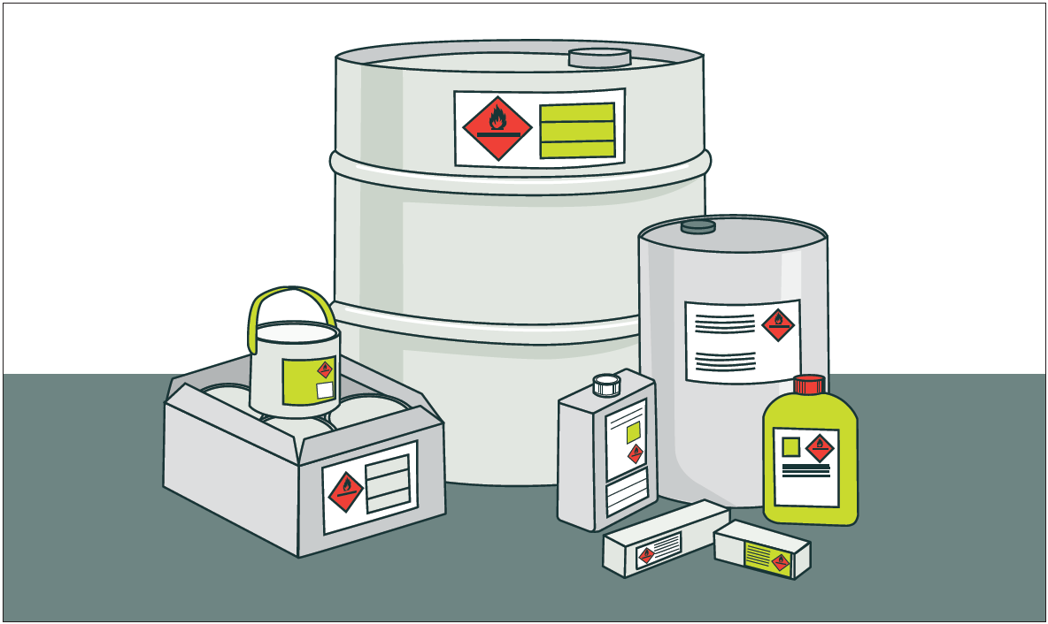
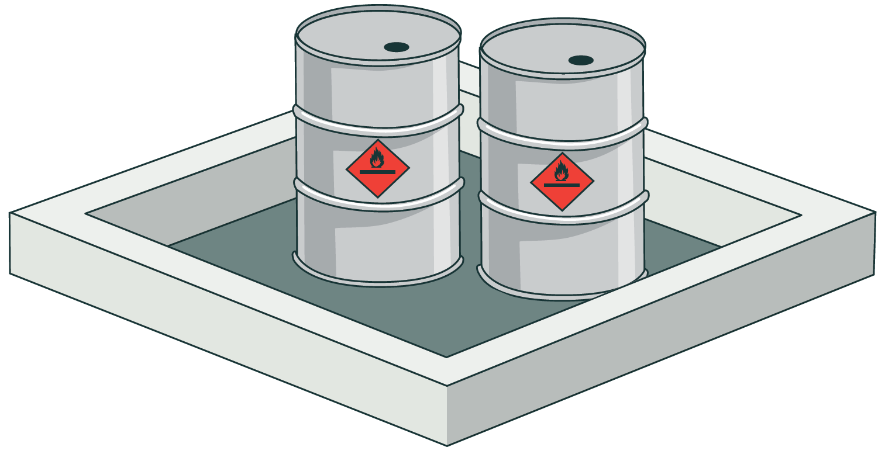
Safety topic of the month – Working with hazardous substances
Hazardous substances must be stored in a way that reduces their chances of accidental release
The original or supplied containers are best
Containers must be labelled
NEVER store them in food or drink containers, or near food storage areas

Slide 16
Safety topic of the month – Working with hazardous substances
Hazardous substances are inherently dangerous but can be handled, used, and stored safety in proper controls are used.
For more information check out these links below
WorkSafe – Hazardous Substances
Hazardous Substances - Your Health
National Poisons Centre
Fire and Emergency NZ

Slide 17
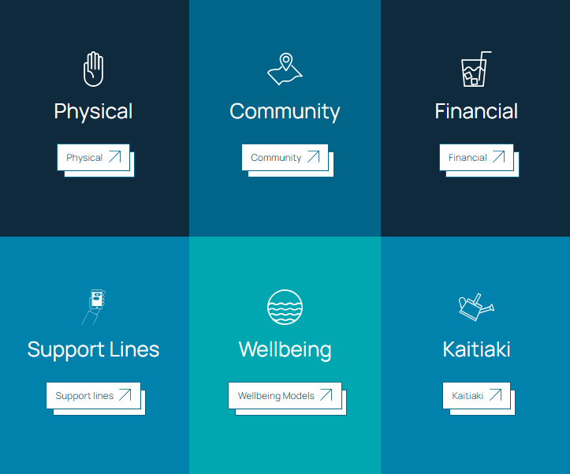
Wellbeing Hub
The Wellbeing Hub is available for all Wellington Water whanau. It has information to support all staff wellbeing.
The Kaitiaki Network is a peer to peer support group trained to have conversations with anyone in the Wellington Water whanau.
CLICK TO VISIT THE
WELLBEING HUB ↗

Slide 18
WorkSafe Updates
Workplace explosion was no joke – a warning to all
A barbeque gas bottle was mistakenly left running overnight in a shipping container on a construction site. The next morning workers from opened the container to start work for the day. They could smell gas, and one of the workers joked about igniting his lighter. When he did, the gas caught fire and exploded.
All five workers, including the man himself, were burned. He deeply regrets his actions and has participated in restorative justice with the other victims.
WorkSafe’s investigation established this was a workplace prank gone wrong.
Being safe at work is a responsibility shared by both the employer and the employee and no one should be harmed because of a prank or joke gone wrong

