Slide 1
Health, Safety and Wellbeing Update
July 2023

Slide 2
Contents
Noteworthy Incidents
Safety Alert – Te Marua ground collapse
Sharing Something Goods
Topic of the month
Wellbeing
Hardhat update
Critical Risk Stats
WorkSafe updates

Slide 3
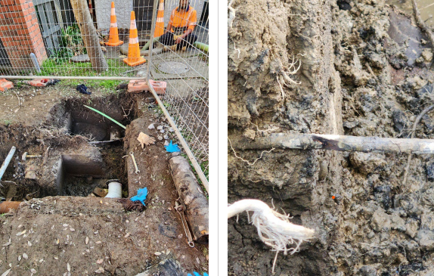
Noteworthy Incidents
Workers were undertaking work outside of a pump station during a planned shutdown. Workers excavated the site to expose the existing services so the repair work could be undertaken.
An existing 150mm diameter waste pipe had to be cut out to allow for a new section to be installed. A worker used a power cut off saw fitted with an abrasive disc to cut through the existing pipe. As the cut was completed, the worker lifted the saw, and the abrasive disc contacted a 240v electrical cable which was near the pipe.
The worker was not immediately aware that the cable had been damaged, shortly following the incident the cable started to spark and crackle. The work area was immediately evacuated, and Wellington Electricity Limited (WEL) were notified of the incident

Slide 5
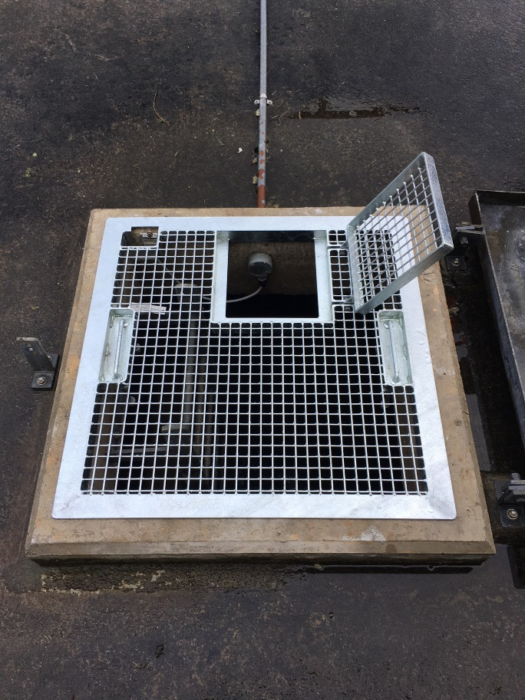
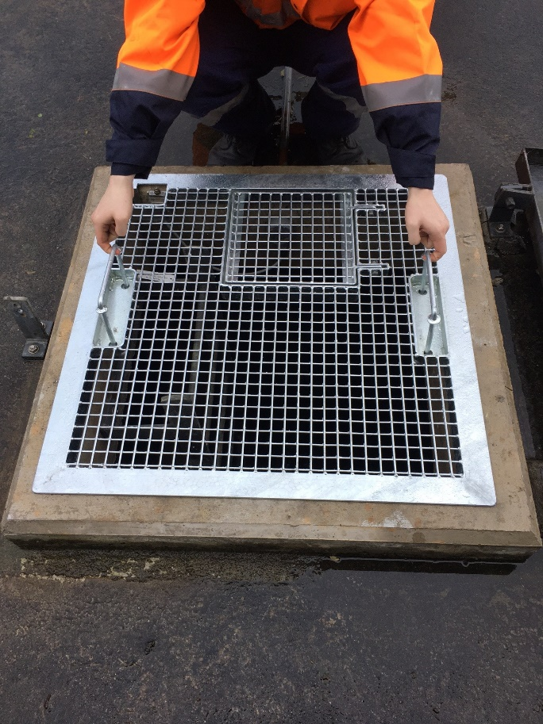
Something Goods
A safety improvement for the team at Te Marua, a reservoir hatch lid was installed so operators can now open the small lid on the hatch door to do sampling and testing without the risk of falling into the reservoir.
Recently a TC observed a moped driver get hit by a bus across the road. They saw a group of people run over to help. The TC identified the immediate need for an ambulance and dialled 111 while others were helping the injured moped driver.

Slide 6
Topic of the month
Mobile Plant and Equipment

Slide 7
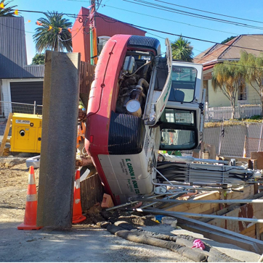
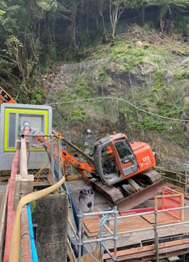
Topic of the month – Mobile Plant and Equipment
In the last 12 months, there have been over 250 reports of incidents involving Mobile Plant and Equipment, making it our highest reported critical risk.
Incidents involving Mobile Plant and equipment can result in serious injury, damage, or death.

Slide 8
Danger Zones and Blind Spots

Slide 9
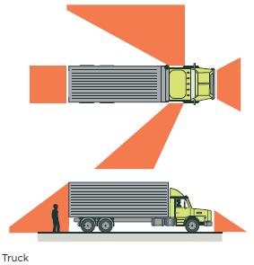
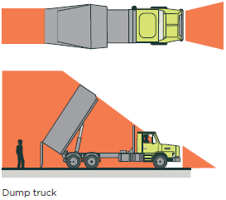
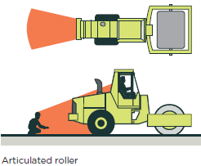
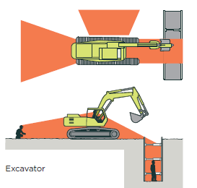
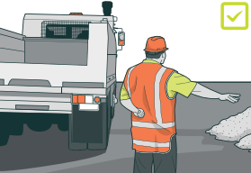
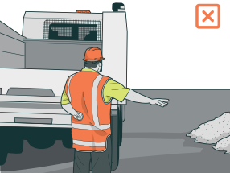
Topic of the month – Mobile Plant and Equipment
Keep Clear of the Gear
People will always come off second best vs. machinery
Always work where the operator can see you
Stop work if you see someone enter a Blind Spot, or Danger Zone
Get the operators attention – make eye-contact

Slide 10
Topic of the month – Mobile Plant and Equipment
Causes of incidents can be:
People and mobile plant sharing the worksite
This is a major cause of accidents, as people can be easily struck by or crushed by mobile plant that is not properly controlled
Uncontrolled movement to, from, and within the worksite
Mobile plant should always be operated in a safe and controlled manner. Sudden movements or changes in direction can easily lead to accidents
Multiple vehicles or mobile plant operating at the same time in a confined area
This can create a lot of traffic and confusion, which can increase the risk of accidents
Mobile plant operating on uneven surfaces or potentially unstable ground
Mobile plant can be very unstable if it is operating on uneven or unstable ground. This can lead to rollovers or other accidents
People using mobile plant in an unsafe manner
This includes exceeding safe speeds, exceeding load limits, or operating the equipment while under the influence of drugs or alcohol

Slide 11
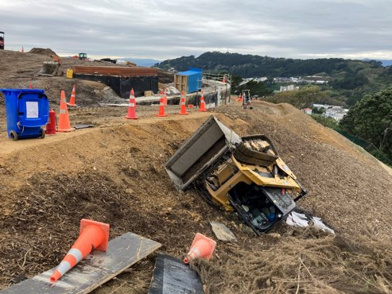
Topic of the month – Key Messages
Be aware of your surroundings and make sure that you have a clear path to move around.
Do not approach mobile plant that is in operation.
Always stay clear of blind spots, and any danger zones (tip zones, swing zones)
If you see something that is unsafe, speak up and let the operator know.
Look out for yourself, your coworkers, and members of the public

Slide 12
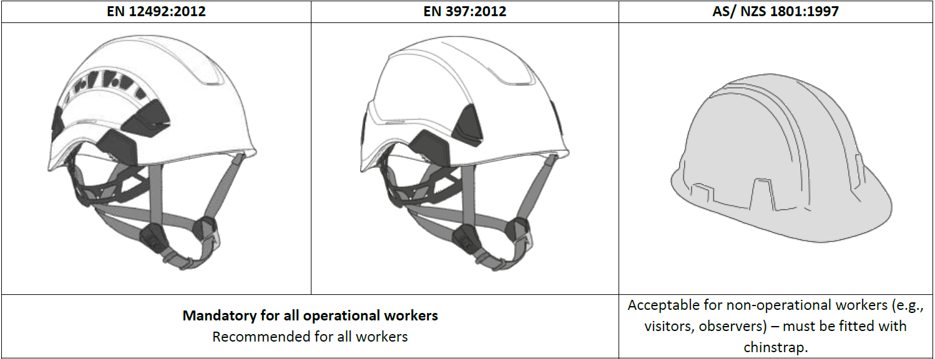
Hard Hats

Slide 13
Critical Risk Stats - June
In June there were 80 reported critical risk related incidents, this is a decrease from May (101) and an increase from June 2022 (27)
Vehicles/Mobile Plant remains our highest reported critical risk this month with 28 reports, followed by Traffic/Pedestrian Movement at 22 and Working near/with services at 17.

Slide 14
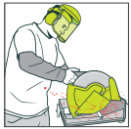
WorkSafe Updates
AFFCO sentenced after a completely avoidable death at meatworks
AFFCO was sentenced following the death of a worker who was crushed by a steel frame full of offal cartons
The worker was trying to free a jammed carton in a freezer when the frame fell and fatally crushed him
There were health and safety procedures in place however these weren’t practical
The freezer was not maintained, and has been decommissioned since due to not meeting modern safety standards

