Slide 1
Health, Safety and Wellbeing Update
August 2023

Slide 2
Contents
Noteworthy Incidents
Sharing Something Goods
Critical Risk Stats
Safety topic of the month
Wellbeing topic of the month
Who to ring when something happens
WorkSafe updates

Slide 3
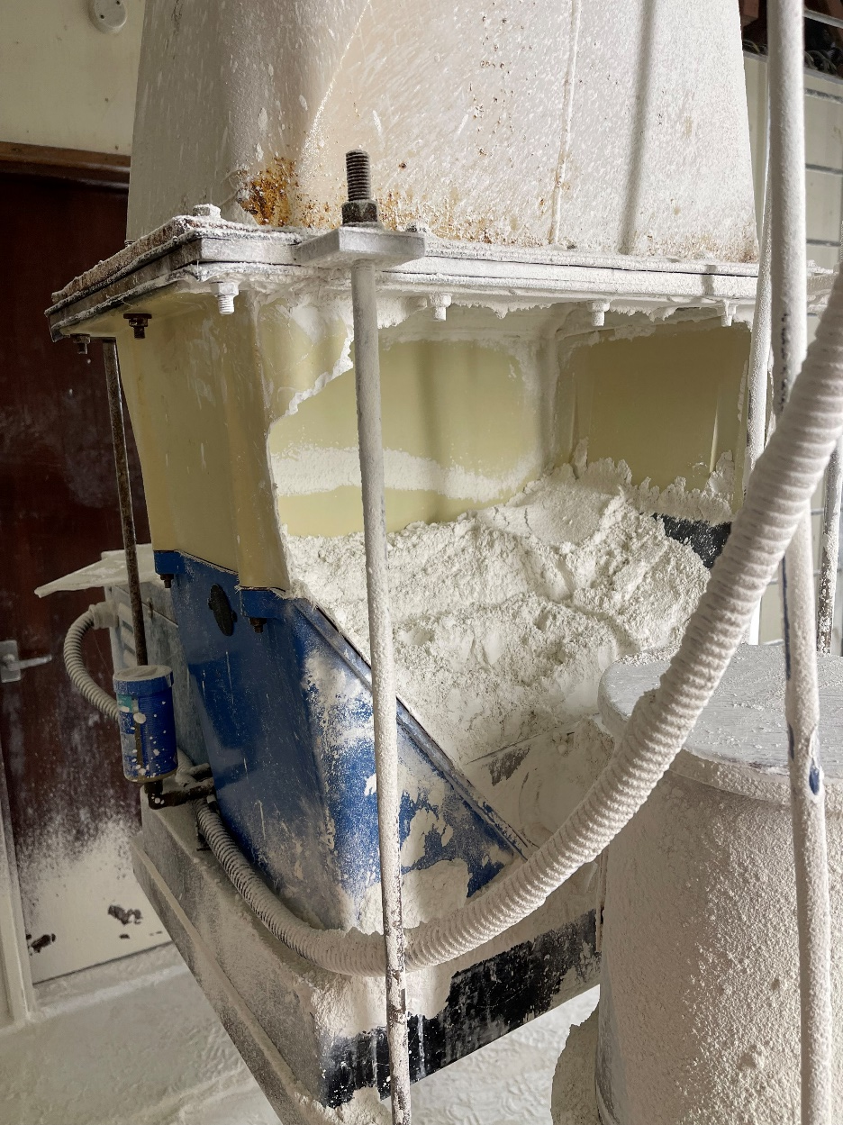
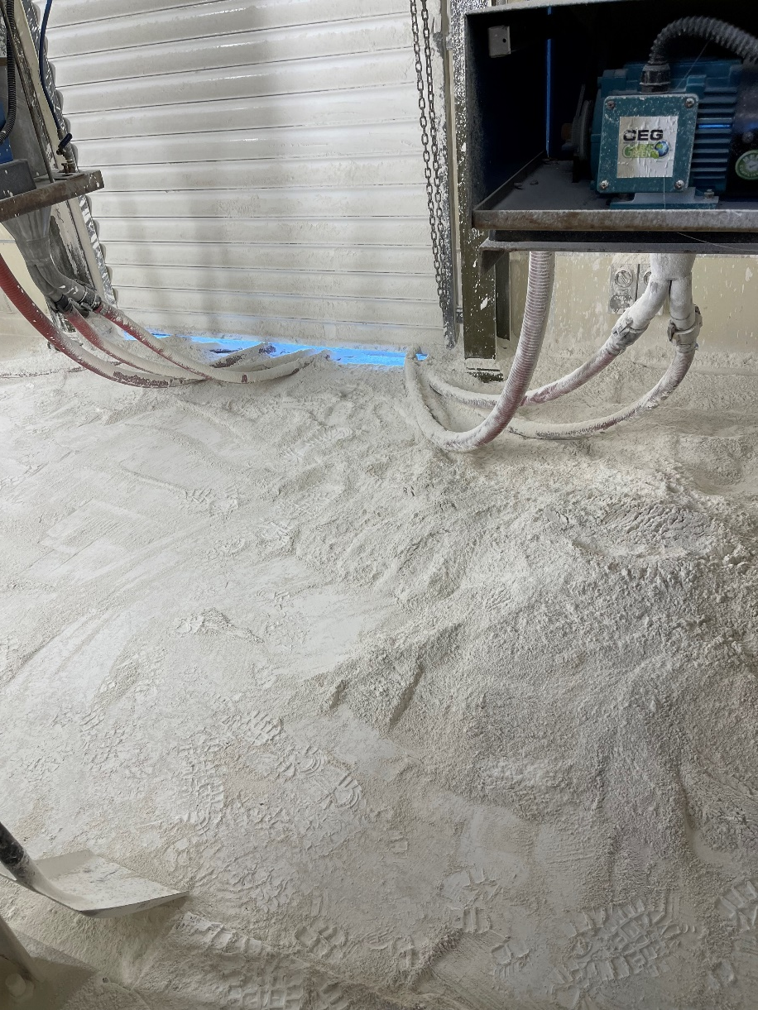
Noteworthy Incidents
A fibreglass lime hopper became over-pressurised, causing it to rupture. This resulted in approximately 150 kg of powered lime being spilled.
There were no injuries, though the outcome could’ve been serious if someone had been in the area.
The incident resulted in the Te Marua Water Treatment Plant being offline for approximately four hours

Slide 4
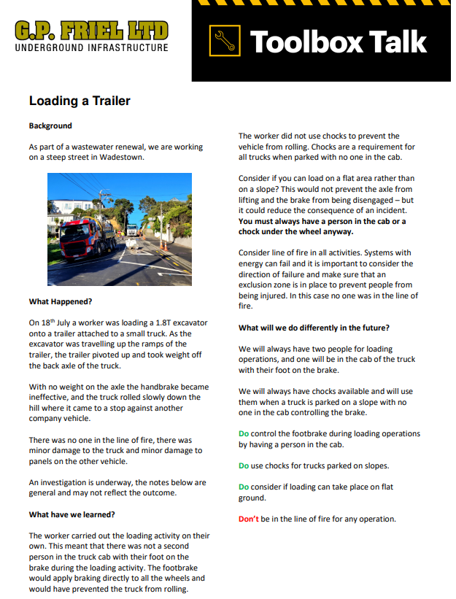
Noteworthy Incidents
A truck rolled down a hill striking another parked vehicle while an excavator was being loaded onto an attached trailer.
Things we will do differently:
We will control the footbrake during loading operations by having a person in the cab.
We will use chocks for trucks parked on slopes.
We will consider if loading can take place on flat ground.
Don’t be in the line of fire for any operation.

Slide 5
Noteworthy Incidents

Slide 6
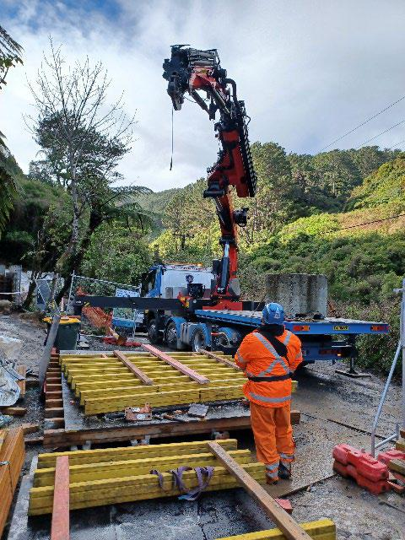
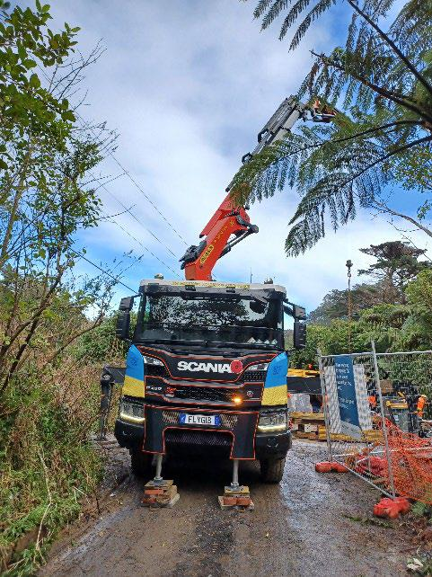
Noteworthy Incidents

Slide 7
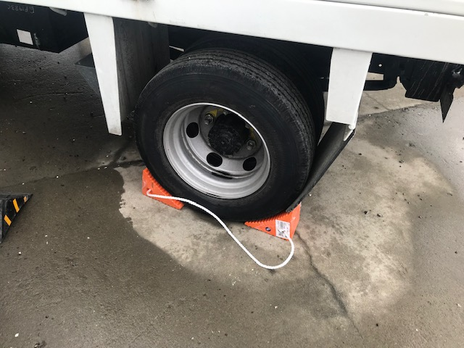
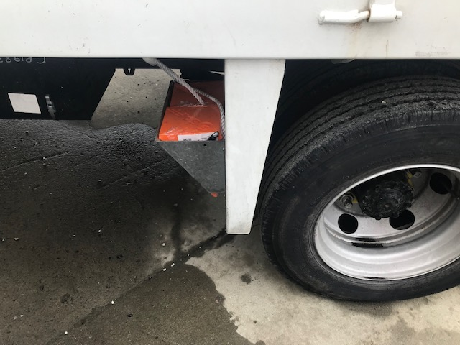
Something Good
One of our team leaders has modified these chocks by installing a rope between them.
This makes them safer when removing them on a slope with truck weight on them as you do not have to get your body parts in the line of fire to remove them.
The mods also have the added benefit of keeping them together so that they cannot be easily lost, left on site, pinched for another truck or chucked out in the spoil.
Nice work team!

Slide 8
Critical Risk Stats - August
In July there were 59 reported critical risk related incidents, this is a decrease from June (84) and an increase from July 2022 (40)
Traffic/Pedestrian Movement is our highest reported critical risk this month with 20 reports, followed by Vehicle/Mobile Equipment at 16 and Hazardous Substances/Chemicals at 11.
If you’re interested in seeing other stats please let us know!

Slide 9
Safety topic of the month
Service Strikes

Slide 11
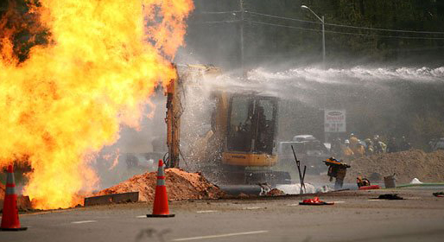
Safety topic of the month – Service Strikes
In the last 12 months, there have been over 136 reports of incidents involving working with services
A strike to a live service can result an electrocution, or an explosion, which can cause serious injury or death to anyone standing on or near the service.
In Australia, 354 people have suffered life changing injuries after striking a live underground electricity cable between 2015-2020.
Construction workers were identified as an extreme risk with 4 out of 5 reported incidents involving them

Slide 12
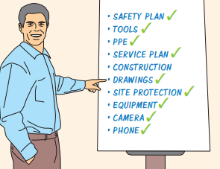
Safety topic of the month – Service Strikes
Think before you dig
Treat all lines and cables as live
Plan ahead - complete your risk control plan and dig permit
Review and double check all plans, scans and markouts
Ensure all services have been identified and marked
Consider taking a photo of markouts before they are dug up
If you can't find a service or discover an unmarked service, stop and reassess
Expose the services by pot holing to confirm location
Always use a spotter
Know what to do in an emergency

Slide 13
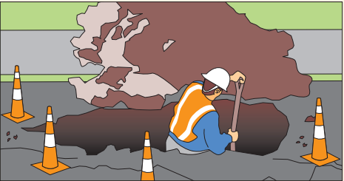
Safety topic of the month – Service Strikes
For more information:
New Zealand Utilities Advisory Group Handbook
Water Ways Underground Services
beforeUdig
Worksafe – Excavation Safety

Slide 15
Wellbeing topic of the month
Financial Wellbeing

Slide 16
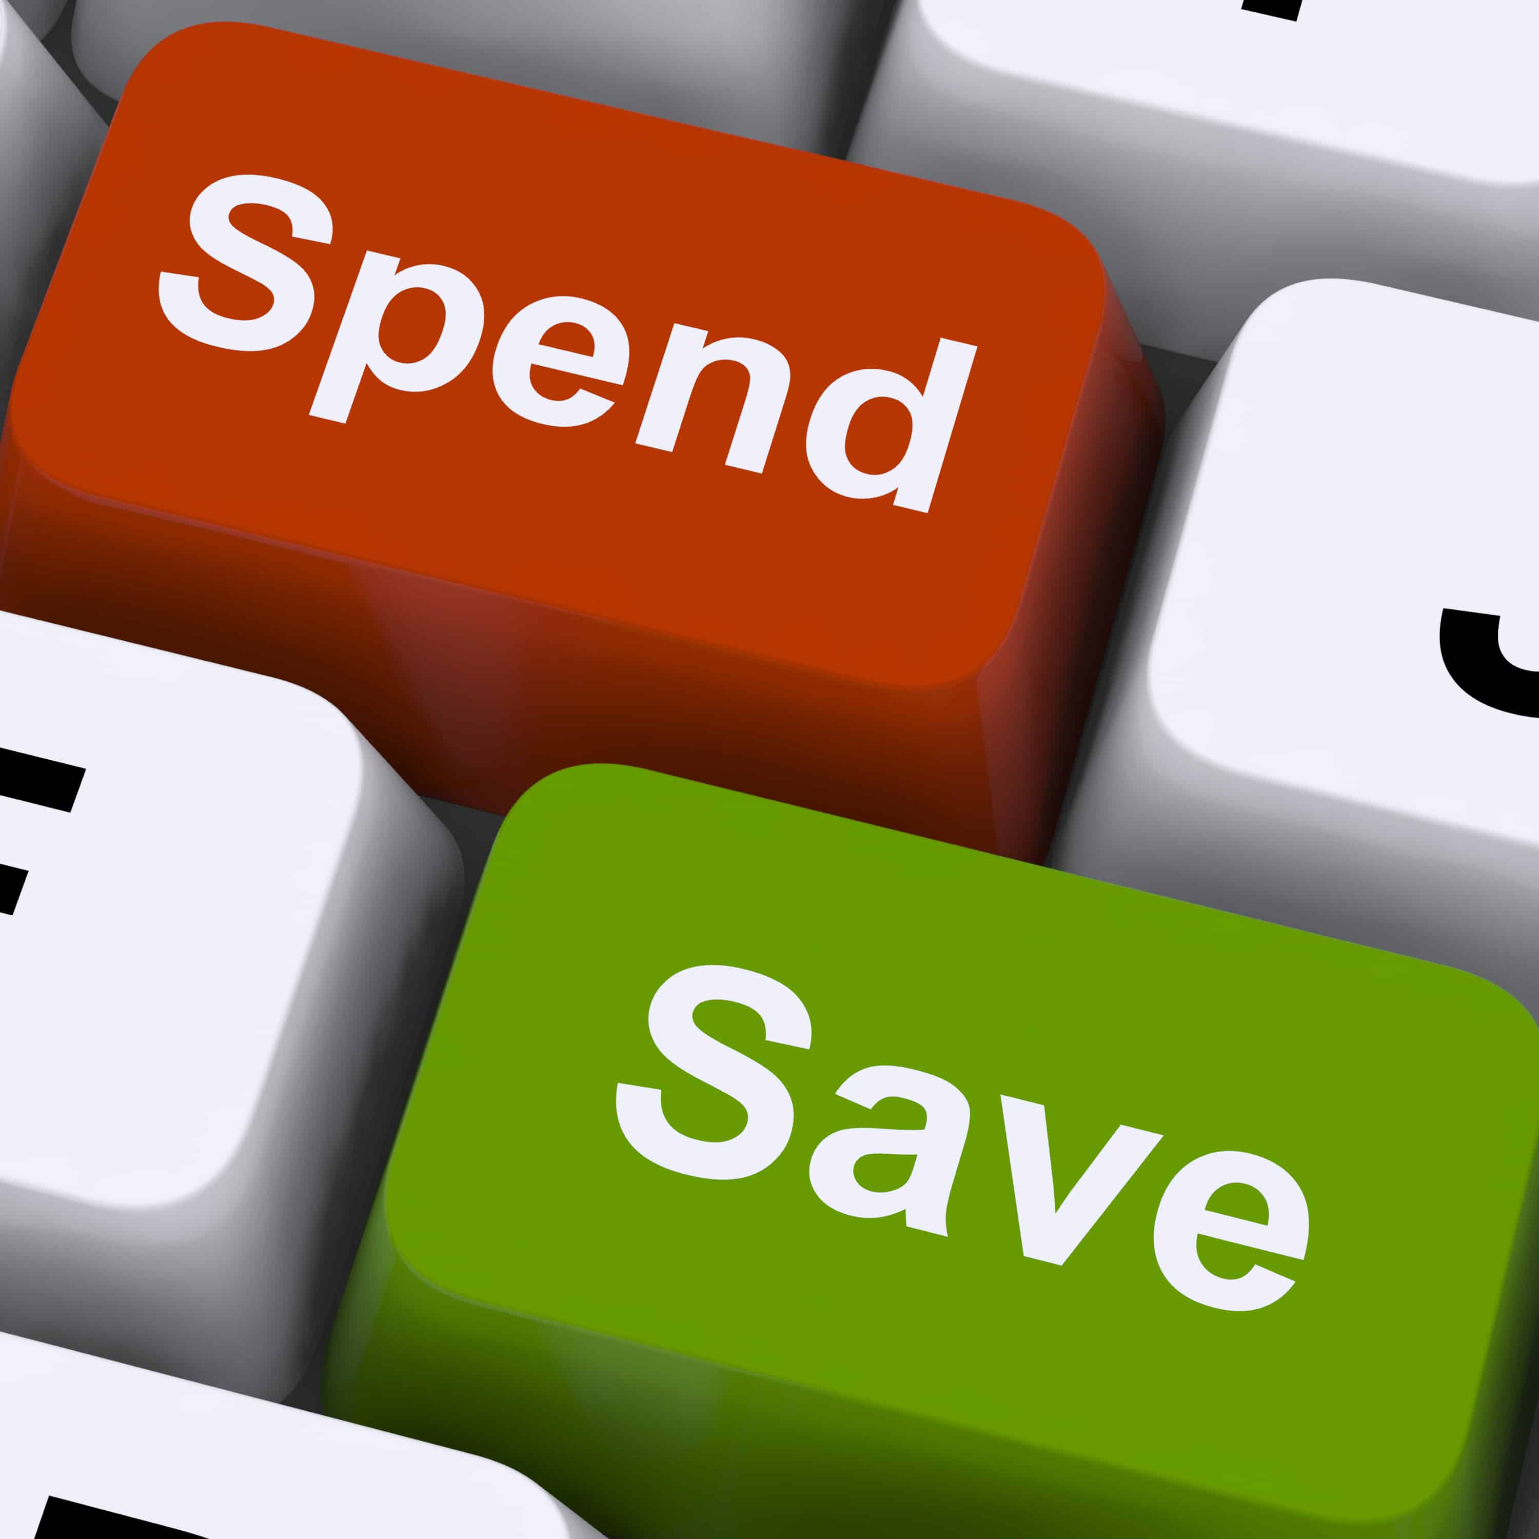
Wellbeing topic of the month: Financial Wellbeing
Having a good relationship with money and a positive mindset will help to feel better about your financial position.
Here are 5 tip to improve your financial wellbeing:
1. Create a budget
2. Review your subscription services
3. Get or update Kiwisaver
4. Consider shopping around for specials
5. Pay off credit cards in full each month
Check out: Sorted.org.nz
Notes:
1. Create a budget – work out what's coming in and what bills must be paid. This leaves you with an amount that must last until you’re paid next. Set aside a portion of $ each pay to savings - Where possible, put an amount aside each pay to a savings account in case of an emergency. Ref: https://sorted.org.nz/tool/budgeting-tool#/welcome
2. Review your subscription services – Do you need all the streaming services? If not, cancel them.
3. Get or update Kiwisaver – Set up Kiwisaver by asking HR/payroll how. Check who your fund is with, is it right for you? Is the % you’re putting in right for you, should you put it up or down? Ref: https://sorted.org.nz/tools/kiwisaver-fund-finder
4. Consider shopping around for specials –
For foods, check supermarket websites, butchers, fruit and vege shops.
-To ensure fruit and vege intake is enough, buy frozen, its snap frozen so still super fresh.
-Wait for a petrol discount day and fill up then.
-If holidaying, check airline and accommodation options to find a good deal.
-Wait for sales on retail items.
5. Pay off credit cards in full each month – don’t get caught out or fall behind, it makes it harder.

Slide 17
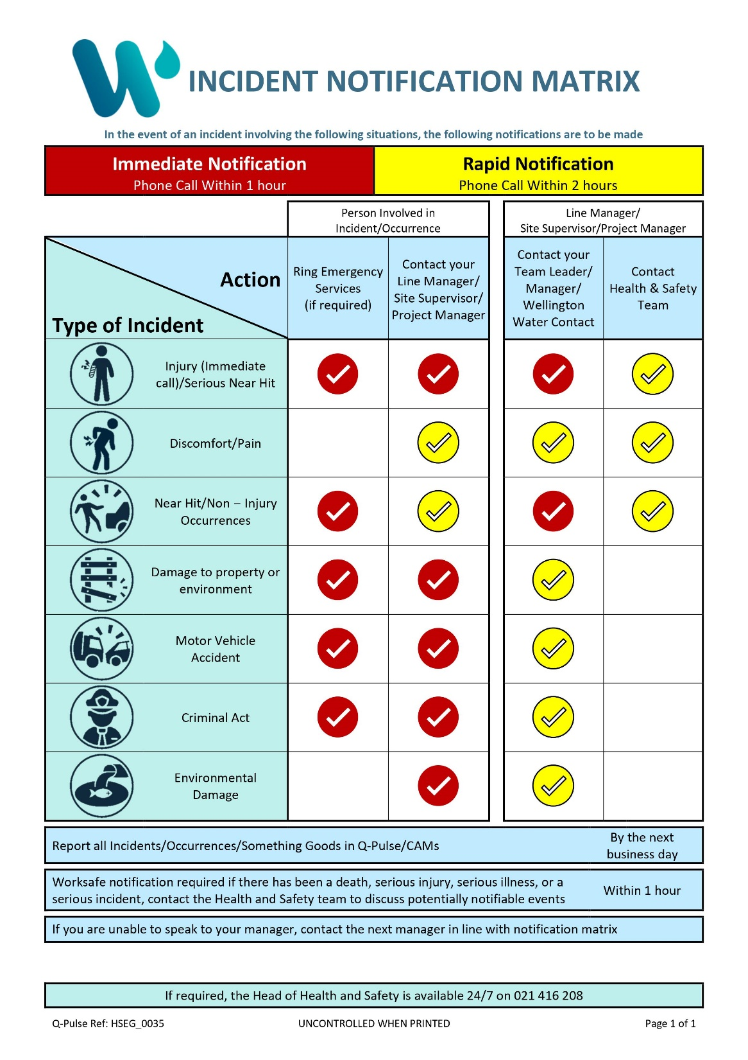
Who to ring when something happens
Wellington Water is introducing a new incident notification matrix.
We need to be told about things more quickly.
This new matrix makes it clear how quickly to report.
If something happens, report it to your line manager, supervisor, or project manager as soon as possible, but no later than one - two hours after the event.
This will help us ensure the correct response is taken.
Notes:
Click on the picture to download the new incident notification matrix from Q-Pulse

Slide 18
WorkSafe Updates
AFFCO sentenced after a completely avoidable death at meatworks
AFFCO was sentenced following the death of a worker who was crushed by a steel frame full of offal cartons
The worker was trying to free a jammed carton in a freezer when the frame fell and fatally crushed him
There were health and safety procedures in place however these weren’t practical
The freezer was not maintained, and has been decommissioned since due to not meeting modern safety standards
Talley's Group Limited, which owns AFFCO, has a history of serious health and safety incidents.
Strong sentences a warning - prevent harm, don’t cover it up
A former health and safety officer has been jailed for nine months after his “outrageous dereliction of duty” led to a lifelong brain injury for a young man just starting out on his career.
The company’s managing director was jailed for 20 months for his involvement.
An apprentice at Aimex Limited was exposed to vapour from solvents he had been directed to use when cleaning an engine room which wasn’t adequately ventilated, causing serious brain injury.
A previous incident involving another employee was covered up, and the two people mislead the WorkSafe invesigators.
The Police became involved and the two men where charged and sentenced.

Slide 19
Upcoming Webinars
Join this live webinar with Matt Vaughan and Dr. Kelly Dale as they discuss the importance sleep and how it impacts our every day lives and performance - with a focus on the role it plays in injury prevention.
When: Thursday 17th August at 1pm Where: Zoom – click the green button to register
This webinar will be recorded and posted online the week of the 21st of August – we’ll share the recording when it’s available.
Register Now

