Slide 1
Health, Safety and Wellbeing Update
December 2023

Slide 2
Contents
Sharing Something Goods
Critical Risk Stats
Safety topic of the month
Wellbeing
WorkSafe updates

Slide 3
Something Good
A contractor has received a letter from one of the residents saying they like their work and give huge thanks for what they do on-site.
A site had to remove a boundary fence and a clothesline of a resident next to site. To help the resident, the site team has gone and bought the resident a new washing line and the guys helped install in the location the resident wanted it. Great to see the teams going the extra mile for residents
3 contractors completed a joint safety walkover on 2 different sites to share ideas, lessons learned and H&S initiatives between them. Great to see this kind of collaboration
While driving past a roundabout, a worker noticed the signboard advertising several business (affected by road works associated with watermain renewal project) was becoming overgrown with long grass. At a meeting held at the site office, the worker raised this asked the team to arrange for long grass growing in front of the sign to be cut down. The staff's willingness to carry out this work so that good relations with the Contractor, WWL and local businesses are maintained is commendable.
A resident wanted to drive their car out of their driveway and asked a worker how she could get out when construction works were happening and traffic management in place. The worker stopped what he was doing and assisted resident out of driveway to get them out safely
If you have any cool stories to share, please send them to safe@wellingtonwater.co.nz

Slide 4
Critical Risk Stats - November
In November there were 84 reported critical risk related incidents, this is an increase from October (63) and from November 2022 (58)
Vehicles/Mobile Equipment is our highest reported critical risk this month with 34 reports, followed by Traffic/Pedestrian Movement at 27 reports.

Slide 5
Safety topic of the month
Dust

Slide 6
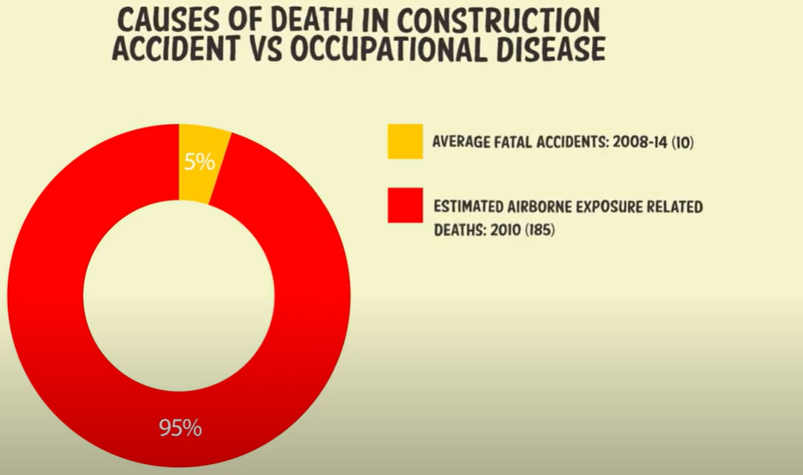
Topic of the month – Dust
Dust and asbestos have the potential to cause serious harm or death when inhaled or exposed to.
This harm could be gradual, chronic and lifelong.
Workers in the construction sector are 20 times more likely to die of exposure to harmful airborne substances than from a workplace accident.
Every year, an estimated 600-900 people die in New Zealand from work-related health issues and a further 5,000-6,000 people in New Zealand are hospitalised after being exposed to airborne contaminants at work, including wood dust and silica.
Never trust the dust

Slide 7
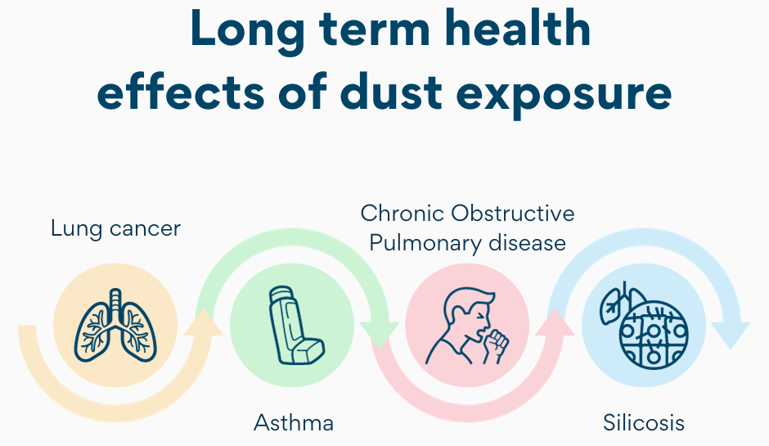
Topic of the month – Dust
Dust is tiny, dry particles in the air.
It can be produced when materials are cut, drilled, demolished, sanded or shoveled.
Many work activities can create dust.
The dust that can’t be seen is the dust that can cause the most harm.
Breathing in dust can have both acute and chronic effects, potentially causing long term health issues.
Dusts can create respiratory problems, skin / eye irritation, asthma or lung cancer.
Hazardous dusts are often invisible and their effect on your health may take many years to show up.
What are our main sources of dust?

Slide 8
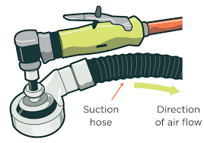
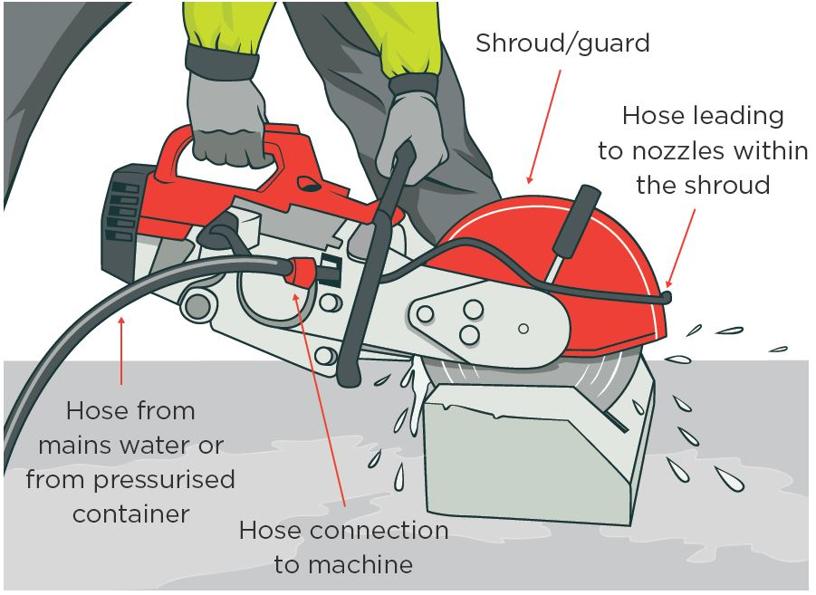
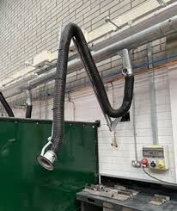
Topic of the month – Dust
Buy pre-cut or prepared materials
Pre-cut and prepared materials can significantly reduce on-site cutting and dusts and can reduce other injury risks
Suppress the dust at its source
It is more effective to control dust before it becomes airborne and a breathing hazard
Use tools that don’t create dust
Hand tools produce very little airborne dust. Try to work with good ventilation and keep others away
Use on tool dust recovery
Consider tools with dust recovery system
Consider water suppression
Water suppression can be as simple as a spray bottle or knapsack sprayer. Manage run-off. Only apply water if safe to do so eg avoiding electrical hazards.
Use local exhaust extraction
Exhaust extraction systems should be considered for established workshops and long-term projects.

Slide 9
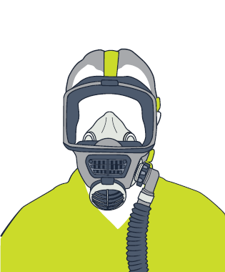
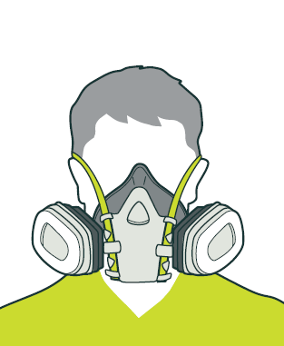
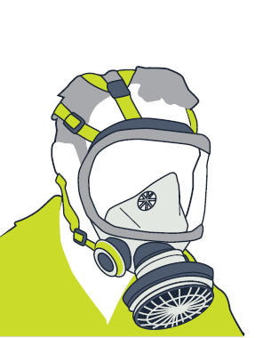
Topic of the month – Dust
Full-face powered respirator
Use respiratory protection (RPE) and other PPE as required
Respiratory protection must be used when exposed to dust that is not controlled by other means
Use the correct and fit tested respiratory protection for the product and task .
Check any SDS’ for its minimum PPE requirements and recommended controls
Avoid creating more dust when removing PPE/overalls etc
Wash your face and hands immediately after working with dust and before eating and drinking
Have your lung function checked through annual health checks if you are regularly exposed to dust at work
Full-face respirator (cartridge)
PPE is the least effective control measure. It should not be the first or only control measure you consider.
Re-usable half-face respirator
For more information check out the Water Ways – Dust Exposure guide here or WorkSafes website here

Slide 10
Topic of the month – Dust

Slide 11
Wellbeing Calendar

Slide 12
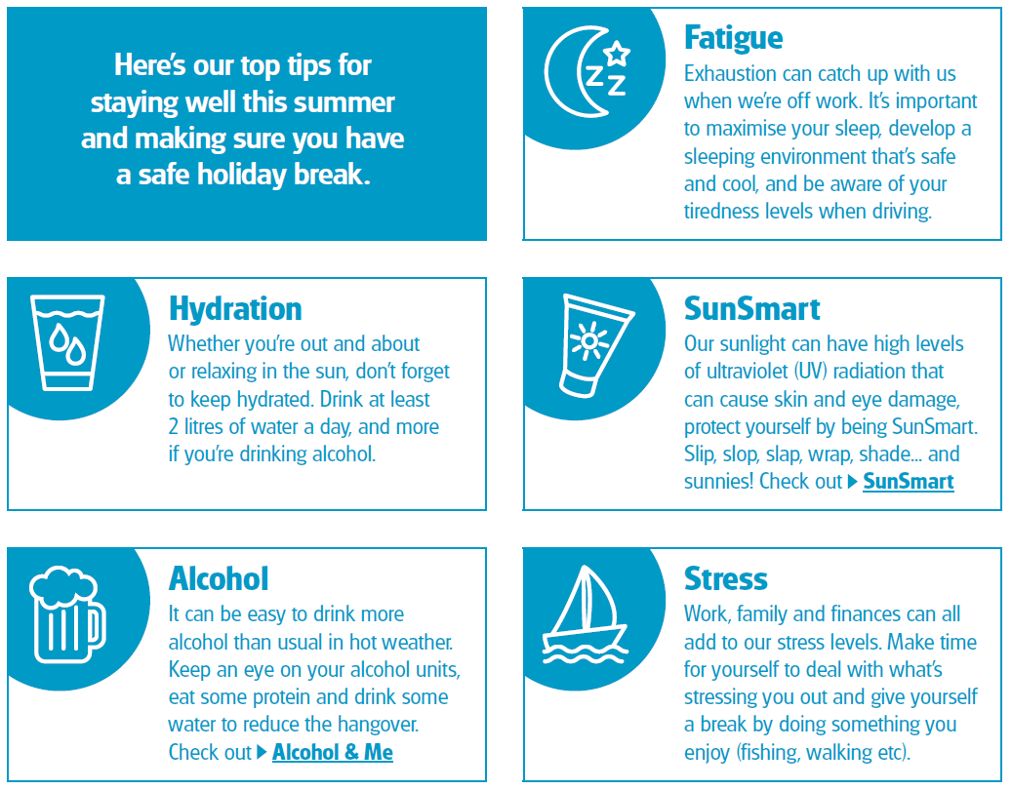

Slide 13
WorkSafe Updates
Inadequate training results in serious injury
A worker was monitoring geese at Auckland Airport and has fired a pyrotechnic launcher towards the geese from their work vehicle.
The worker sustained serious injuries to their right palm, and lost two fingertips on their right hand.
WorkSafe invested and found the worker did not have adequate training on the safe use and storage and handling of the pyrotechnic cartridges.
WorkSafe also found the SOPs were not up to scratch
WorkSafe National Manager of Investigations states “This matter highlights that businesses and organisations need to pay adequate attention to the use of equipment or keeping across training regimes. Passing down knowledge without having check-ins can mean gaps in information or that training is not aligned with best practice.”

