Slide 1



Soldiers Memorial Park
Water Treatment and Bore
Upgrade Project

Slide 2
Project overview: why this work is needed
Wellington Water on behalf of SWDC is upgrading the water bore, pump and treatment facilities at Soldiers’ Memorial Park on Kuratawhiti Street.
The current bore and treatment facilities only supply Greytown and supply 100% of Greytown’s water needs.
The current bore still meets demand, but:
  – the current pump and treatment facilities are aging and in need of replacement
  – we cannot stop the existing pump and treatment facilities without compromising supply
Upgrades will increase the resilience of Greytown’s drinking water supply.

Slide 3
Scope of work
Work includes:
  Drilling a new bore (consents to be lodged with Greater Wellington).
  Installing a new bore pump and above ground water treatment plant to connect to the water supply network and discharge clean water into water race (approved).

Slide 4
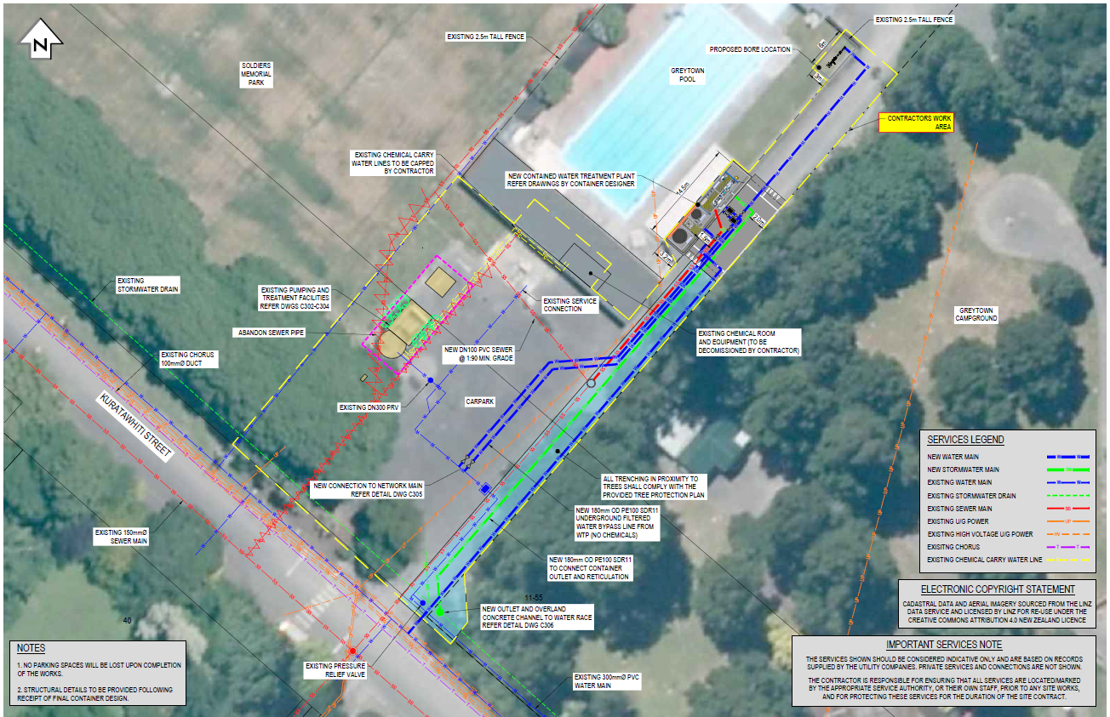
Scope of works map
Notes:
This map shows the location of the existing treatment facilities, the preferred bore location and where the new treatment facilities and underground pipework will be installed.
Originally the new treatment plant was supposed to be located in the carpark area (near the existing bore), however in order to minimize loss of parking, the new plant has been relocated to the right side of the Pool Complex (with the additional benefit of being away from the public).
The yellow line denotes the exclusion area that will be needed for the construction of the project. Wellington Water has consulted with SWDC and have agreed to close the swimming pool carpark for the duration of the civil works to ensure safety.
Pedestrian access to the clubrooms/bowls club and sports field will be maintained and vehicle access needed to the clubrooms will be discussed with park users as part our engagement process.
Once the treatment plant is up and running the two existing containerized treatment systems will be removed enabling the car parking to be returned to the community and the portion of the chemical room in the swimming pool used by WWL for treatment purposes will be decommissioned and removed, enabling the expansion of the existing facilities for the pool users..

Slide 5
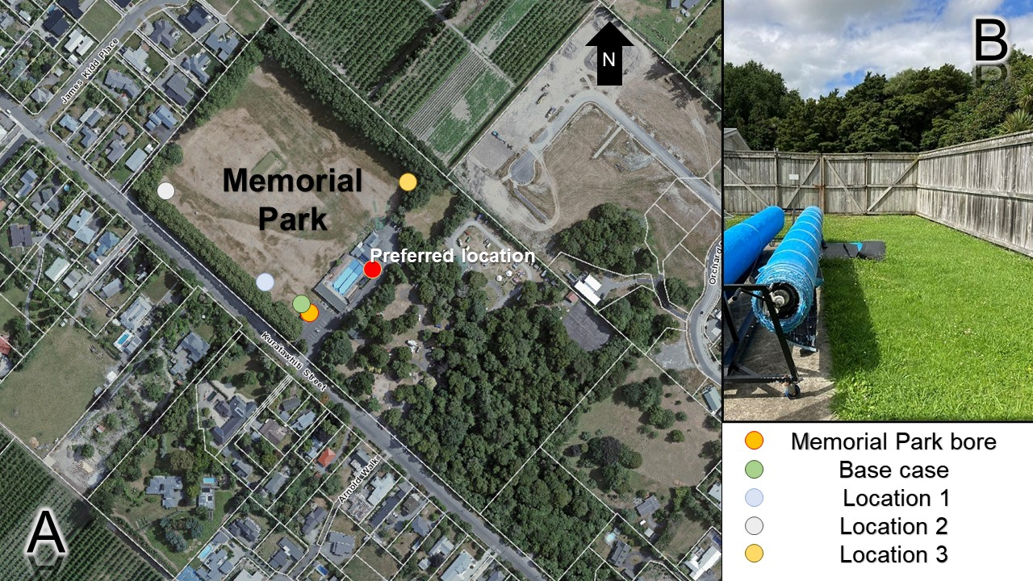
Bore location investigations
Location 1: next to existing bore
Location 2: 50m from existing bore
Location 3: 169m from existing bore
Location 4: 139m from existing bore
Location 5: 68m from existing bore (preferred location)
Existing Memorial Park bore – remains in service
Notes:
WWL has investigated 5 locations to identify a preferred bore location.

Slide 6
Bore location investigations
Location name | Rationale | Comments
Location 1: next to existing bore | Estimate “current” well interference effects on neighbours. | Not recommended due to potential interference effects during drilling and risk of turbidity issues during operation.
Location 2: 50m from existing bore | 50m away from Memorial Park bore, to reduce interference effects on the new/back up production well. | Not recommended due to impact on the operation of the sports field and the proximity to the notable trees.
Location 3: 169m from existing bore | Furthest point northwest within the park. | Not recommended due to impact on the operation of the sport field and increased costs (furthest location).
Location 4: 139m from existing bore | Northeast of the existing bore, away from wastewater mains. | Not recommended due to impact on the operation of the sports field and from being located in a flood sensitive area.
Location 5: 68m from existing bore (Recommended option) | Preferred location based on consultation with WWL and SWDC staff. | No impact on the operation of the sports field and is outside of the footprint of the proposed upgrade to the sports pavilion.

Slide 7
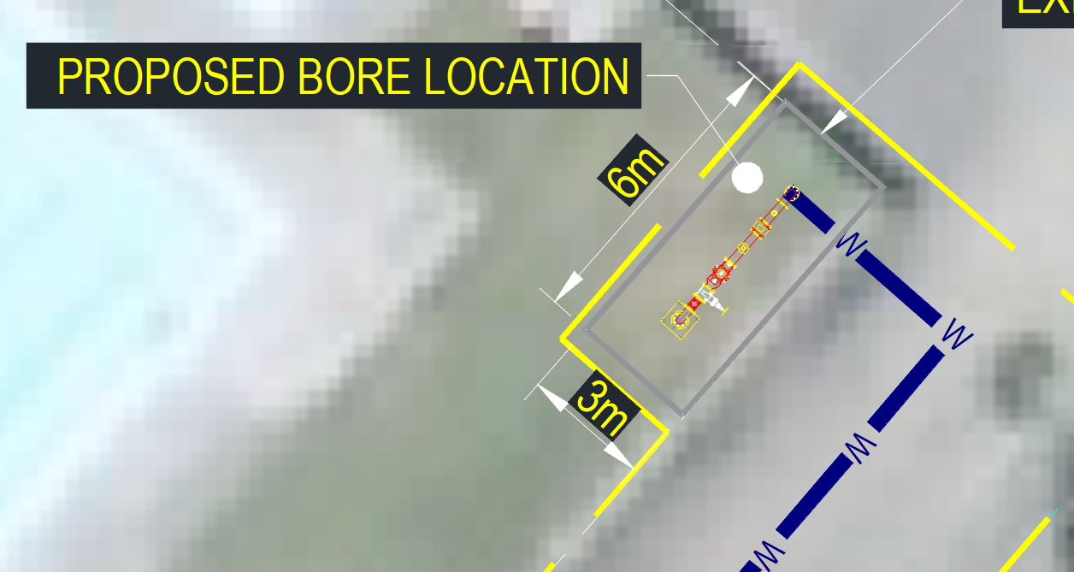
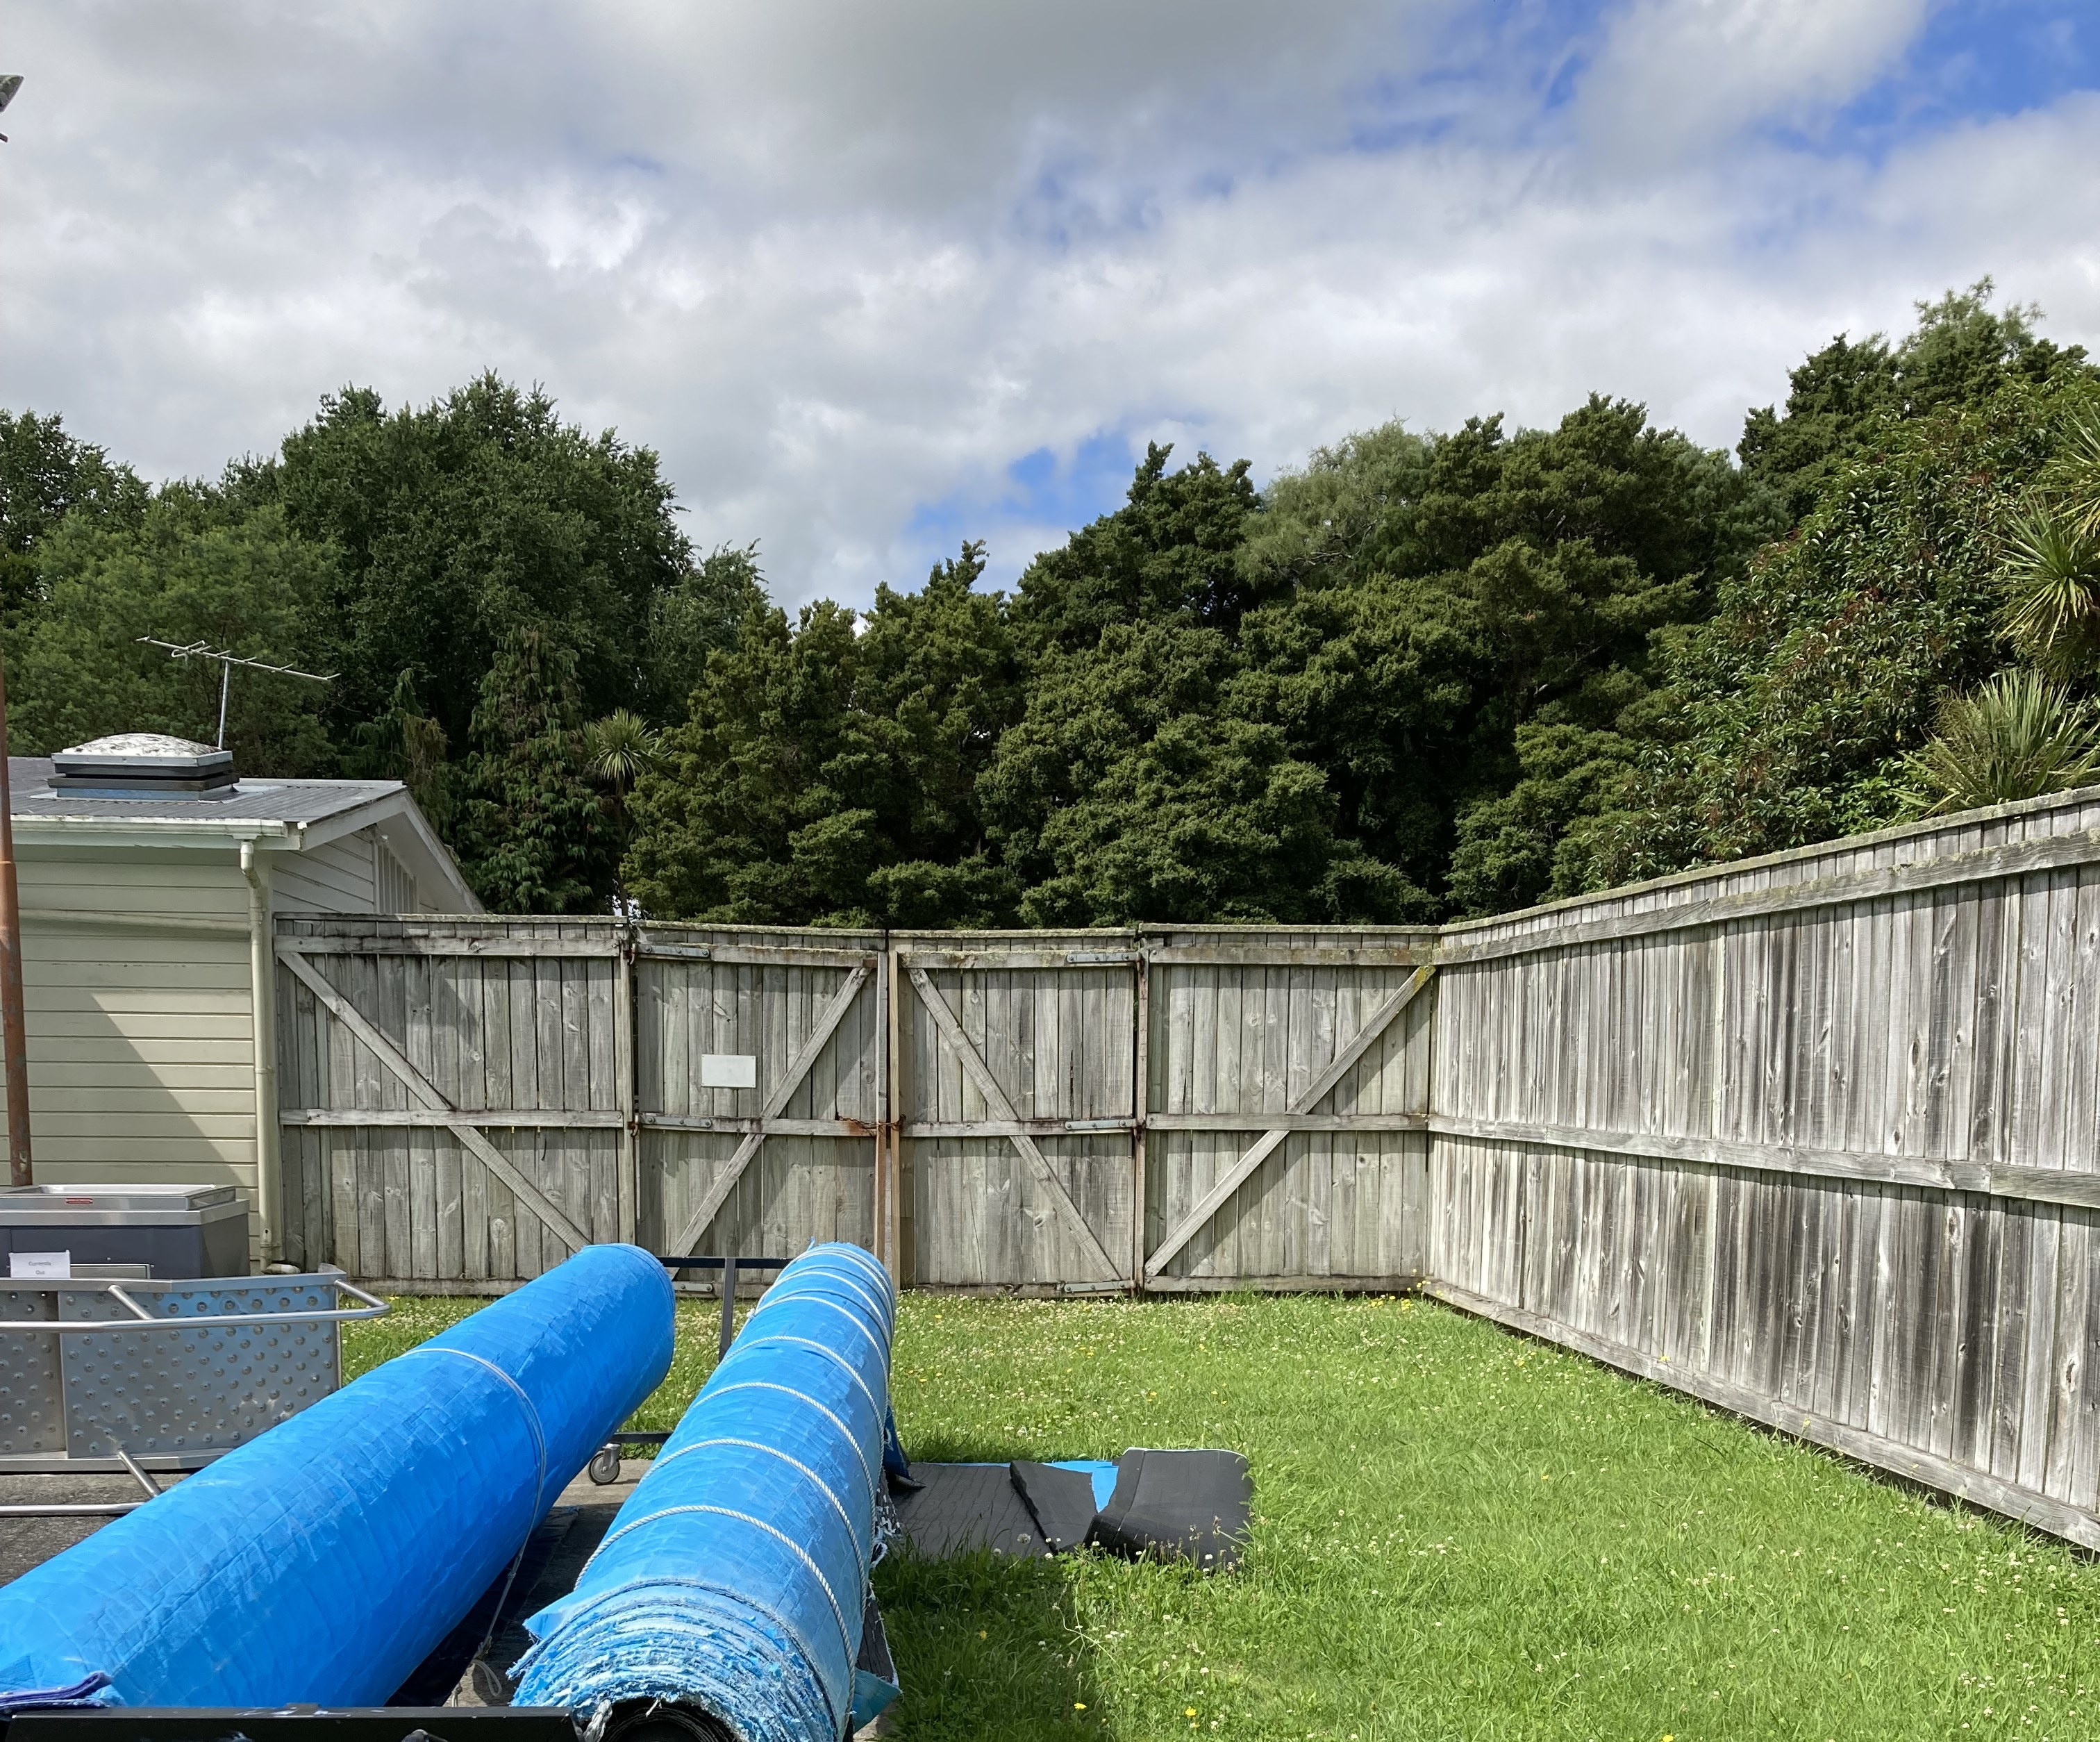
Proposed Bore Location
Preferred location is inside the Greytown swimming pool complex area on the grassed area beside the toddler pool. Using approximately 3m x 6m of land.
Bore works would include:
  Survey of swimming pool to determine existing condition before works begin
  Installation of well inside the pool complex (by drilling method)
  Installation of a new bore pump and pipe work
  Water Quality Testing/Pump Testing
  Installation of cladding/fencing around the bore (isolating it from the pool complex)

Slide 8
Impacts
Construction timeframes – Mid 2023 – late 2023
Traffic management on Kuratawhiti Street at times
Pool carpark closed during construction with limited vehicle access to clubrooms (park users can continue to park on the Soldiers’ Memorial Park side of Kuratawhiti Street)
Some construction noise
Swimming complex lose approx. 18m² of land
WWL and contractors will work with user groups to minimise disruption

